Slide 1

An Epidemiology of Information
Digging into Data Project Director Meeting, October 12, 2013

Slide 2

Principal Investigators
  Tom Ewing (History/Virginia Tech)
  Bernice L. Hausman (English/VT)
  Bruce Pencek (University Libraries/VT)
  Naren Ramakrishnan (Computer Science/VT)
  Gunther Eysenbach (Centre for Global eHealth Innovation/University of Toronto)
Graduate Research Assistants
  Samah Gad (Computer Science/VT)
  Kathleen Kerr (English/VT)
  Michelle Seref (English/VT)
  Laura West (History/VT)

Slide 3

Methods
Topic: newspaper coverage of 1918 Influenza in US / Canada
Historical Newspapers
  Chronicling America Database
  Peel’s Prairie Provinces Database
Analytical Methods
  Topic modeling and segmentation
  Tone classification
  Visualizations
The Ogden Standard,
December 5, 1918, page 9

Slide 4
Four Project Case Studies
Weekly Newspapers
  24 papers
  1,000+ pages
Daily Newspapers
  16 papers
  21,000 pages
Public Health Officials
  Royal S. Copeland, New York City Health Commissioner
  Papers in / outside NYC
Vaccination-Visualization
  US sample (90 titles)
  Before, during, after epidemic
Morning Oregonian, November 18, 1918, p. 1

Slide 5
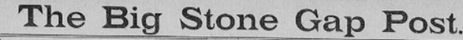
“Richmond, Va., Nov.14—It is hardly likely that the general public will ever realize the extent of the suffering and the anguish caused by the Spanish influenza in some of the more remote mountain communities of Virginia where the frightful malady raged with a degree of severity which is difficult to explain. Particularly did the mining and lumber sections of the southwestern counties suffer, though the State Health Board acted with amazing celerity in establishing emergency hospitals where the need of outside help seemed most pressing. Despite the fine organizations of these institutions and the zeal with which their attaches labored day and night, scores of sufferers in mountain cabins and shacks far distant from railroads, could not be reached by all, and in some instances it was heard [sic] even to find persons to bury the dead. In several neighborhoods the supply of coffins utterly ran out while almost everywhere there was a shortage of doctors and nurses. Worse still, the well people of some communities became so terrified when they noted the ravages of the disease, that they were either afraid or unwilling to help the sick, and consequently a few dauntless spirits were left to perform duties which taxes their endurance to the staggering point.

Slide 7

“To be sure, subject-area experts won’t die out. But their supremacy will ebb. From now on, they must share the podium with the big-data geeks, just as princely causation must share the limelight with humble correlation. This transforms the way we value knowledge, because we tend to think that people with deep specialization are worth more than generalists—that fortune favors depth. Yet expertise is like exactitude: appropriate for a small-data world where one never has enough information, or the right information, and thus has to rely on intuition and experience to guide ones way. In such a world, experience plays a critical role, since it is the long accumulation of latent knowledge—knowledge that one can’t transmit easily or learn from a book, or perhaps even be consciously aware of—that enables one to make smarter decisions. But when you are stuffed silly with data, you can tap that instead, and to greater effect. Thus those who can analyze big data may see past the superstitions and conventional thinking not because they’re smarter, but because they have the data.” (pp. 142-143)
Viktor Mayer-Schonberger and Kenneth Cukier, Big Data. A Revolution that will Transform how We Live, Work, and Think (Boston: Houghton Mifflin, 2013)

Slide 8
Tone Classification Categories:
Alarmist: uses fear or urgency; induces a sense of panic; mentions a number in a comparative context (e.g., 10 more deaths today); mentions a seemingly large number for the context (i.e., hundreds in a single day).
Warning: refers to the gravity of the situation; serious but not urgent; cautioning; advises the reader what to do; mentions measures being taken as a sign of seriousness of threat
Reassuring: comforting; implies threat is diminishing; addresses fears with soothing sensibility; motivates action with sense of hopefulness, improvement, or possibility of avoidance of disease
Explanatory: neutral source of information; lacks distinctive affect.

Slide 9
Tone classification on 8 weekly newspapers
Selected texts: local reporting on the disease, including news articles, statements from county and city health officials, editorials and letters, and advertisements from local companies that referenced influenza.
This sample did not include reports on individual victims, such as obituaries or reports of ill individuals.
Total of 723 sentences from Hays Free Press (66), Colville Examiner (169), Iron County Record (142), Perrysburg Journal (25), Red Deer News (70), Middlebury Register (94), Era Leader (35), and Big Stone Gap Post (122).

Slide 10
Title | Alarmist | Warning | Explanatory | Reassuring | Total
Hays | 0.0% | 15.2% | 69.7% | 15.2% | 66
Colville | 1.8% | 19.5% | 55.0% | 23.7% | 169
Iron County | 0.7% | 16.9% | 59.9% | 22.5% | 142
Perrysburg | 0.0% | 16.0% | 72.0% | 12.0% | 25
Red Deer | 0.0% | 14.3% | 67.1% | 18.6% | 70
Middlebury | 1.1% | 10.6% | 66.0% | 22.3% | 95
Era Leader | 5.7% | 20.0% | 57.1% | 17.1% | 35
Big Stone Gap | 3.3% | 16.4% | 57.4% | 23.0% | 122
All Titles | 1.5% | 16.3% | 61.0% | 21.2% | 723

Slide 12
Bad OCR
FLEW ON THE WINGS
OF DEATH TO THE HILLS
State Board of Health Re-j
ceivcs Heart-Rending Re?
ports of Grippe's Rav?
ages in Southwest
Virginia.
Richmond, Va., Nov. i t.?It
ii hardly likely that the general
public will over realize the ox
tent of tlio Buffering und thu
anguish caused by the Spanish
influenza in some of thu more
remote mountain communities
of Virginia where the frightful
malady raged with a degree of
severity which is difficult to
explain.
Particularly did the mining
and lumber sections of the
southwestern counties suffer,
though the Stair Health Hoard
acted with amazing celerity in
establishing emergency bos
pitals where the need of outside
help seemed most pressing. De?
spite the lino organization of
these institutions and the zeal
with which their attaches la?

Slide 13
Issues with Tone Classification
Substantial time needed to prepare text
  Identify relevant articles
  Transcribe text / correct OCR
  Separate text into sentences
(Dis)agreement among coders
Level of analysis: phrase, sentence, or article
Limited number of newspapers available for text mining (Chronicling America and Peel’s Prairie Provinces)
Accuracy rate of the classifier
Balancing precision with scale

Slide 14
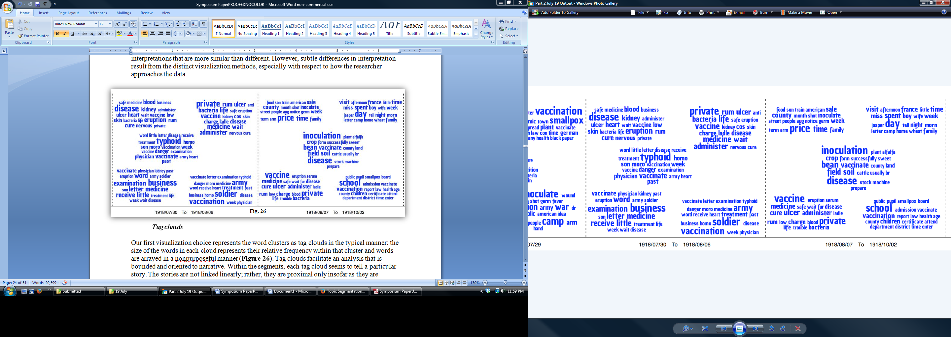
Visualizations: Tag Clouds

Slide 15
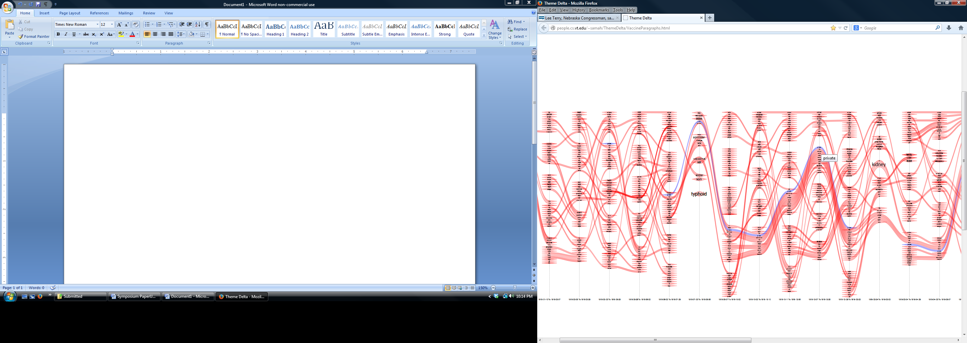
Visualizations: ThemeDelta

Slide 16
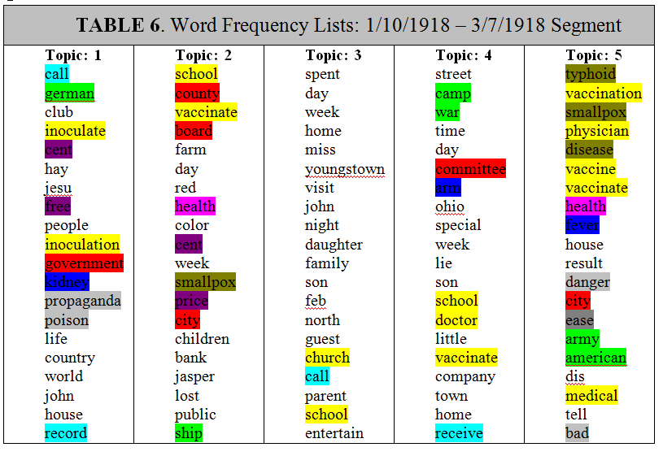
Visualizations: Word Frequency Lists

Slide 17
“An Epidemiology of Information:
New Methods for Interpreting Disease and Data”
A Digging into Data Research Symposium—October 17, 2013
Virginia Tech Research Center – Arlington
Broadcast to Virginia Bioinformatics Institute, Blacksburg Campus
Co-sponsored by US National Endowment for the Humanities Office of Digital Humanities and the History of Medicine Division National Library of Medicine National Institutes of Health
Presentation: The Epidemiology of Information: Alternative Analytics for Public Health—Focus on Historical Interpretation
Presentation: The Epidemiology of Information: New Methods, New Challenges, New Opportunities—Focus on Methods and Rhetoric
Keynote: Hunting the 1918 Influenza Virus: Then and Now and Tomorrow – David Morens, NIAID, and Jeffrey Taubenberger, NIAID
Panel: Implications: Considering the Spanish Flu, Data Mining, and the Transforming World of Epidemic Disease and Documentary Traces
Panel: How Big Data Can Change Public Health—Alternative Forms of Public Information: Social Media for “Epidemic Intelligence”

