Slide 1
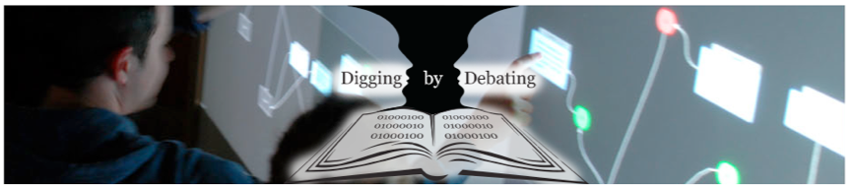





Digging by Debating (DbyD):
From Big Data Text Repositories to Argument Analysis
The InPhO Group, Indiana University: Colin Allen with Robert Rose, Jaimie Murdock, Jun Otsuka, Doori Lee, Indraneel Dey
The Cyberinfrastructure Network Science Center, Indiana University: Katy Börner with Robert Light
The International Centre for Public Pedagogy (ICPuP), University of East London (UEL): Andrew Ravenscroft with Simon McAlister
ARG:dundee, University of Dundee: Chris Reed with John Lawrence
Centre for Digital Philosophy, University of Western Ontario: David Bourget
1

Slide 2
From Big Data to Argument Analysis
Linking massive datasets to specific arguments, where ‘text is data’
Project Goals
Uncover and represent the key argumentative structures of digitized documents from a large philosophy/science corpus;
Allow users to find and interpret detailed arguments in the broad semantic landscape of books and articles, and to support innovative interdisciplinary research and better-informed critical debates
Data Sources
Stanford Encyclopedia of Philosophy, HathiTrust Collection, PhilPapers
4 Levels of Analysis: Macro (Sci/Phil Maps) to Micro (detailed arguments)
Visualizing points of contact between philosophy and the sciences
Topic modeling to identify the volumes/pages ‘rich’ in a chosen topic;
Identify and map key arguments; apply a novel analysis framework for propositions and arguments;
Sentence modeling to get back to HathiTrust materials
2
Notes:
S2* project overview slide [any]
-- bulleted outline of project goals as per funding
-- list of data sources
-- unique aspect of this project: 4 levels of analysis

Slide 3
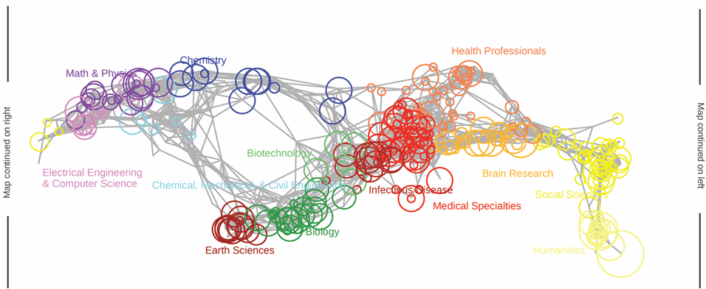
Mapping Philosophy in the Sciences
(analysis level 1)
UCSD Map of Science: generated using more than 12M papers and their references from Elsevier’s Scopus and Thomson Reuters’ Web of Science (25,000 journals), see http://sci.cns.iu.edu/ucsdmap
Shows 554 subdiscipline nodes aggregated into 13 color-coded disciplines.
Overlaid are citations made by the Stanford Encyclopedia of Philosophy to visualize the impact of the sciences on philosophy.
Node sizes scale from 0 (no circle) to 43. Highest numbers are in Humanities, Earth Sciences, and Math & Physics.
3
Notes:
In order to visualize the impact of the sciences on philosophy, we overlaid citations made by the Stanford Encyclopedia of Philosophy on the UCSD map of science. In order to normalize against the high number of citations (particularly in the humanities), node size relates to the number of SECTIONS of the Stanford Encyclopedia of Philosophy that reference each subdiscipline. Node sizes scale from 0 (no circle) to 43. Highest numbers are in Humanities, earth sciences, infectious diseases and Math & Physics. Lowest numbers are in Chemical, Mechanical and Civil Engineering and Electrical Engineering and Computer Science. Future work will try to map the influence of philosophy on science, completing the circle and the visualization of information flow to and from philosophy.

Slide 4
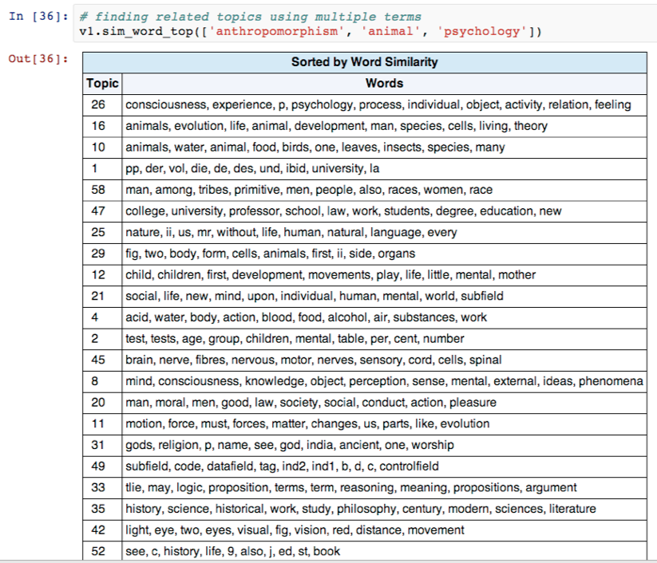
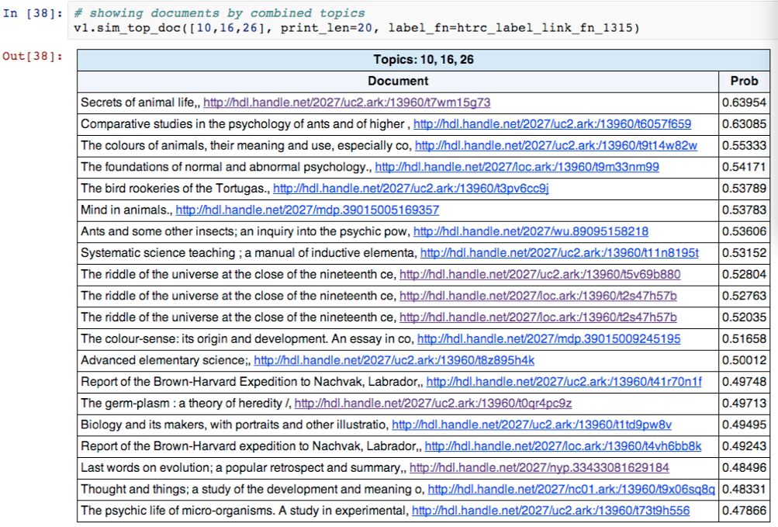
Topic Modeling in HT Books
(analysis level 2)
  LDA Topic Modeling: Bayesian method generates set of "topics" – probability distributions over terms in the corpus
    Every topic contains every term – different probabilities in the different topics
    The number of topics is a user-selected parameter
  Finds the set of topics best able to reproduce term distributions in the documents
  Documents may be whole volumes, chapters, articles, single pages, even individual sentences – modelers' choice
4
Notes:
Start with 1,315 volumes by keyword search -- model at volume/book level
Select 86 by topic match -- re-model at page level
Select 3 by topic match -- remodel at sentence level

Slide 5
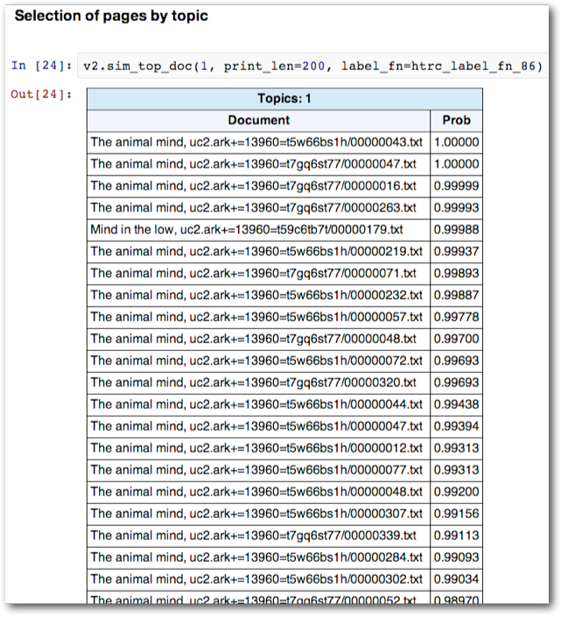
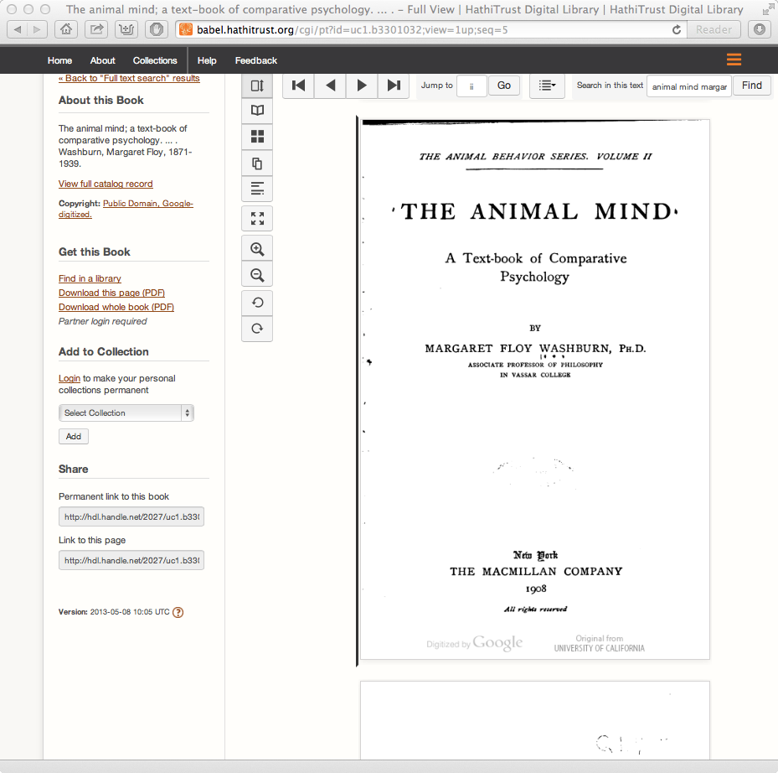
Topic Modeling in HT Books
(analysis level 2)
  LDA Topic Modeling: Bayesian method generates set of "topics" – probability distributions over terms in the corpus
    Every topic contains every term – different probabilities in the different topics
    The number of topics is a user-selected parameter
  Finds the set of topics best able to reproduce term distributions in the documents
  Documents may be whole volumes, chapters, articles, single pages, even individual sentences – modelers' choice
5
Notes:
Start with 1,315 volumes by keyword search -- model at volume/book level
Select 86 by topic match -- re-model at page level
Select 3 by topic match -- remodel at sentence level

Slide 6
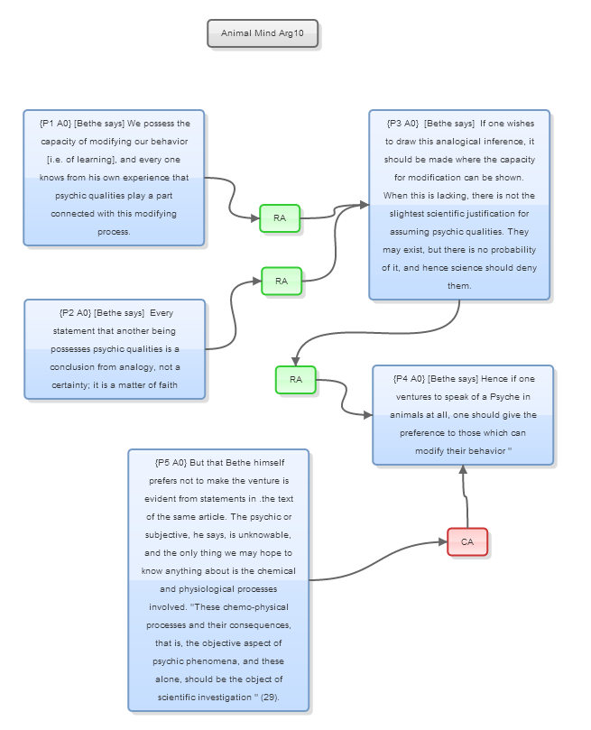
Argument Selection, Mapping and Analysis (analysis level 3)
1. Identifying arguments from rated pages (currently human/ manual, but developing algs for automation)
2. Mapping of key arguments with OVA mapping tool:
- Provides a formal framework, or ‘lens’, for investigation and comparative analysis, e.g. role, structure, status
- More indirectly: meaning, importance and context
6
Notes:
S5* analysis level 3, Andrew, will explain this slide, clarifying what detail means
-- argument extraction & analysis

Slide 7
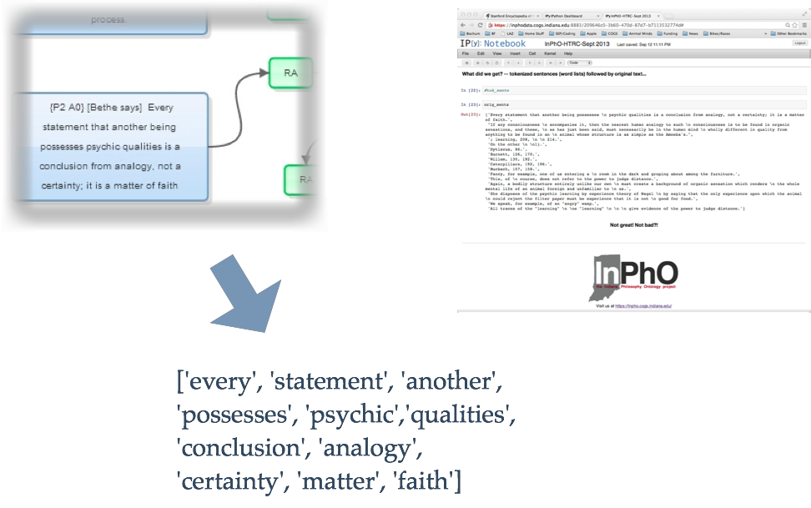
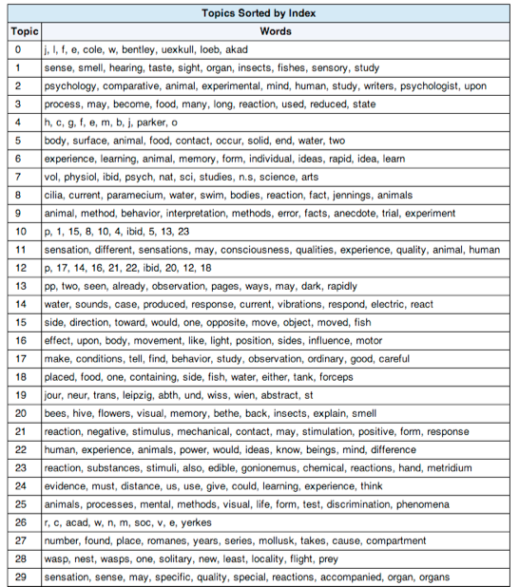

Back to the Sentences
(analysis level 4)
7
Notes:
S6* analysis level 4 [Colin, Andrew]
-- sentence modeling to get back to HT materials

Slide 8
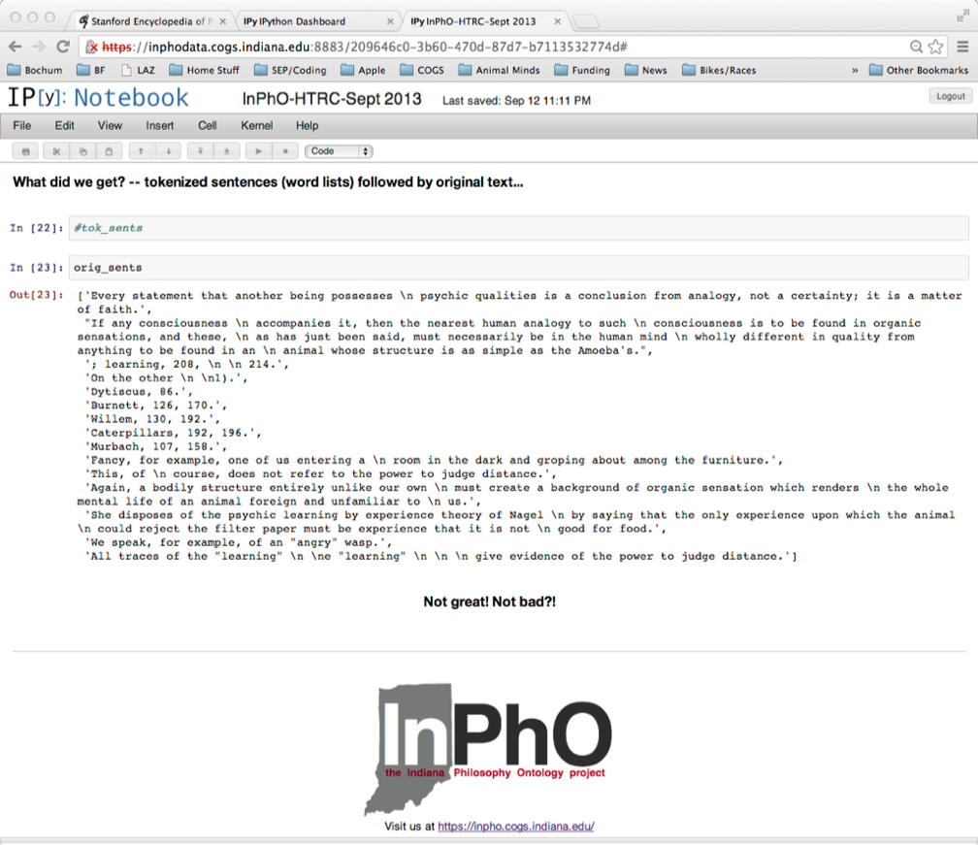
Back to the Sentences
(analysis level 4)
8
Notes:
S6* analysis level 4 [Colin, Andrew]
-- sentence modeling to get back to HT materials

Slide 9
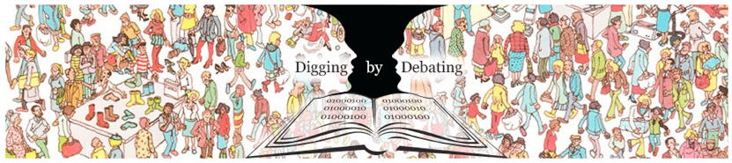
DbyD: Conclusions so far...
Future work
From loose integration to usable tools, e.g. linked to Philpapers
To understand and incrementally construct argument maps (mark-up interface) AND automated extraction and mapping
Funding from future DiD or similar Big Data initiatives (‘open data’?)
diggingbydebating.org
Project Achievements - proof-of-concept and loose integration of key components:
1. Method for visualizing points of contact between philosophy and sciences
2. Method for Text selection from Big Data using multi-scale modeling techniques
3. Identified, represented and mapped key arguments about topics (OVA) and devised a novel framework for investigation and comparative analysis
4. Used sentence-level Topic Modeling to ‘go back’ to the texts to find similar propositions to those mapped (investigating context)
9
Notes:
Think this is self explanatory, but worth emphasising ‘slipperiness’ of argument and argumentation in texts, and implications for automated extraction and mapping
-- checklist of what we've done, what needs further funding
-- moving from a virtual pipeline to interactive pipeline

