Slide 1
ISHER: Integrated Social History Environment for Research
Sophia Ananiadou
National Centre for Text Mining
School of Computer Science

Slide 2
Aims
Enrich digital archives with semantic metadatA
Transform the way social historians work
produce a semantic search system for social history
Develop text analytics infrastructure for social history

Slide 3
The partners
Natural Language Processing/Text Mining
UK, NaCTeM, University of Manchester (Sophia Ananiadou)
US, Cognitive Computation Group, UIUC (Dan Roth)
NL, Radboud University, Nijmegen (Antal van den Bosch)
Users
NL, International Institute of Social History
US, Cline Center for Democracy, Univ. Illinois
UK, BBC

Slide 4
Enriching text for search
Search system
End-users: social history researchers
News reports on social unrest
New York Times; 1.8 million articles (1987-2007)
ACE2005 corpus
NE and event annotations on news articles
Develop and evaluate analytics
Access to corpora and searchable data sources
Analysis engines for entities and events
Extract discourse information for social history events

Slide 5
Interoperable Text Mining Infrastructure
Leverage and expand an interoperable infrastructure environment
Used for annotation and creating text mining workflows
UIMA-based U-Compare, Argo and brat

Slide 6
Text mining pipelines in Argo
Collection reader
One or more analytic engines
Annotation editor
to correct/augment
A ‘consumer’ to collect annotations for indexing
http://www.nactem.ac.uk/argo/

Slide 7
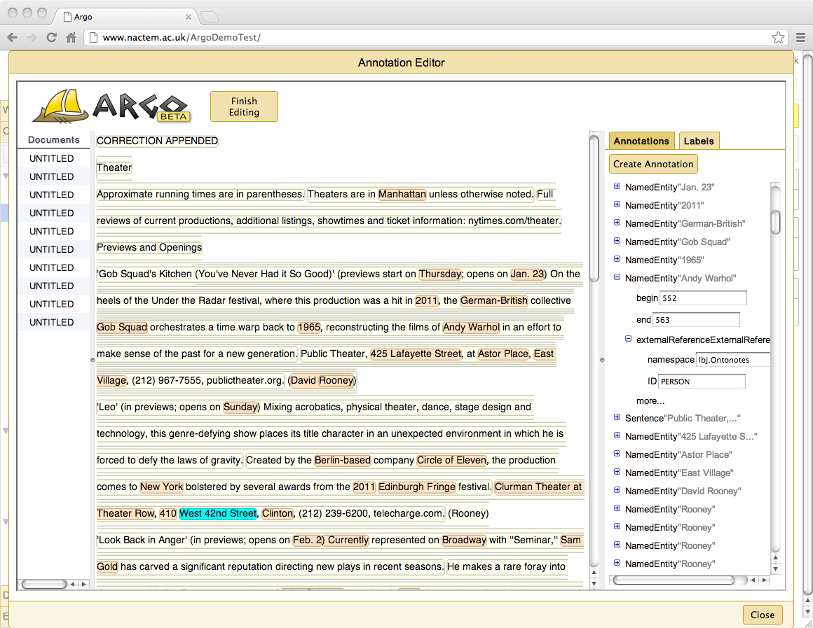
NER annotations

Slide 8
ACE: Data set for training
ACE 2005 Multilingual Training Corpus
599 English articles
5,349 events: 8 types, 33 subtypes (e.g., Life-Marry)
9,793 roles: 35 role types (e.g., Agent)
61,321 entities/values (~ event arguments)
54,824 entities: 7 types, 45subtypes (e.g., ORG-Media)
5,469 timex2 elements: 1 type
1,028 values: 5 types, 5 subtypes (e.g., Numeric-Money)

Slide 9
ACE 2005: Events
“Several hours later, dozens of Israeli tanks advanced into the northern Gaza Strip backed by helicopters which fired at least three rockets in the Jabaliya area, Palestinian security sources said.”
The marking denotes an event associated with the following details:
Type: Movement
Subtype: Transport
Modality: Asserted
Polarity: Positive
Genericity: Specific
Tense: Past
Event arguments:
Entity: “dozens of Israeli tanks”, role: Vehicle
Entity: “The northern Gaza Strip”, role: Destination
Anchor (or in other words trigger):
“Advanced”

Slide 10
Event Extraction Text Mining Workflow
Pipeline system with machine-learning-based modules
Trigger detection
Edge detection
Event detection
http://www.nactem.ac.uk/EventMine/

Slide 11
Interpretation of events
A event may:
represent a fact, a specific event, an opinion/analysis, a hypothetical situation, recommendation, etc.
be presented as the author’s own knowledge/point of view, or that of a third party
be expressed together with a level of certainty (e.g., speculation)
Represent a situation in the past, an ongoing situation, or something that will happen in the future
be negated, i.e., there is an indication that the event did not happen
meta-knowledge
Notes:
Limitations of Typical Representation
We have seen so far that the bio-event representation captures the knowledge about biological processes described in the text, and it allows a biomedical document to be viewed as a collection of nested bio-events. However, the typical representation lacks some of the necessary information required for the correct interpretation of bio-events. For example, information about the polarity, certainty and the type of knowledge being conveyed are all required for a complete understanding of the bio-events.
Some Examples
Let us see some example which further clarify the point [show next slide]

Slide 12
Enriching event annotation
Enriching event annotation with meta-knowledge information allows more sophisticated event extraction systems to be trained
Additional search criteria can be specified e.g.
Find only events that represent known facts
Find only events which are reported with high or complete certainty

Slide 13
Meta-knowledge examples
A past event
A past event reported by a third party

Slide 14
Meta-knowledge examples (2)
A future event
A planned event reported by a third party
A negated, hypothetical event

Slide 15
Meta-knowledge examples (3)
A hypothetical event
A future event with high, but not complete confidence

Slide 16
Meta-knowledge Scheme for newswire
Modality
Subjectivity
Positive
Negative
Neutral
Multi-valued
Genericity
Specific
Generic
Asserted
Presupposed
Speculated
Other
Participants
Attacker
Place, etc
Event
(Centred on an Event Trigger)
Class / Type
Polarity
Positive
Negative
Source-Type
Author
Involved
Third Party
Tense
Past
Present
Future
Unspecified
Notes:
[show basic bio-event]
This is the typical bio-event representation with event-type, participants and their types.
[show the meta-knowledge dimensions]
These are the six meta-knowledge dimensions that we have identified. Let us now look at each dimension is more detail [next slide]

Slide 17
ACE Annotation Summary
Meta-knowledge information for all 5349 events in ACE corpus reviewed/updated to reflect changes and extensions to meta-knowledge scheme
“Clue” words and phrases annotated for each attribute type
Substantial agreement reached between 2 different annotators (average of 0.76 Kappa)

Slide 18
ACE meta-knowledge analysis
Analysis revealed varying meta-knowledge characteristics in different parts of ACE corpus
Speculated events are more than twice as likely in newsgroups discussing news stories than in news reports themselves
Asserted, definite events tend to decrease with the formality of the text type/setting
General topics, rather than specific events, are 2-3 times more likely in discussions about news than news reports

Slide 19
ACE meta-knowledge analysis
Events with negative subjectivity more than twice as those with positive polarity
“Bad news sells better than good news”
Strongly negative words often chosen over more neutral words to help “sensationalise” stories
e.g. terrorism, genocide, fierce, bloody
Attribution of events to sources other than the author/reporter most common in newswire (35% of all events)
Most common for such information to come from eyewitnesses

Slide 20
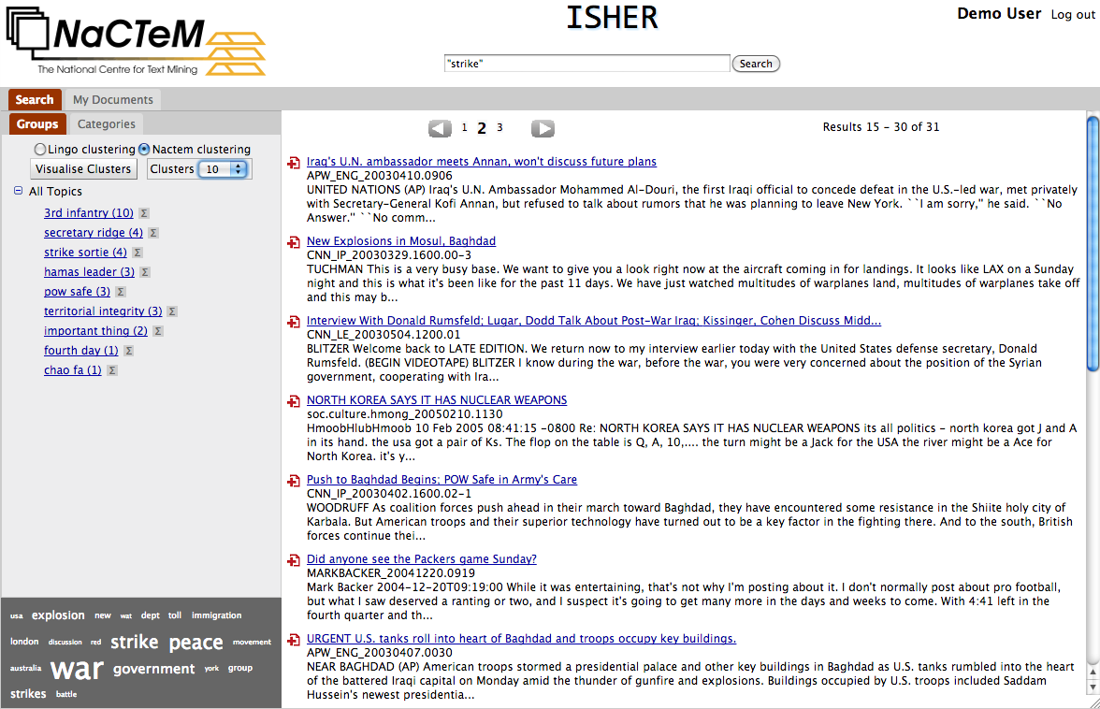
http://www.nactem.ac.uk/ISHER/

Slide 22
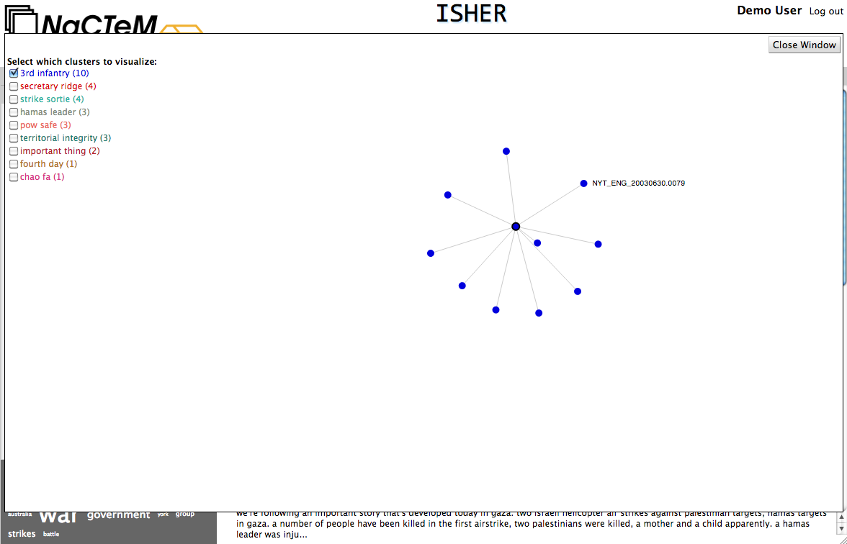

Slide 25
Events

