Slide 1
Mining Microdata:
Economic Opportunity and Spatial Mobility in Britain, Canada and the United States, 1850-1911
Digging Into Data Challenge, ESRC/NSF/CRSH
Lisa Dillon, Département de Démographie, Université de Montréal (team member)
Notes:
Scholars : history, economics & demography

Slide 2
U.S.: Evan Roberts, Steven Ruggles, John Robert Warren
Canada: Kris Inwood, Lisa Dillon, Peter Baskerville
UK: Kevin Schürer
Interdisciplinary team: history, economics, demography, sociology, computer science

Slide 3
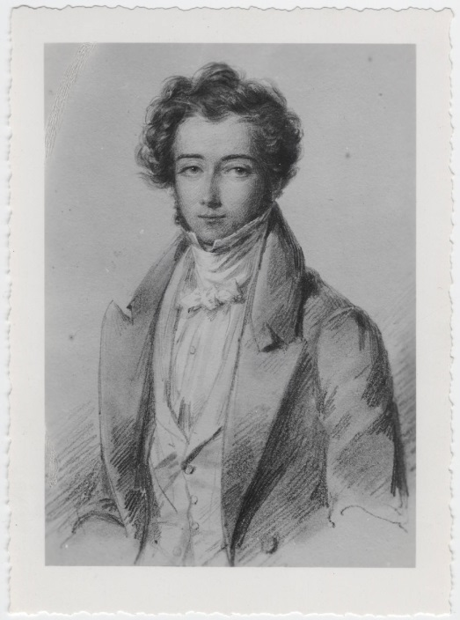
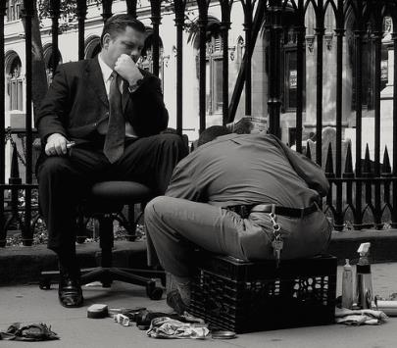
Equal opportunity as a « national myth »
19th c theorists: NA : economic mobility
1915: richest 1% in U.S. 18% income (similar to Canada & Britain)
Today: 24% (higher than Canada & Britain)
Severe consequences
Insufficient public reaction
Historic evolution of this gap insufficiently understood
Need long-term comparisons to situate economic opportunity in context
Notes:
Severe consequences: the richest are capturing a disproportionate share of real economic growth per family; increase in risk of child abuse
In a blog published just a few days ago (October 10, 2013), University of Ottawa economicst Mile Corak made the link between job losses on account of the Great Recession since 2008 and family life: he cites a study by researchers at Columbia University and the London School of Economics showing that this economic declension is associated with a six-fold increase in the chances that children will experience physical abuse.
The Great Recession didn’t just deplete bank accounts and disseminate home equity; it also ushered in a major crisis of confidence. Family life, even among those who did not experience job loss, is much more stressful, making parenting a bigger challenge.
A soon to be published research paper by Jeanne Brooks-Gunn, William Schneider, and Jane Waldfogel, researchers at Columbia University and the London School of Economics, shows that the drop in consumer confidence beginning in 2007 is associated with a six-fold increase in the chances that mothers will hit their children frequently (on about at least a monthly basis).
the historic evolution of this gap insufficiently understood: why the climb in income inequality since the mid-20th c?

Slide 4
Research Questions
What were the relative levels of economic and geographic mobility in Britain, Canada, and the United States in the late 19th & early 20th centuries?
What were the mobility trends in each country?
How were economic opportunity and geographic mobility interrelated in each country?
What individual and community characteristics were associated with economic and geographic mobility?

Men only!

Slide 5
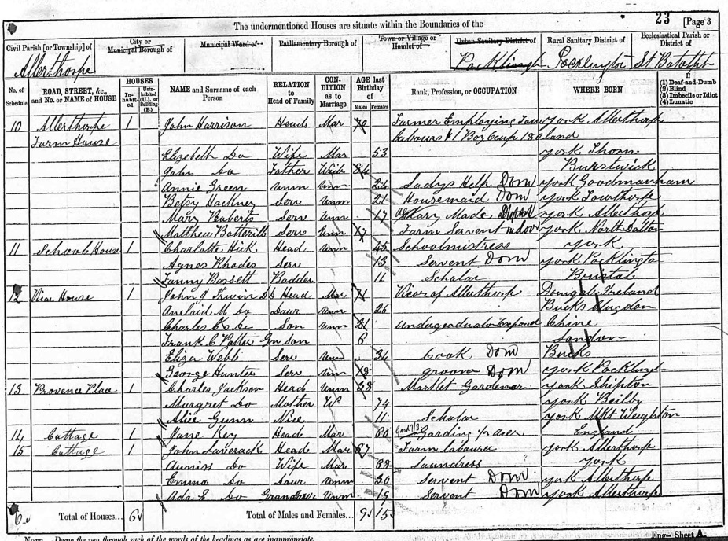
Data
19th & early 20th C censuses from U.S., Canada and Britain
80 million+ cases of complete-count data currently available for 1880/1
Another 93 million to come
Samples 1850/1 & 1910/1
Occupation, relationship to head, age, sex, marital status, birthplace
Record linkage of 2 sets of panels:
1850/1 to 1880/1 (linkage, analysis underway)
1880/1 to 1910/11 (linkage begun)
Comparing occupations of fathers and sons
Notes:
Use training data to implement a Support Vector Machine on the full set of unlinked census data to classify each potential match. Based on the training data, the SVM calculates a confidence score for every potential match; when one and no more than one potential match exceeds the threshold, we establish a link.
Once we have established the full set of links, we weight the cases to represent the potentially linkable population with respect to age, sex, birthplace, whether related to head, occupational group and size of place in the terminal year
Traditional log-linear models – 2-dimensional occupational contingency tables
Assessing mobility levels while controlling for trends and cross-national differentials in the composition of occupational classes
Multilevel random intercept logistic regression models that introduce individual-level variables including migration status and contextual control variables …

Slide 6
1852 Census of Canada: Alec Shearer 41 Farmer (log house)
1881 Census of Canada: son Adam 36 Labourer

Slide 7
Project focus, 2012-2013: Linkage
3 working meetings in 2012/2013 (Guelph & Leicester)
Due to scale: automatic record linkage
Using training data (manually-linked data) to feed support vector machines, which build a model to predict whether subsequent pairs are a match (confidence score)
One to one matches accepted (minimize false links)
Procedures designed to maximize the representativeness of linked cases & accuracy of links
Linking on characteristics which do NOT change over time (to reduce selection bias)
Relatively small panels 3,000 linked men for each country (e.g. 20% of Canadian men aged 0 to 15 in 1852 linked: 2,239)

Slide 8
Example: Occupation of Son in 1881 Canada
Occ of Father in 1852 | Prof’l | Admin, Manager | Clerical | Sales | Service | Farmers, fishermenhunters | Production transport | Labourer | Non-occ, missing
Professional, technical and related workers | 0.20% | 0.10% | 0.10% | 0.20% | 0.10% | 0.10% | 0.10% |  | 0.20%
Clerical and related workers |  |  |  |  |  | 0.10% |  | 0.10%
Sales Workers | 0.30% |  | 0.20% | 0.30% |  | 0.10% | 0.40% | 0.10% | 0.20%
Service Workers | 0.10% |  | 0.10% | 0.10% | 0.10% | 0.30% | 0.20%
Farmers, fishermen, hunters etc | 2.00% | 0.50% | 0.70% | 3.00% | 1.00% | 43.30% | 9.90% | 5.20% | 3.00%
Production & related workers & transport | 0.60% | 0.20% | 0.30% | 1.30% | 0.30% | 3.80% | 3.20% | 1.20% | 0.30%
Labourers | 0.10% |  | 0.10% | 0.60% | 0.20% | 3.90% | 2.30% | 2.90% | 0.70%
Non-occupation, missing or ambiguous responses | 0.20% | 0.20% | 0.30% | 0.50% | 0.10% | 2.80% | 1.20% | 0.60% | 0.20%
 | 3.40% | 1.00% | 1.80% | 5.90% | 1.70% | 54.40% | 17.20% | 10.00% | 4.60%
better | 24%
worse | 21%
same | 50%
25% have moved out of farming, while 11% have moved into farming

Slide 9
How do we make consistent outputs…of inconsistent inputs?
For example…
French Canadian name homogeneity
Lower literacy of French Canadians
1852 Canada: birthplace ambiguities (« Canada » « Canada B » = Canada bas or Canada British)
1851 Britain: birthplace highly specific
Result: fewer one-to-one links in Canada
SSHA Chicago Nov 2013 & ESSHC Vienna April 2014
Notes:
BIRTHPLACE e.g. In 1852 Canada provincial birthplace not always well enumerated – there is some fuzziness here as sometimes we only have “Canada”, and sometimes ethnicity is conflated with birthplace (we have “French Canada” but we don’t know if that = Quebec or not); Great Britain has much more detailed birthplaces (birthplace granularity); the British data are great – want to cite the mean size of the birthplace units (blocking unit) in each country, and the distribution (minimum, maximum, s.d.) Graph population by size of birthplace zone for U.S. and G.B. Therefore it will be a lot more difficult to have one-to-one links in Canada than in the other two countries (Use the 1880/1881 NAPP 100% data for the 2 countries)
Blocking on place of birth constrains that to not vary (done on coded version).
Table 2: Name homogeneity (differs between populations); could impact linkage of the French-Canadian population
Name standardization and coding
Luiza: Double metaphone -- frequency distribution of double metaphone codes in the three countries.
Makes more sense in two time period model.
[in a multiple-period linkage problem the variable that’s inconsistent is variable]
A cluster of other problems
Literacy – different levels for French Canadians – Kris showed me a page 18 showing that inability to read have .93 odds of entering the classifier and they have .74 logit odds of being linked
Missing age will be a bigger problem for certain populations—ascertain % of missing age declarations
De facto versus de jure!
Enumeration procedure : schedules left with householder in Britain, picked up the next days and THEN transcribed into the CEB’s.

Slide 10
Collaborations
Big data philanthropy!
Different goals for the creation of population data:
Genealogists: maximum inclusion of subjects, not necessarily variables (indexes); maximize links
Academics: maximize representativity of the linked panels
Finessing data usage agreements to make data available to all social scientists
Consolidate partnerships for future
www.napp.data.org
Notes:
Data usage agreements to make data available to social scientists under conditions that safeguard the interests of both parties.

Slide 11
Annex

