Slide 1



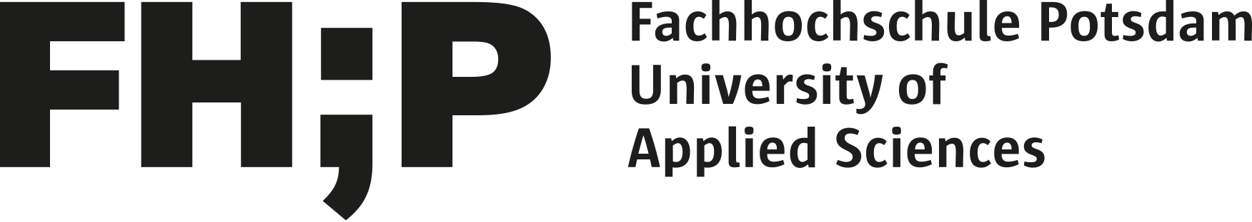
THEMIS.COG
Theoretical and Empirical Modeling of Identity and Sentiments in Collaborative Groups
Notes:
The THEMIS.COG project is aimed at Theoretical and Empirical Modeling of Identity and Sentiments in Collaborative Groups. THEMIS.COG provides new theoretical insights into the dynamics of self-organized collaborations, in which people come together to work on a common problem, without prompting by a third party. Understanding the social forces behind self-organized collaboration is increasingly important in today's society. Technological and social innovations are increasingly generated through informal, distributed processes of collaboration, rather than in formal, hierarchical organizations. Our work uses a data-driven approach to explore the social and psychological mechanisms that motivate self-organized collaborations and determine their likelihood of success or failure, focusing on the example of open, collaborative software development in online collaborative networks (OCNs) like GitHub.
The project is a collaboration between the University of Waterloo, Canada, The Potsdam University of Applied Sciences, Germany, and Dartmouth College, USA. More information on the project, as well as related publications, can be found at https://themis-cog.github.io/

Slide 2
THEMIS.COG
PROJECT GOALS
Understanding New Forms of Collaboration​
  Online Collaborative Networks
  GitHub
Expanding Theories of Social Interaction​
  maintaining social relationships vs. maximizing personal gains
  relational vs. transactional interactions
Leveraging Theories of Identity for Computational Social Science and Targeted Analysis of Big Data​
  Affect Control Theory
  Affective alignment as key motivating factor for group interactions

Slide 3
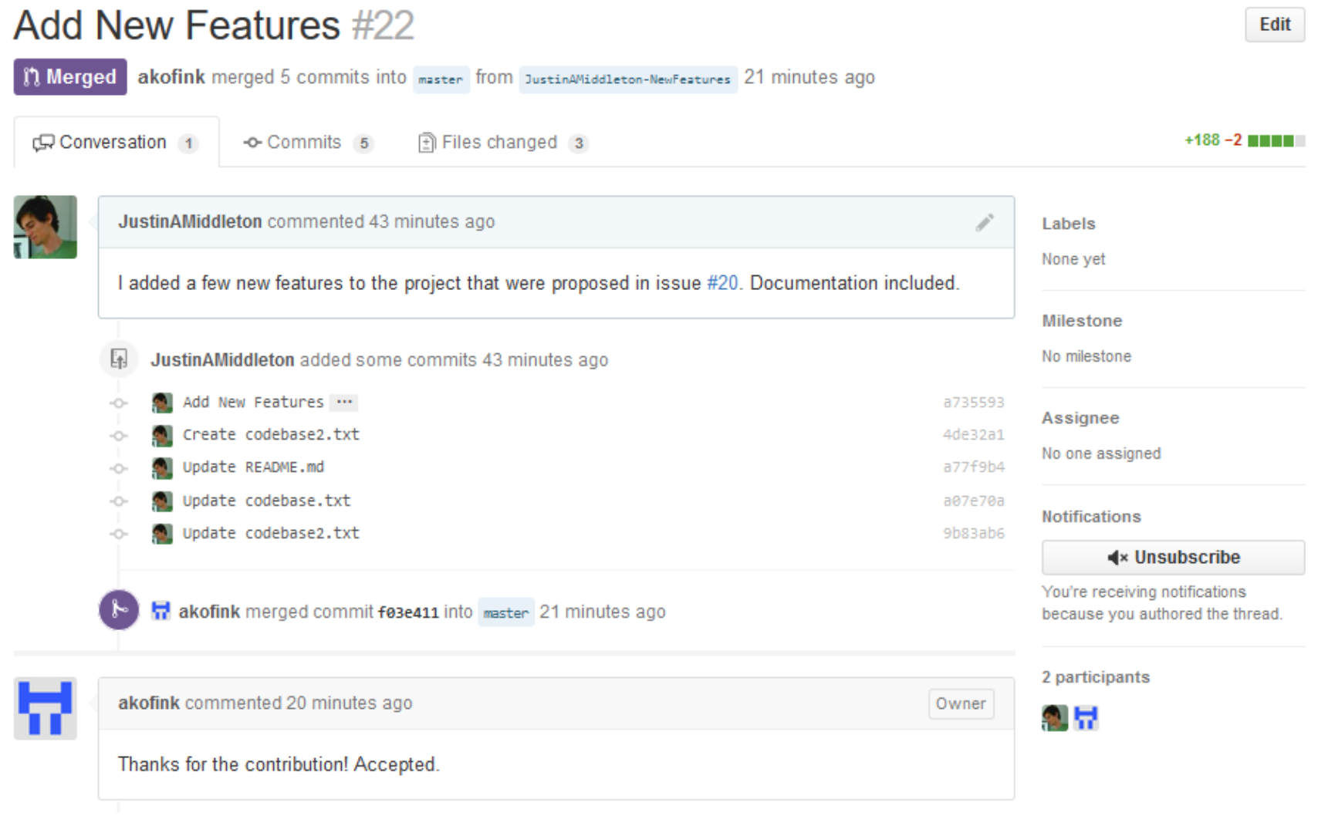
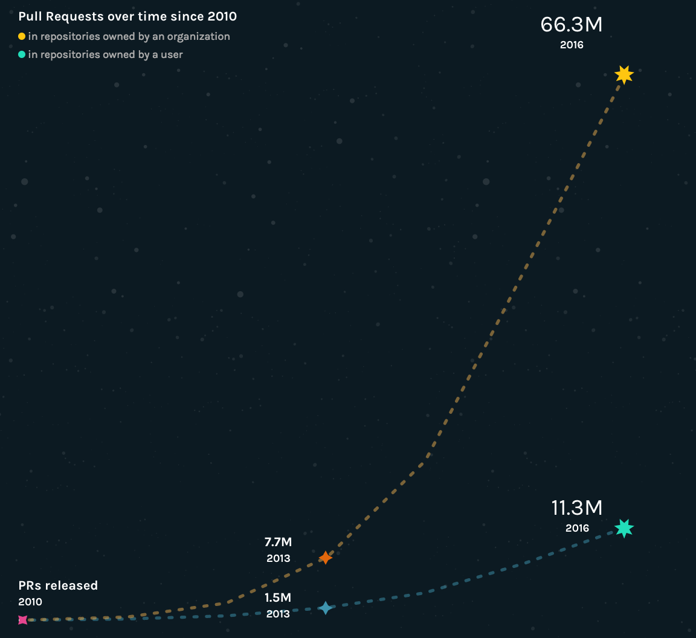
THEMIS.COG
GitHub.com
6 million active users
20 million active repositories
10 million active issues
331 thousand active organizations
Open source

Slide 4
THEMIS.COG
The Good,
The Bad,
and the Ugly
yay no more saving addresses twice in memory
i am grateful that you took the time to write it
is this github being stupid?
dam i was sleeapy sorry let me fix that
Christ people. This is just sh*t.
Wtf ? Who is fucking with my if Statement?!

Slide 5
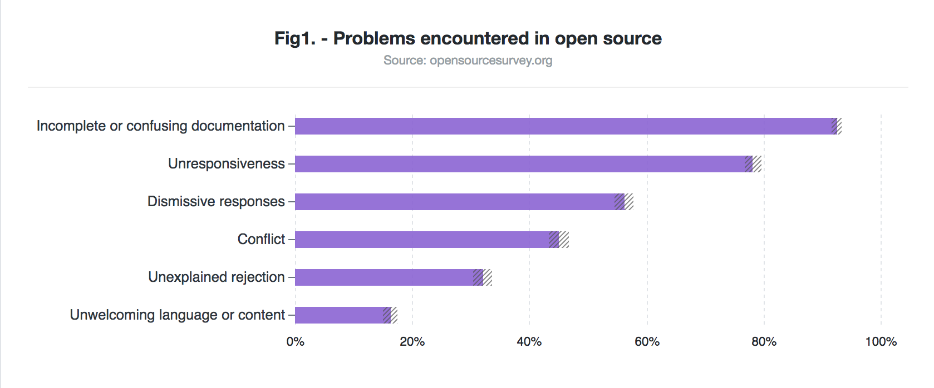
THEMIS.COG
Understanding New Forms of Collaboration: Effects of Emotions

Slide 6
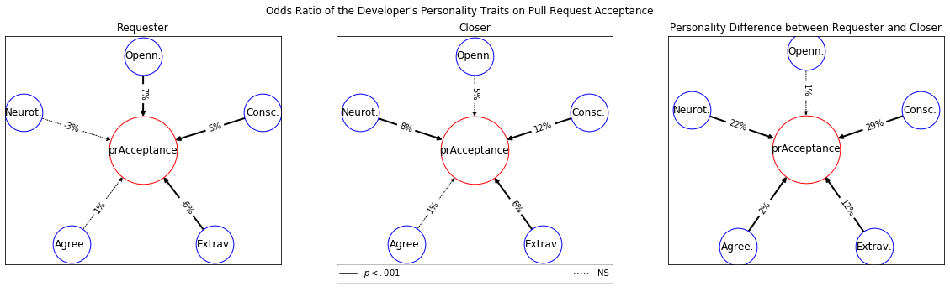
THEMIS.COG
Understanding New Forms of Collaboration: Effects of Personality Traits
BIG 5 Personality: Openness, Conscientiousness, Neuroticism, Agreeableness, Extraversion
Notes:
Main contribution: empirical evidence showing the effects of requesters’ and closers’ personality traits, and the difference in personality traits between the requester and the closer on pull request acceptance. Evidence supported and explained by the literature in personality psychology.
Requester: Openness and Conscientiousness have positive effects on the pull request acceptance, while Extraversion has a negative effect.
Closer: Conscientiousness, Extraversion, and Neuroticism have positive effects on the pull request acceptance.
Absolute Difference: The absolute differences in Openness, Conscientiousness, Extraversion, and Neuroticism affect the pull request acceptance positively.
Takeaway: Open developers bring creative solutions to the team. Conscientious developers will not only work diligently, but will be detail-oriented and deliver high quality standard of work. Lastly, having a diverse in terms of personality traits is beneficial for open collaboration.

Slide 7
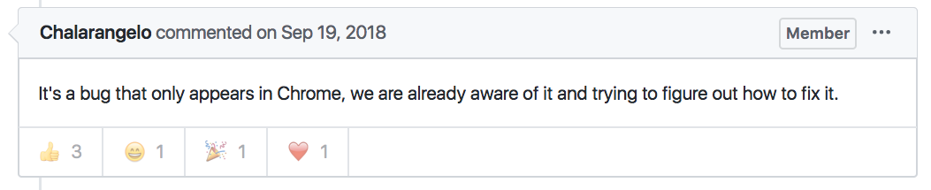
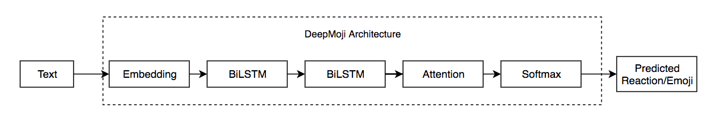
THEMIS.COG
Understanding New Forms of Collaboration: Predicting reactions
Notes:
Github provides a feature where you can “react” to pull request comments with a set of predefined emojis or “reactions”
This can indicate how users in a group perceive/react to a comment, or it can represent how they feel they are supposed to react to a specific user (e.g. react positively towards a person in a position of power)
DeepMoji is a deep learning architecture designed by the Media Lab at MIT et al to detect an emoji based on a Tweet (from Twitter)
The architecture is shown, basically a series of Bidirectional LSTMs
This architecture was implemented on the Github dataset of Pull Request comments
7

Slide 8
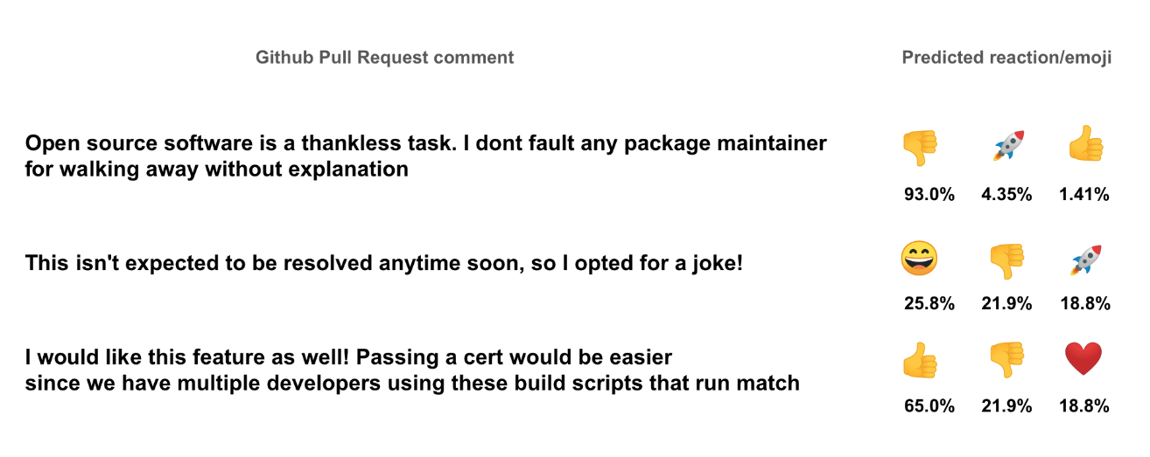
THEMIS.COG
Understanding New Forms of Collaboration: Predicting reactions
Notes:
Here is an example of the trained DeepMoji model predicting reactions for pull request comments
(These are actual pull request comments, and in these cases the predicted reactions were actually a correct reaction – i.e. these are test cases for which the model predicted accurately)
Currently the model can predict reactions at better than random accuracy
Additional non-textual information such as project network structure is being used to supplement this model to further improve accuracy (Not shown in slides)
8

Slide 9
THEMIS.COG
Understanding New Forms of Collaboration: Diffusion Across Groups and Networks
How are diffusion processes in a large social network influenced and facilitated by group collaborations?
GitHub provides details on both interactions within group projects, and connections between members outside of projects.
The spread of coding languages in the community over time is highly visible.
We are currently focused on Julia, a coding language that became popular in the 2010s.
Notes:
We’re in the early stages of examining how group collaborations facilitate the diffusion of an innovation, in the case the “Julia” coding language.
There have been many studies of diffusion on networks, including on how the spread of something from node A to node B is dependent on more than whether there is a single connection. Studies have shown that individuals may not adopt a behavior or accept an idea until a certain minimum number of proportion of their connections do.
Furthermore, classic work in the small groups literature has found that group characteristics such as size, structure, the position of the potential adopters in the group, the position of those who have already adopted, and the relative positions of the adopters all influence whether a group adopts an innovation broadly conceived.
We aim to merge the network and small group literatures on diffusion by looking at how group processes facilitate the diffusion of an innovation across a population. The unique structure of the GitHub data allows us to look at the spread of an innovation across a large social network that has many embedded group collaborations.
Figure: The green dotted line/right-axis indicates the number of new users by year, the black solid line/left-axisindicates the number of new Julia projects by year. The overall point is that this is a good case study for diffusion in the timeframe captured by the GH dataset.
9

Slide 10
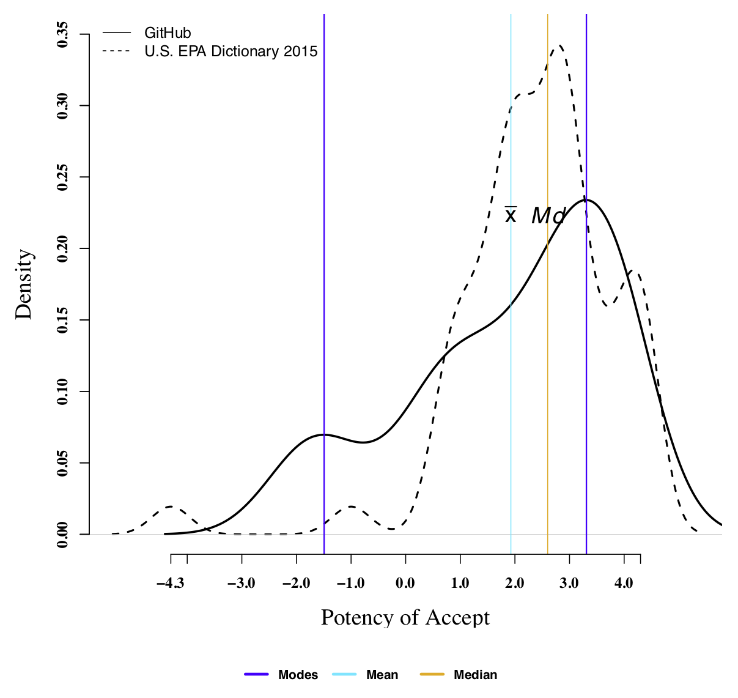
THEMIS.COG
Expanding Theories of Social Interaction​: Measuring Subcultures
503 GitHub users rated 524 roles, behaviors, traits, and coding concepts using theory-driven measures of cultural sentiments
Of the 524 concepts rated, 163 had bimodal meaning distributions, with each mode including at least 20% of participants
Concepts like “error messages,” “argument,” and “accept” have unique subcultural meanings for GitHub users
The more often respondents use GitHub, the more likely they are to identify with the subculture; not true of membership duration
Notes:
In this study, we assessed the level of consensus in cultural sentiment ratings gathered from 503 software developers who use GitHub. We were particularly interested in the possibility that more than one modal rating of a concept may be present in the data, reflecting differentiation between mainstream and subcultural developer meanings for a concept. We identified modes in respondents’ cultural sentiment (EPA) ratings for each concept rated, allowing us to discern which carried widely consensual meanings (one mode) and which were more divisive (two or more modes). We determined (1) which modes reflect majority vs. minority rating patterns by calculating the proportion of respondents whose ratings align with each mode; (2) whether each respondent’s ratings most often align with majority or minority modes, and (3) whether alignment with majority vs. minority modes is associated with other respondent characteristics measured in the study. While there are many concepts with unimodal, normally distributed meanings, ratings of 163 of the 524 concepts rated had more than one mode. Respondents who use GitHub more frequently were significantly more likely to identify with the minority, subcultural mode.
The illustrative figure displays one concept for which ratings were divided, accept. While the majority of respondents rated this concept quite high in potency (3.3), a smaller contingent rated the concept quite low in potency (-1.5). This is perhaps because of the dual denotative meaning of this concept on GitHub, where acceptance can refer to a person being integrated into a group (the dominant cultural meaning) or a code revision being integrated into a piece of software (the subcultural meaning). Using the mean to represent the central tendency of respondent ratings would be quite misleading in this case; because it incorporates ratings from the minority mode, the mean value is substantially lower than the central tendency of the dominant mode (2). Despite the bimodality of this distribution, the sample mean is quite similar to those found in earlier ACT cultural “dictionaries” (e.g., in the UGA dictionary, mean potency is 2.3 for this concept.
Our method can be used by researchers interested in studying cultural meaning consensus, variation, and subcultures, with some modifications depending on the goals of the specific study (e.g., isolating the central tendency of the dominant mode may be most appropriate for consensus studies, comparing modes and the respondents that fall closest to them may be more appropriate for studies of variability or subcultures). Mean and median are only sound choices for unimodal meaning distributions.

Slide 11
THEMIS.COG
Understanding New Forms of Collaboration:​ Topology of Groups on GitHub
Notes:
The five panels show five commonly occurring group types on GitHub.
In each panel, the top graph shows the most central/most representative group structure of that type, while the lower graph shows a peripheral/less representative group structure.
The two graphs together illustrate the structural range of the category.
The box around clusters 3, 4, and 5 indicate that these clusters came from a common parent, and were subsequently clustered a second time because there remained notable heterogeneity across our structural indices.

Slide 12
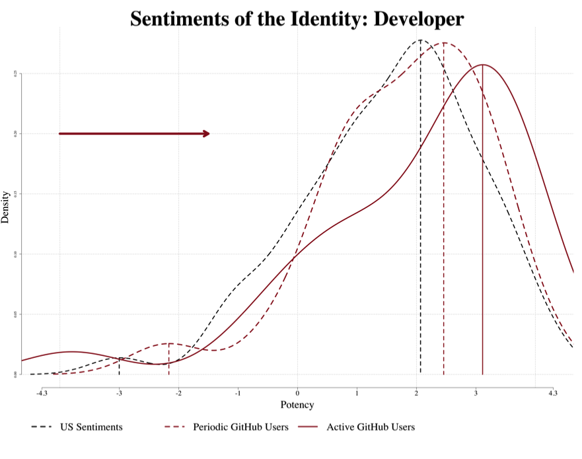
THEMIS.COG
Expanding Theories of Social Interaction​: Modeling the Development of Subcultural Meanings as the Interaction of Culture and Structure
Notes:
This slide is a theoretical summary.
In year 1-2 of the project, we identified that there are five common group types on GitHub.
In year 2 of the project, we implemented a new version of Group Simulator capable of modeling group structure and and behaviors from a discrete list (making Group Simulator more suitable for modeling organizational settings like GitHub).
In year 2-3, we are focusing on two things: differences in the sentiments and emoji use of our group types (some old fashion sentiment analysis here), and modeling these groups using Group Simulator II to see if the transient impressions and emotions predicted correspond with what we are finding in the data.
Results significant at 0.1 level
We are trying to explain what we see in the figure. We find that active GitHub users have a more powerful impression of developers than either periodic users of GitHub or undergraduates.
We believe this difference arises from the interaction contexts active developers find themselves in. Unlike the programmers in Office Space, developers on GitHub control the vision and scope of their projects.
We expect that periodic users have a less potent impression than active users but a more potent impression than undergraduates because they identify somewhat as developers but are likely working in standalone groups or with a few friends rather than in complicated/version controlled, and frankly often more exciting projects.
Graph Details
U.S. Sentiments refer to the 2015 U.S. Student Sample
Active GitHub Users refer to users reported using GitHub either 3-4 times a week or every day.
Periodic GitHub Users refer to users who reported using GitHub on a monthly basis or less.
The GitHub data comes come from the dictionary we collected in 2018. No adjustments were made to the data, except users who failed to complete the survey were dropped.

Slide 13
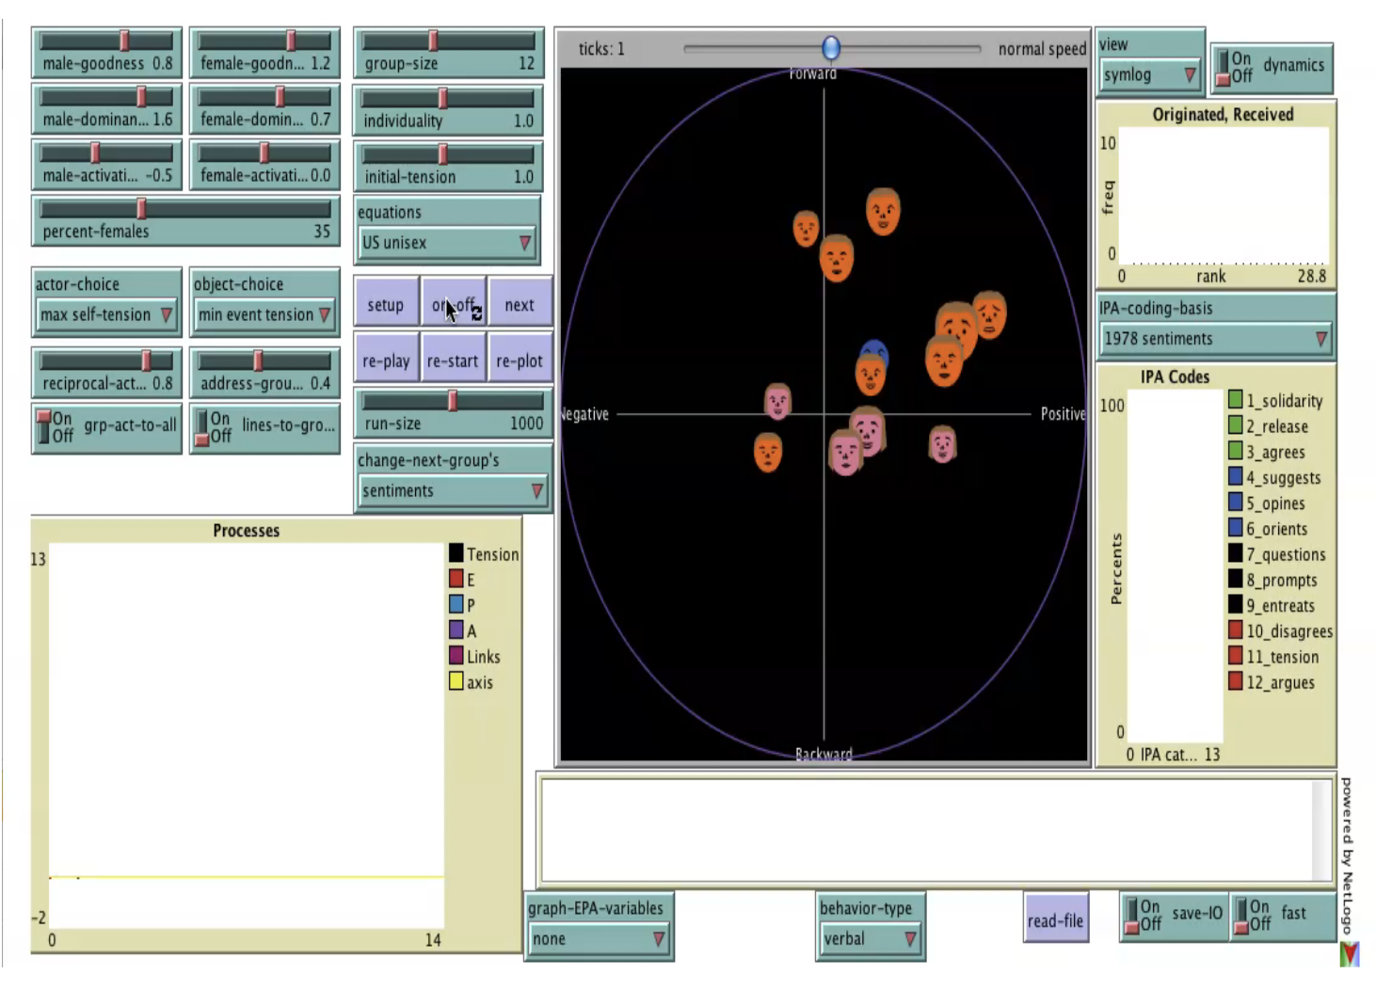
THEMIS.COG
Leveraging Theories of Identity​: Group Simulator
Affect Control Theory
Emotional Alignment
Based on Identity
Social dynamics from group structure
Dyadic Interactions
Action on-the-group

Slide 14
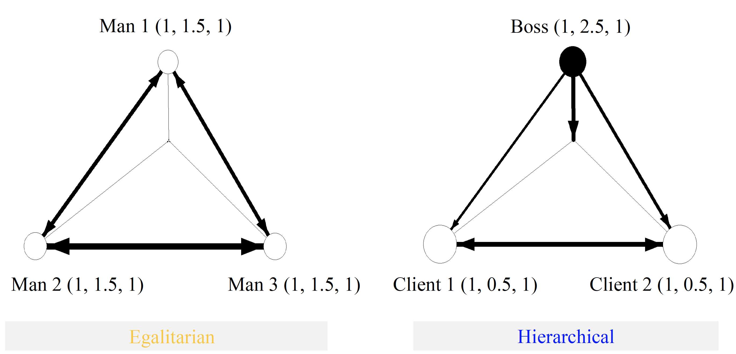
THEMIS.COG
Leveraging Theories of Identity: Impact of Structures on Group Dynamics
“man” power: 1.5
“boss” power: 2.5
“man”
“man”
“client” power: 0.5
“client”
less
Power Differential
more

Slide 15
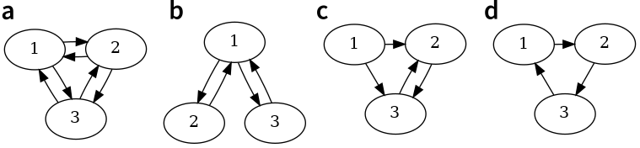
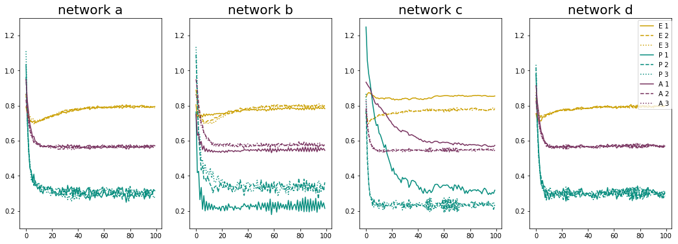
THEMIS.COG
Leveraging Theories of Identity: Simulating the Impact of Group Structures on Group Dynamics
Notes:
The traces depict the average values of Evaluation, Potency and Activity for each agent in networks a, b, c, and d respectively.
The key take-away from this slide is that networks b and c are hierarchical (not all agents are equally acted upon by the other agents). I have outlined these networks to highlight this point.
Group c is the most hierarchical and thus differs the most from the other networks.
The impression dynamic that is the greatest factor behind this effect is the object diminishment effect, the loss of potency an identity experiences from being the object of an action.
The tick marks on the x-axis indicate turns in the simulation. Each value for each turn is the average of over 200 simulations with group-action-rate = 0.1 for the different network topologies. The colors indicate the average values of Evaluation, Potency and Activity for each agent.

Slide 16
THEMIS.COG
Leveraging Theories of Identity: Simulating the Impact of Group Structures on Group Dynamics
Notes:
In this study, we ran simulations using GroupSimulator, ACT’s model of group dynamics, to show how both group structures and the cultural sentiments attached to group members’ identities shape patterns of behavioral exchange and emotional experiences in software development teams on GitHub, the world’s largest software development platform. We use GroupSimulator to predict behaviors and emotions in software development teams, with a specific interest in comparing the deflection, behavior, and emotions generated in groups (1) that have hierarchical vs. egalitarian group structures, (2) that exhibit greater or less reciprocity in contributions, and (3) wherein members primarily direct their actions toward specific individuals vs. the broader group.
This figure shows the mean deflection score at each address-the-group rate percentage, by group structure and by actor versus object person. The lines are weighted based on the confidence intervals; but with each percentage aggregated over approximately 200,000 observations.
Affect control theory predicts that agents that are acted upon by agents with equivalent potency will experience more deflection than agents acted upon by more potent identities (Morgan, Rogers, and Hu 2016). In addition, as the number interaction opportunities becomes more concentrated, there are fewer opportunities for deflected agents to act. Combined, the greater deflection experienced by being acted upon by a status equal and the fewer number of opportunities to act result in higher rates of deflection for agents in egalitarian groups.
This graph reveals two findings: (1) an agent experiences more deflection (affective mis-alignment) as the object of an interaction than when it is an actor; (2) when the relational norm to address the group, as opposed to address to individuals at the dyadic level, becomes increasingly strong, hierarchical groups generated more affective alignment (lower deflection) than egalitarian ones; Perhaps, members in hierarchical groups experience lower levels of uncertainty given their explicit roles in the group whereas members in egalitarian group expected themselves to be treated as equals and, when treated as the object person, experienced higher levels of deflection.
[The simulation did not produce consistent findings regarding emotions]
Structure of the group is going to influence object-people more – actors get to define the structure
Ability to address the group – as it increases, the effect increases because the actor (the “boss”) gets to exert their power more (by addressing the group)

Slide 17


THEMIS.COG
Conclusions
Group dynamics on GitHub are partially based on emotion and identity
Emotion is difficult to measure on GitHub
Other social networks may provide more varied emotional content
Network analysis of groups provides deep insights into relational structures in online collaborative work
Leveraging this information is crucial for positive impacts of online collaborations
https://themis-cog.github.io/
https://cs.uwaterloo.ca/~jhoey
@drjessehoey

