Slide 1

Digging into High-Frequency Data: Present and Future Risks and Opportunities (Atlantis project)
High-Level Overview of Project Outcomes
Round 4 Conference, Alexandria VA
January 29-31, 2020
Notes:
Internationally connected (across Atlantic) network of co-authors and data

Slide 2
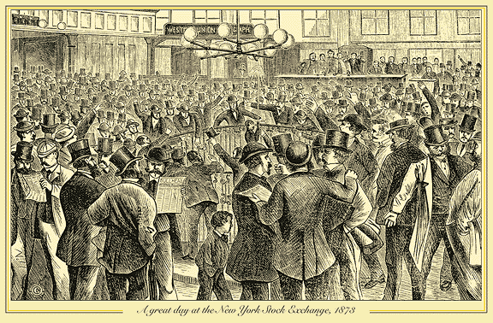
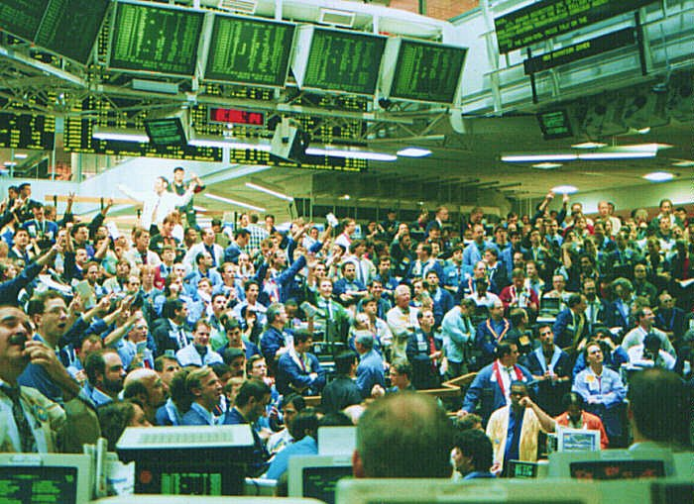
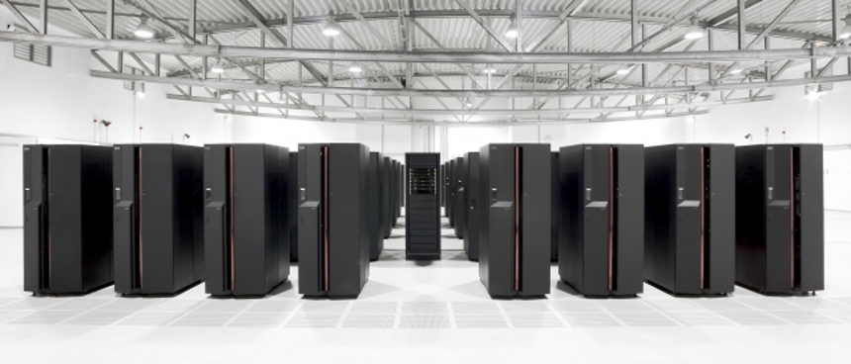
Evolution of Stock Exchange
19th Century
(Late) 20th Century
Today
Increased Automation
Notes:
More automation as we move from one century to another. The structure of the market is changing.

Slide 3
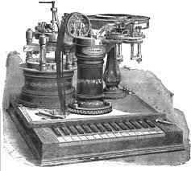
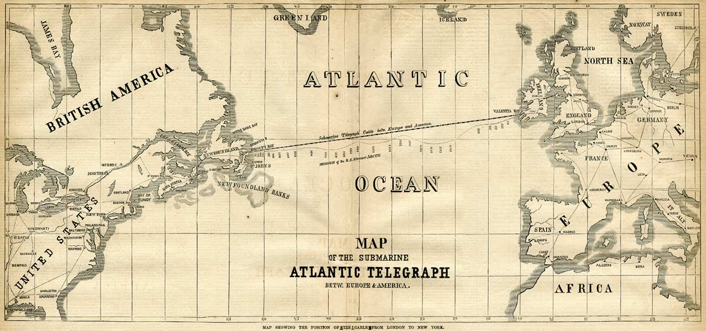
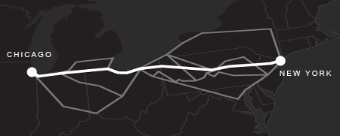
Investments in Speed
1840s: US Telegraph System
1866: First transatlantic cable
2010: Spread Networks’ cable: 3 milliseconds faster!
Microwave Networks. Source: Shkilko and Sokolov (2019)
Notes:
Who gets the best price? Speed matters to get the best price, make the markets more efficient, to efficiently spread information and incorporate it in prices.
Then fiber optic cables were built along existing railroads (were zigzag), so faster than existing cables but because of the kinks (due to railroad infrastructure) it was not optimal. In 2010, the fiber optic cable was developed that was the fastest cable available at the time, it was 3 milliseconds faster. The dark highlighted one was a straight line and hence faster whereas the slower cable was zigzag.
Recently, microwave technology was applied to construct microwave networks.
Microwaves are generally about twice as fast as fiber optic but have very limited capacity and hence only support few traders. We are now talking about microseconds
Both pictures show the connections between Chicago and New York
Think about it: blink of an eye is 200 milliseconds, and now we trade at 2 milliseconds or even microseconds. Blink of the eye is thus 200,000 microseconds.
So, is speed good?
On one hand: We have clear efficiency gains, processing data, settlement, technology reduces transaction costs.
On the other hand: When computers operate 1/200,000 faster than a blink of the eye, there is no room for human judgement or intervention. When crashes happen, algorithmic trading can exacerbate losses before any human intervention is taking place. Think about reptilian brain, fight, flight or run. We need human sense, intervention, working of amigdala.
Shall we reduce the speed of the market? How to do it: financial transaction tax, discrete vs. continuous auctions.

Slide 4
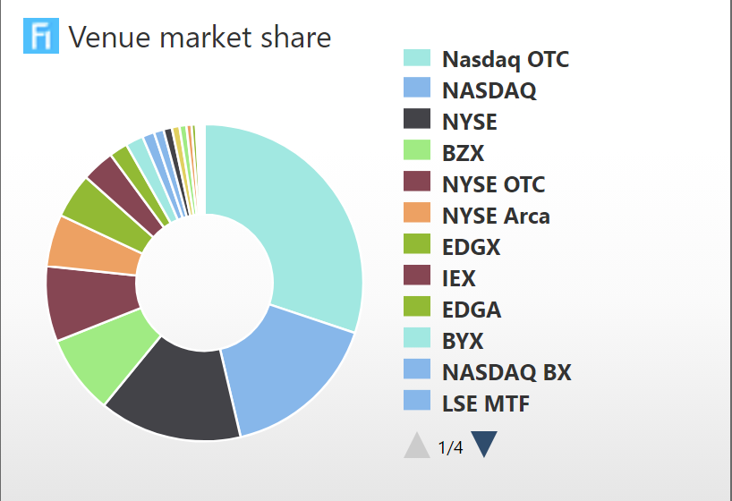
Market Fragmentation
Increased competition among trading venues
  Downward pressure on explicit trading fees and costs
  Fragmentation potentially affects the quality of the price discovery process negatively
  Lit versus dark fragmentation
S&P 500 Stocks Fragmentation
Source: Fidessa
Notes:
All venues are US venues.
Market fragmentation destroys the monopoly that one stock is traded on one venue.
Fragmentation here means the same stock trading in multiple venues/locations/orderbooks. Due to this, just to piece together a complete picture of a stock's liquidity means analyzing data from several venues. In the past, at least to the best of my knowledge, this was not the case. If I wanted to look at MSFT's liquidity I could just look at Nasdaq. Today Nasdaq is not even 1/3rd of the total US market. When we incorporate international fragmentation, things become more complicated, but the argument is still the same.
Transparency and different types of fragmentation: lit vs. dark fragmentation
Lit fragmentation means public orderbooks that have pre-trade transparency, dark fragmentation means venues without (or with limited) pre-trade transparency. Dark fragmentation includes predominantly dark pools, internalization, and OTC.
On one hand, fragmentation goes away with monopoly, but on the other hand it introduces issues with transparency. Also there is no longer a single consensus price (compromised price discovery)

Slide 5
Emergence of High-Frequency Traders (HFT)
Algorithmic traders (highly sophisticated algorithms)
Arbitrageurs (exploit differences in the price across different markets)
High speeds to explore inefficiencies
High turnover rates
Short-term investment horizons
Carry no inventory over night
  No risk exposure
  No capital to absorb risk
Co-location
High order-to-trade ratios
Leverage high-frequency financial data and electronic trading tools
Notes:
New types of traders. Do they help the market or exacerbate losses?

Slide 6
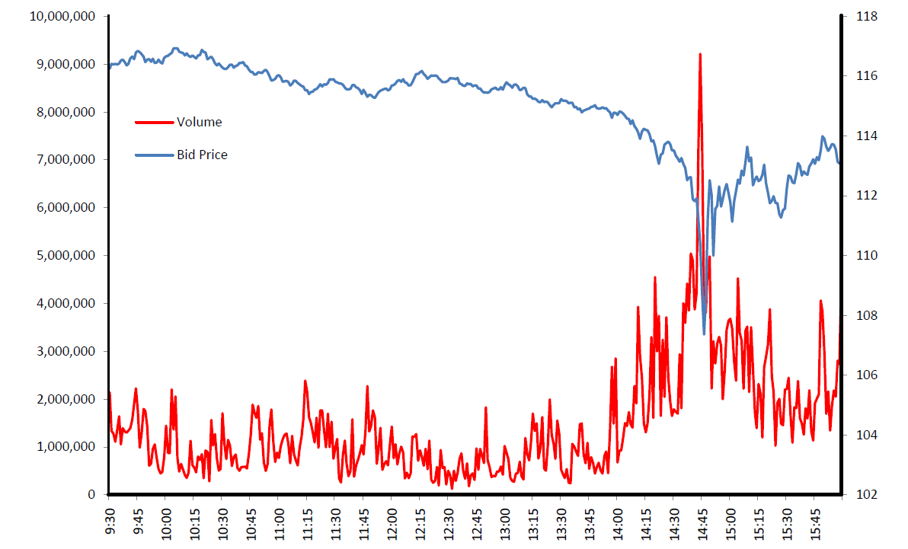
High-Frequency Trading (HFT)
Flash Crash of May 6th 2010
Technology has dramatically improved the efficiency of our trading markets. Rather than putting the individual investor at a disadvantage, high-frequency trading cuts costs significantly for everyone. Individual investors are the ultimate beneficiaries when their pension funds and mutual funds can transact large volumes of trades anonymously with great speed and at lower cost.
- Burton Malkiel, Princeton University
The real question is, assuming that flash trading improved “price discovery,” does the information produced lead to better resource allocations, e.g. improve the allocation of capital to one industry or another, to one firm or another?
Joseph Stiglitz, Nobel Laureate
The impact of the regulatory and technology barriers is demonstrated by the fact that it took the CFTC and SEC five months of intense work to figure out what happened over a few minutes on May 6th.
– Sen. Carl Lewin
Notes:
Do HFT cause fragility in the market or they help with improving efficiency of our trading markets?
During the flash crash of May 6th 2010, there was an intra-day crash, but the prices rebounded within 20 min. There was a huge spike in trading volume, specifically by HFT.
So, what happened? First of all it took CFTC and SEC five months to piece all data about who trades with whom and where, millisecond data on transactions and orders, and different venues of trading due to market fragmentation during that 20 min interval. That was not an easy task. In our project we are creating a platform which puts together data from different traders and different trading venues and has capacity to store milliseconds of data orders and transactions. We are creating a platform to make it easy to study future crises using high frequency millisecond data, so for each event we do not create everything from scratch and study for 5 months.
Do HFT help the efficiency (Burton Malkiel view) or exacerbate the crashes (our view) and does not produce better resource allocations (negative view by Stiglitz)

Slide 7
Objective One: Data infrastructure
WP 1.1: Data collection and build-up of order book
  Several Exchanges
  Disparate Trading Rules
  Timestamp Asynchronicity
WP 1.2: Complexity and Dimensionality Reduction
  Standardized measures of market performance
Exchange One
Bid-Ask Spread
Depth
Exchange Two
Volumes
Order Books
Trades
Price Impact
Exchange Three
Imbalance
Autocorrelation
Exchange Four
Volatility
…
Notes:
Exchanges: US, India, Paris, London, Germany
For each exchange calculate market liquidity and efficiency measures, and also put all exchanges together and calculate measures for them to be comparable (frequency, data, etc.)
W.P. is work package from our proposal
We need good capacity to manage all this data.
Need to get good data infrastructure
Standardization and dimensionality reduction (lots of information like raw messages, standardize into order books, put it into smaller measurable measures)
Advantage is that we can have a comparison across exchanges. So, we are comparing apples to apples. Say I want to compare volumes across different exchanges. We are cleaning up the data. Stay with the data pertinent to research at hand. Standardize across venues, over time, etc. Exchange rules also change over time. Address changes appropriately. London stock exchange introduced in September 2015 intra-day auction (fixed at noon), need to make adjustment to the quote to process the data correctly.

Slide 8
Objective Two: Micro Perspective
WP 2.1: Effect of HFT on traditional aspects of market quality
  Liquidity and Price Efficiency
  Interactions between cash and derivatives markets
WP 2.2: Financial Architecture of the Markets
  Designated market-makers
  How to integrate fragmented markets?
  Select (Working) Papers:
  Liquidity Commonality and HFT
  Are HFTs Informed?
  Effect of HFT on hedging performance of options market makers
  Paying for Market Liquidity: Competition and Incentives
  A Tale of Two Cities: Inter-Market Latency, Market Integration, and Market Quality
Notes:
What is the effect of HFT on market quality and financial architecture of the markets? HFTs on the one hand play an important role in integrating fragmented markets (by arbitraging). On the other hand, they may impose adverse selecting costs on other (slower) traders. HFTs, by providing liquidity, can induce positive network externalities on the market. But they may withdraw altogether when “the going gets tough”
What is the role of market structure in this debate:
Do we need designated market makers? – we pay them to make markets run efficiently and to provide liquidity. Paris has designated market makers, but not Nasdaq, Germany, London, or India
How to integrate physically separate markets? Faster speeds combined with high capacities allow most traders to react quickly (positive), but small capacities allow rent-seeking by HFTs (need to quantify this)

Slide 9
Objective Three: Macro Perspective
WP 3.1: Role of HFT as arbitrageurs
  Liquidity shock spill over across markets
  Contrarian trading by HFTs during stressed periods
  Arbitrage activity across the cash and derivatives market
Select (Working) Papers:
Liquidity Provision: Normal Times vs Crashes
High-Frequency Trading During Flash Crashes
Measuring Limit Order Book Resilience in Fragmented Markets
Notes:
Do they exacerbate the crashes or help to decrease the crisis implications? Since they have no inventory, do they have enough capacity to absorb the losses and be contrarian, and thus prevent further collapses?
Fragility is important. HFT can contribute to the fragility of the market. During crises they are not stabilizing the market. If some market event happened, they can potentially exacerbate the downward spiral. Speed is good to absorb information but we can make rushed decisions. We are missing human judgements.

Slide 10
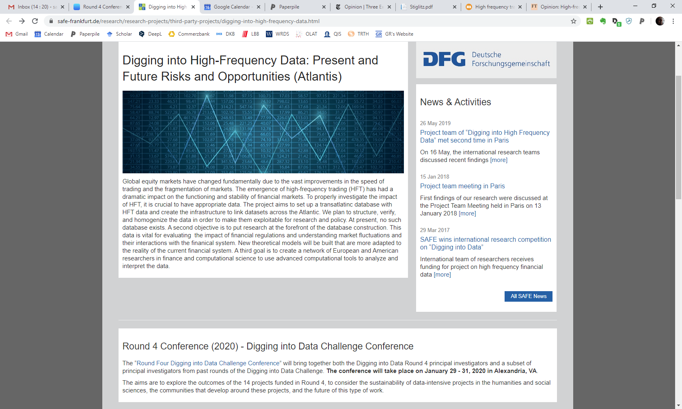

Project Website
https://safe-frankfurt.de/research/research-projects/third-party-projects/digging-into-high-frequency-data.html
Notes:
Our studies show that HFT are exacerbating some shocks. They are making market more fragile.
Please talk to my colleagues and attend poster sessions. Presentations are on the webpage too.

