Slide 1
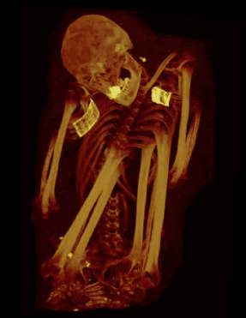
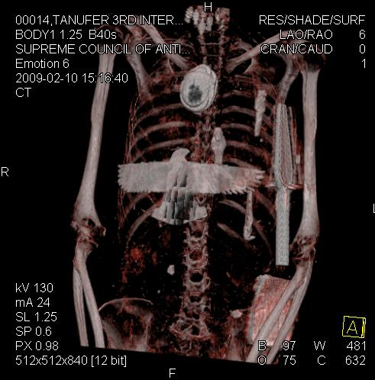
The IMPACT Study How old is atherosclerosis?
Randall C. Thompson, MD
Professor of Medicine
University of Missouri – Kansas City
Attending Cardiologist
Mid America Heart Institute

Slide 2
The IMPACT Study How old is atherosclerosis?
Randall C. Thompson, MD
Professor of Medicine
University of Missouri – Kansas City
Attending Cardiologist
Mid America Heart Institute

Slide 3
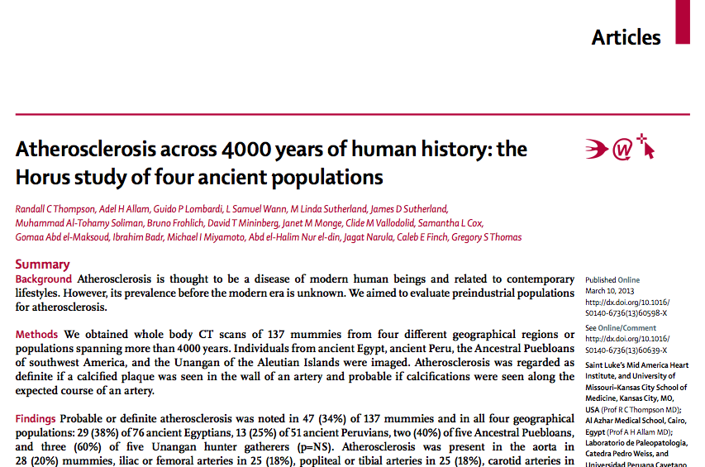
Thompson et al: The Lancet, March 10, 2013

Slide 4
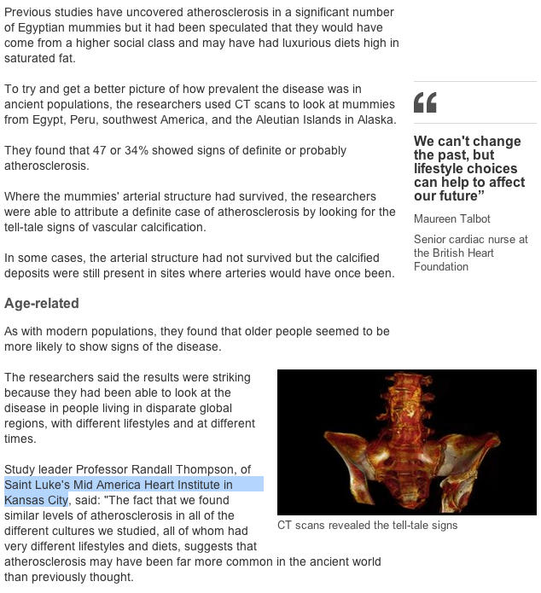
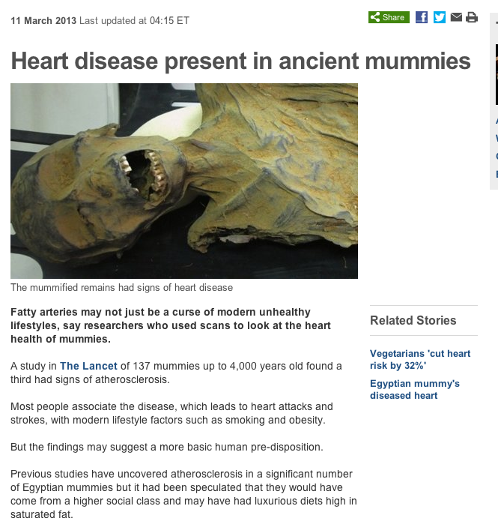

Slide 5
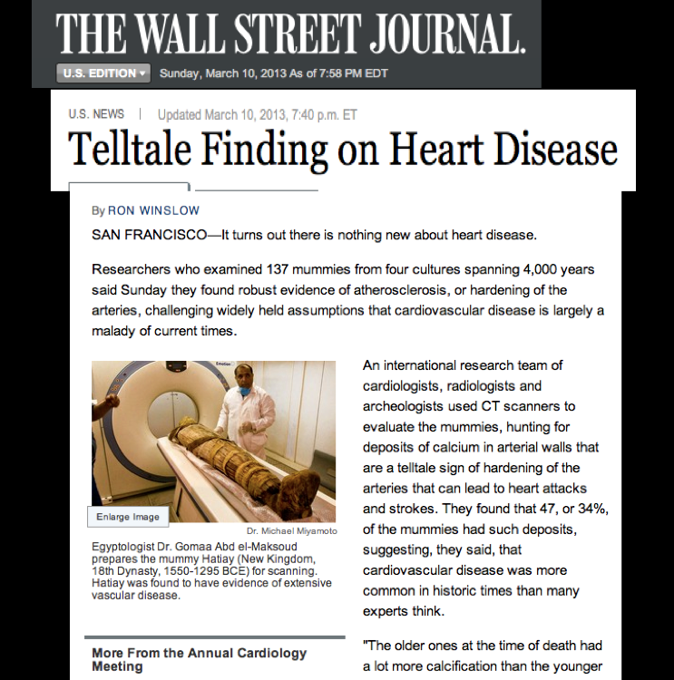
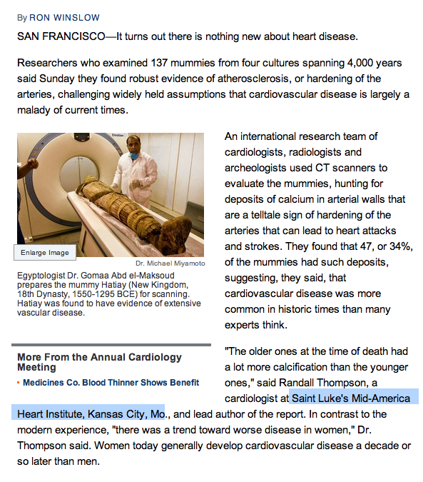

Slide 6
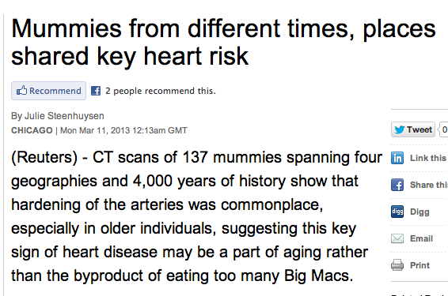
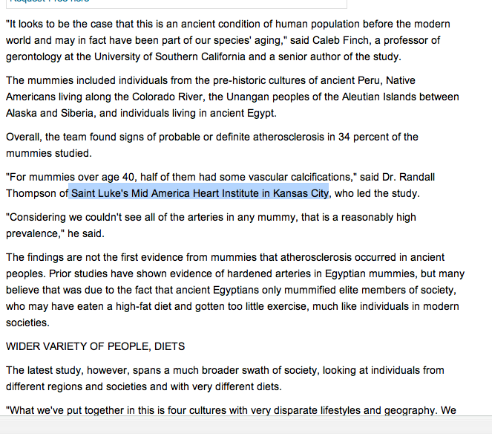

Slide 7
Randall C. Thompson
Adel H. Allam
Guido P. Lombardi
L. Samuel Wann
M. Linda Sutherland
James D. Sutherland
Muhammad Al Tohamy
Soliman,
Bruno Frohlich,
David T. Mininberg
Janet M. Monge
Clide M. Vallodolid
Samantha L. Cox
Gomaa el-Maksoud
Ibrahim Badr
Michael I. Miyamoto
Abd el-Halim Nur el-din
Jagat Narula
Caleb E. Finch
Gregory S. Thomas
Thompson et al: The Lancet, March10 , 2013

Slide 8
Background
Atherosclerosis is commonly considered to be a disease of modern times and related to modern lifestyles.
But…is it? Maybe this statement isn’t completely true.
Was it present in ancient people?

Slide 9
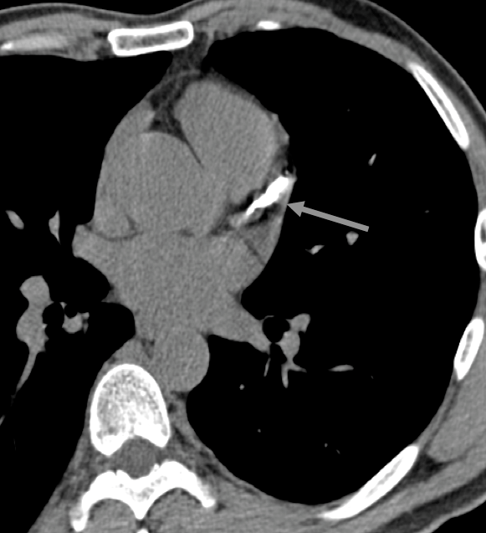
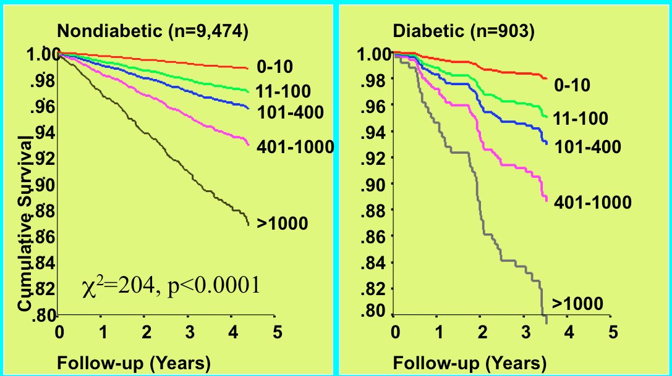
Coronary Calcium Scoring

Slide 10
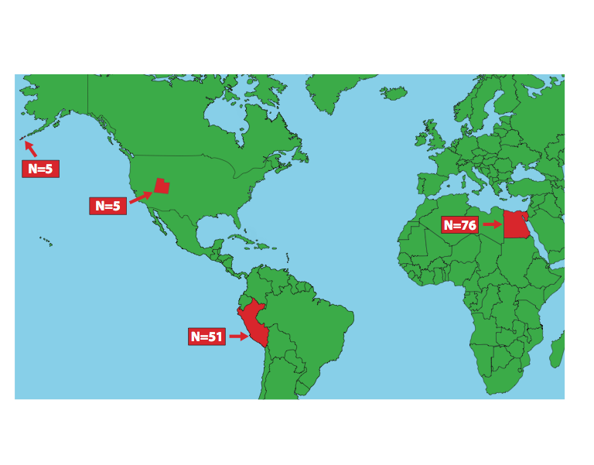
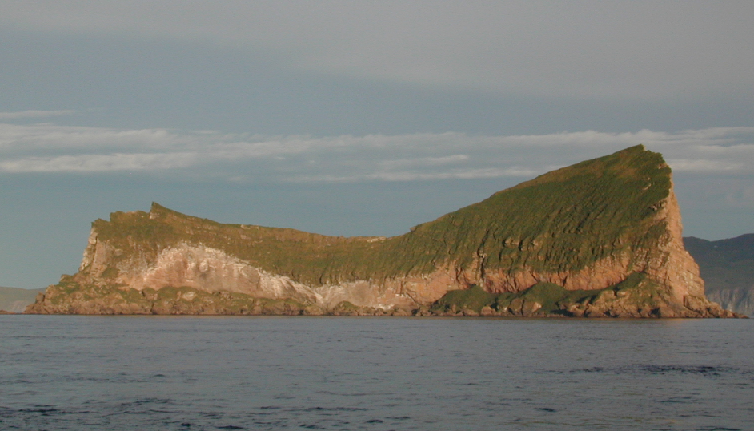
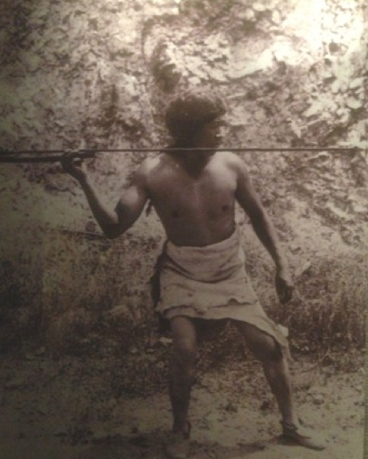
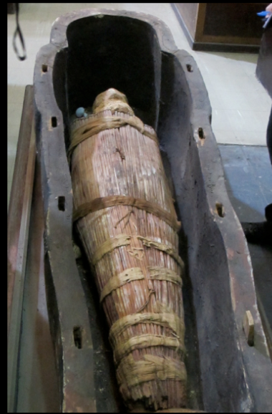
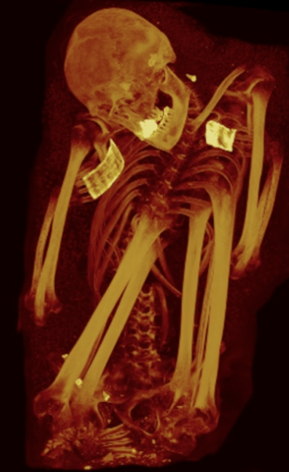

Slide 11
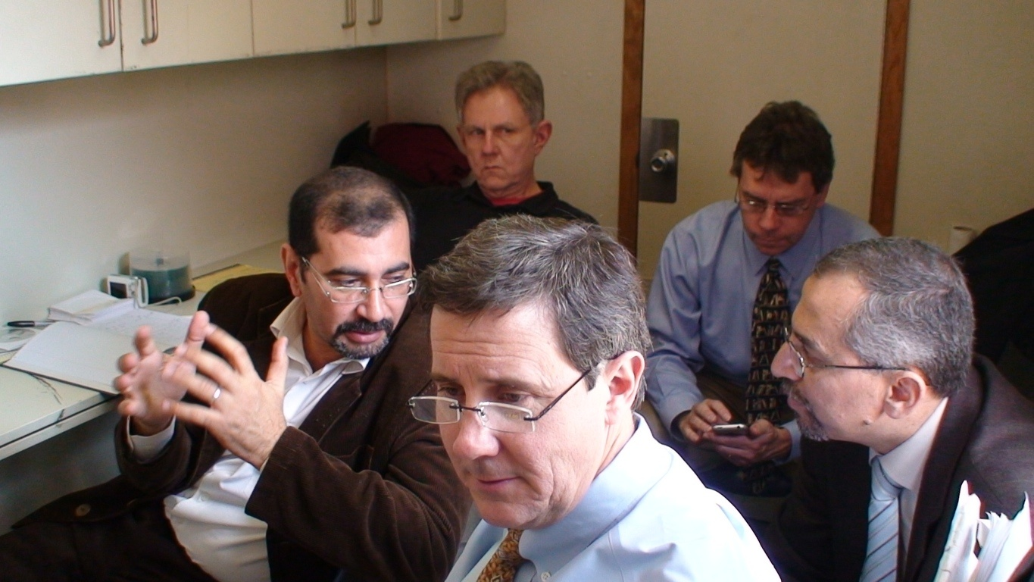
Consensus interpretation

Slide 15
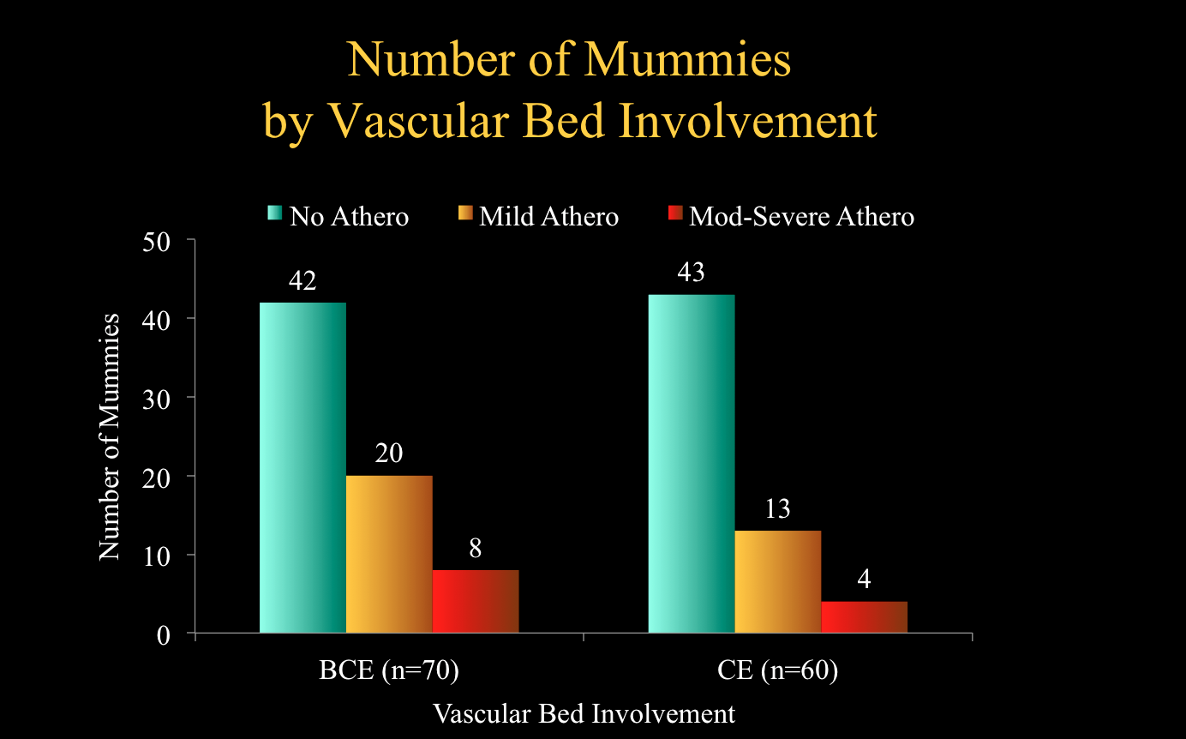

Slide 16
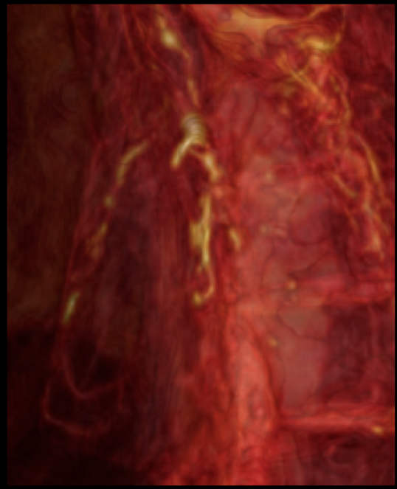
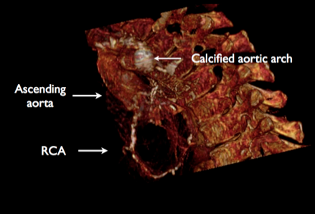
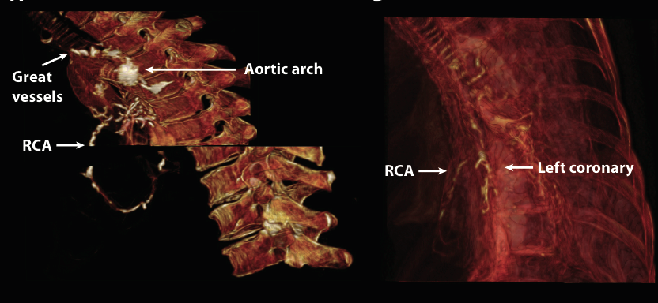
Unangan F 47-51y
Ahmose-Meritamun Egyptian M 40-50 y
Thompson et al: The Lancet, March10 , 2013

Slide 17
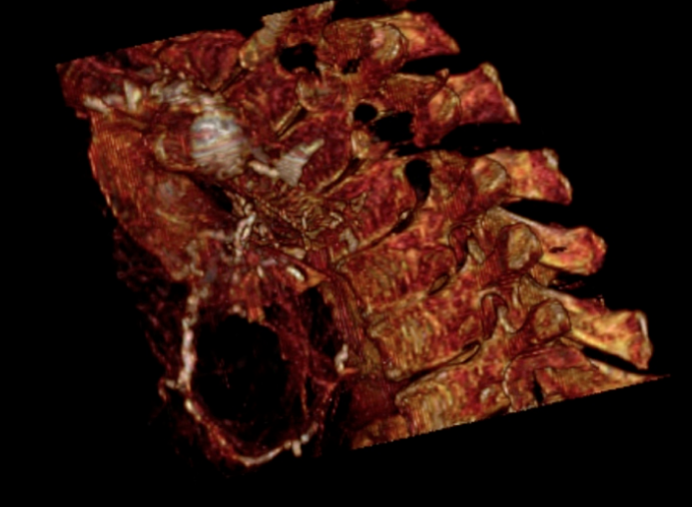
Unangan F 47-51y
Ahmose-Meritamun Egyptian M 40-50 y
Thompson et al: The Lancet, March10 , 2013

Slide 19
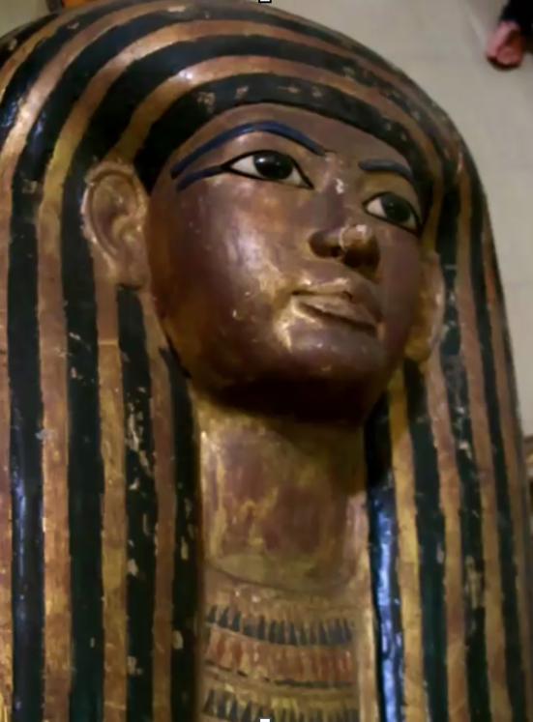
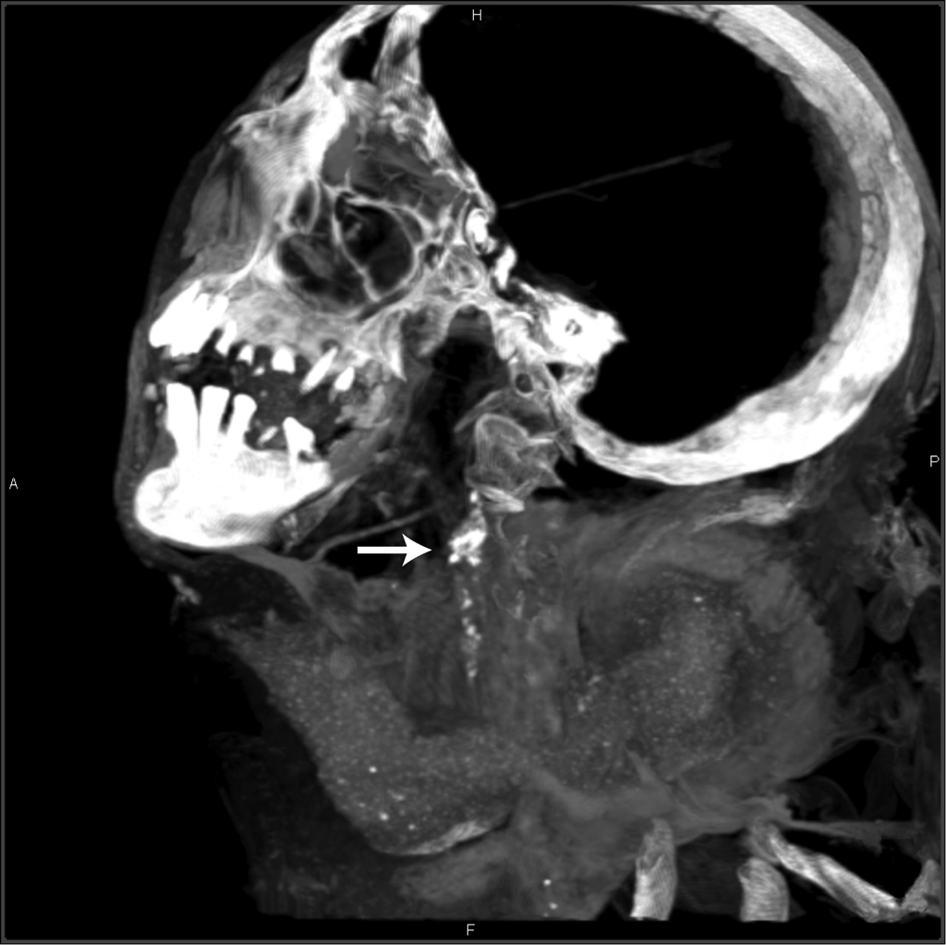

Slide 20
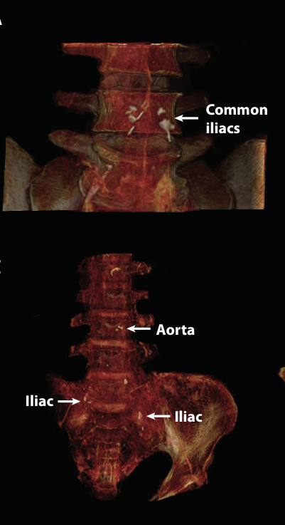
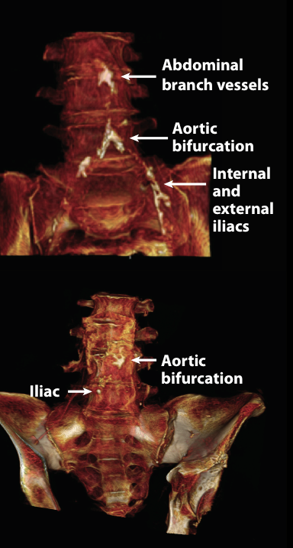
Unangan F 47-51y
Egyptian F 45-50y
Ancestral Puebloan F 46-51y
Peru F 41-44y

Slide 21
Unangan F 47-51y
Egyptian F 45-50y
Ancestral Puebloan F 46-51y
Peru F 41-44y

Slide 22
Diet
 | Egypt | Peru | Ancestral Puebloans | Aleutian
Diet | Farmers, domesticated animals | Farmers, domesticed animals | Forager-farmers | Hunter gatherers
Food examples | Wheat, barley, dates, figs, olives, beans, radishes, onions, cucumber, lettuce, cabbage | Corn, potato, sweet potato, manioc, beans, bananas, hot pepper | Corn, squash pine nuts, seeds, grasses | Marine, berries, no agriculture
Protein sources | Domesticated cattle, sheep, goats, pigs, hyenas, ducks, geese, birds, fish | Domesticated alpaca, guinea pigs, ducks, deer, birds, fish | Rabbit, mice, big horn sheep, mule deer, fish | Seal, sea otter, whales, shellfish, sea urchins, birds, eggs, fish

Slide 23
Housing
 | Egypt | Peru | Ancestral Puebloans | Aleutian
Housing | Above ground mud brick houses | Above ground mud homes | Subterranean single family homes (pithouses) | Subterranean single & multi-family homes (barabaras)
Smoke exposure | Cooked with wood or coal in yard or on roof | Cooked with wood or alpaca dung outside | Used fire for warmth and cooking | Used fire for warmth and cooking in barabaras; used seal oil lamps for light

Slide 24
Summary
Because of the large number of CT scans accumulated for this study, we were able to demonstrate that atherosclerosis was present in humans in numerous cultures, across a very wide geographic distribution, and dating back at least 4000 years.
Atherosclerosis, including coronary artery disease, was also found in a population not known to have atherosclerosis, hunter gatherers.

Slide 25
IMPACT
Numerous questions remain and The IMPACT Study is continuing.

Slide 26
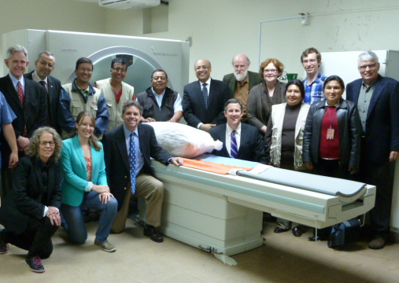
Randall C. Thompson
Adel H. Allam
Guido P. Lombardi
L. Samuel Wann
M. Linda Sutherland
James D. Sutherland
Muhammad Al Tohamy
Soliman,
Bruno Frohlich,
David T. Mininberg
Janet M. Monge
Clide M. Vallodolid
Samantha L. Cox
Gomaa el-Maksoud
Ibrahim Badr
Michael I. Miyamoto
Abd el-Halim Nur el-din
Jagat Narula
Caleb E. Finch
Gregory S. Thomas
Thank You

