Slide 1
Digging into the Knowledge Graph (2017-2020)
Presentation at the Trans-Atlantic Platform Digging into Data Round 4, January 29 - 31, 2020
NSF, USA

Slide 2
Project in a nutshell
Consortium (small)
Richard Smiraglia (University of Wisconsin, Milwaukee; now Institute for Knowledge Organisation and Structure)
Rick Szostak (University of Alberta)
Andrea Scharnhorst (Royal Netherlands Academy of Arts and Sciences)
Team
Vanessa Schlais, Ronald Siebes, Tobias Renwick
Partners
Aida Slavic (UDC), Wouter Beek (Triply), Daniel Martinez Avila (Sao Paolo)
O1: Develop methods to index the LOD cloud with the aim of improving findability and searchability– focus on vocabularies relevant for the SSH domain.
O2: Develop recommendations for LOD publication for communities in the SSH, with emphasis on the re-use of existing vocabularies.
O3: Develop guidelines for archiving LOD datasets from the SSH domain and to support the sustainability of domain-specific vocabulary.

Slide 3
Intersection of LOD and KOS
The idea was to see if Knowledge Organization systems could enhance operability in LOD.
Our colleagues in the Netherlands had developed the LOD Laundromat
I had developed the BCC
We networked with the coordinator of UDC
We have pursued two case studies, one in Music and the other in Economics, building on the expertise of the US and Canadian PIs

Slide 4
O1: Develop methods to index the LOD cloud
Achieved
Indexing SSH vocabulary (using the DANS KOSo) with generic KO systems (example Dahlberg’s classification)
Pending
Application of these principles to (a subset) of the LOD cloud

Slide 5
O2 Develop recommendations for LOD publication for communities
Achieved
Guidelines how to publish LOD
Pending
Publishing the BCC as LOD (and with thesaural interface)
Publishing the UDC as LOD (taken care of the historic legacy – UDC editions)

Slide 6
O3: Develop guidelines for archiving LOD datasets
Achieved
Design and implement a KOS observatory – archived as data dumb (Dataverse)
Contributed to Preferred format recommendations (LD as a data format) of DANS
Panel at DH2019 on Curating Linked Data
Pending
Make the archived information in the KOSo machine readable

Slide 7
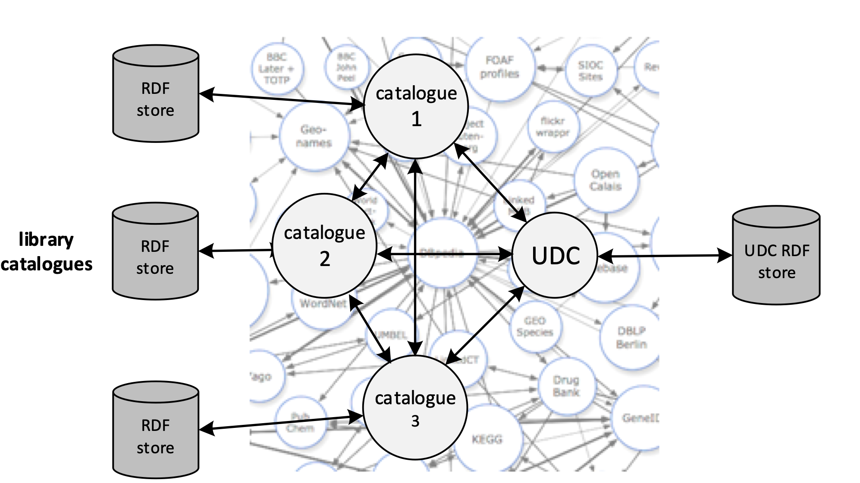
Interesting insights
Case study: UDC publication as LOD
Careful design choices are needed to a) protect the historic legacy (provenance) and b) to enable a viable business model
Case study: Computerized Mensural Music Editing (CMME) as LOD
Relevance of authorative, institutional stable curators which act as LD publishers as libraries or public consortia to enable to only the isolated publication but the interlinking of resources
Case study: BCC:
One challenge is that many terms are broader than LOD counterparts.
O2, O3
O2, O3

Slide 8
Publications
Coen, G, Smiraglia, RP, Doorn, P & Scharnhorst, A 2019, 'Observing trajectories of KOSs Across Space and Time: The DANS KOS Observatory (KOSo)' Proceedings from North American Symposium on Knowledge Organization – NASKO, vol. 7, no. 1, pp. 35-47.
Siebes, R., Gregory, K., Coen, G. Scharnhorst, A. 2019. ‘Linked Open Data. 10 Things toward the LOD Realm: The “I” in FAIR in a Semantic Way’. Document LibraryMozilla Sprint May 2019. https://librarycarpentry.org/Top-10-FAIR/2019/09/05/linked-open-data/
Scharnhorst, A, van Erp, M, Siebes, R, Guéret, CDM, Crick, T, Tykhonov, V, Coen, G, Smiraglia, RP, Doorn, PK, van den Berg, H, de Vries, J, Meroño-Peñuela, A, Ashkpour, A & De Valk, R 2019, Curating and Archiving Linked Data Datasets from the Humanities - From Data of the Present to Data of the Future. In: Book of Abstracts DH2019. ADHO.
Scharnhorst, A, Smiraglia, RP, van Berchum, M, Young, JB & Siebes, R 2019, 'Composers and musical ‘works’ in the Linked Open Data Cloud'. Extended abstract RISM Workshop, Mainz
Ávila, DM, Smiraglia, RP, Szostak, R, Scharnhorst, A, Beek, W, Siebes, R, Ridenour, L & Schlais, V 2018, 'Classifying the LOD Cloud: Digging into the Knowledge Graph' BRAJIS - Brazilian Journal of Information Science: research trends; vol. 12, no. 4, pp. 6-10.
Szostak, R, Scharnhorst, A, Beek, W & Smiraglia, RP 2018, Connecting KOSs and the LOD Cloud. in F Ribeiro & ME Cerveira (eds), 15th INTERNATIONAL ISKO CONFERENCE: Challenges and opportunities for Knowledge Organization in the digital age. Advances in Knowledge Organization 16, vol. 16, Ergon Verlag, Würzburg, pp. 521.
Smiraglia, Richard P., and Rick Szostak. 2018 “Converting UDC to BCC: Comparative Approaches to Interdisciplinarity.“ Challenges and Opportunities for Knowledge Organization: Proceedings of the Fifteenth International ISKO Conference 9-11 July, Porto, Portugal, ed. Fernanda Ribeiro and Maria Elisa Cerveira. Advances in Knowledge Organization 16. Würzburg: Ergon Verlag.
Smiraglia, Richard P. 2018. “Digging into the [Mensural Music] Knowledge Graph: A Use Case in the LOD Cloud.” Panel presentation at the 87th Annual Meeting of the Music Library Association. In What to Expect When You’re Analyzing, Transforming, and Inputting: A Linked Data Guide. Portland, Oregon.

