Slide 1
ISEBEL
Intelligent Search Engine for Belief Legends

Slide 2
Initial motivations

Slide 3
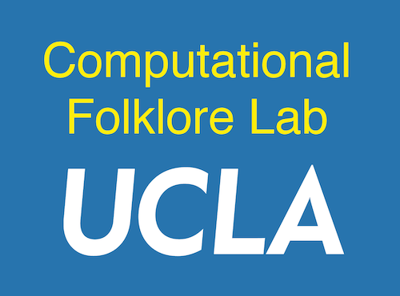
Collaborative project
Meertens Instituut, Amsterdam, Netherlands (Theo Meder)
Uni-Rostock, Rostock, German (Holger Meyer, Christoph Schmitt)
UCLA, Los Angeles, USA (Timothy Tangherlini)

Slide 4
Motivation
Predicated on the notion that Folklore is one of the first “big data” fields in the Humanities, given its focus
on the data-driven analysis of
millions of variants of informal expressive culture
that circulate on and across social networks
Folklore has been collected and archived throughout the world
Provide access
Support research into similarities and differences in archival collections of expressive cultural traditions, to support studies
across broad geographic distributions
across broad range of linguistic diversity

Slide 5
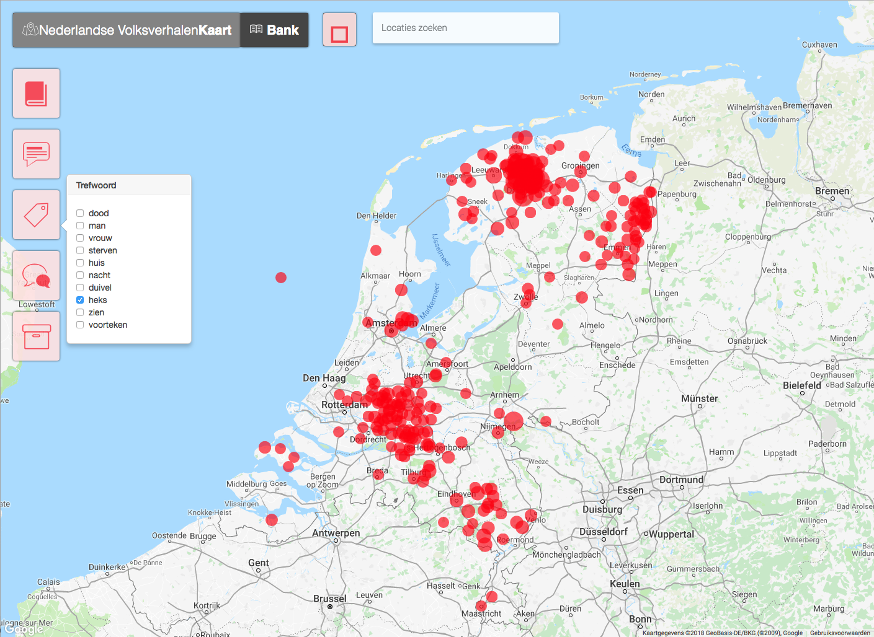
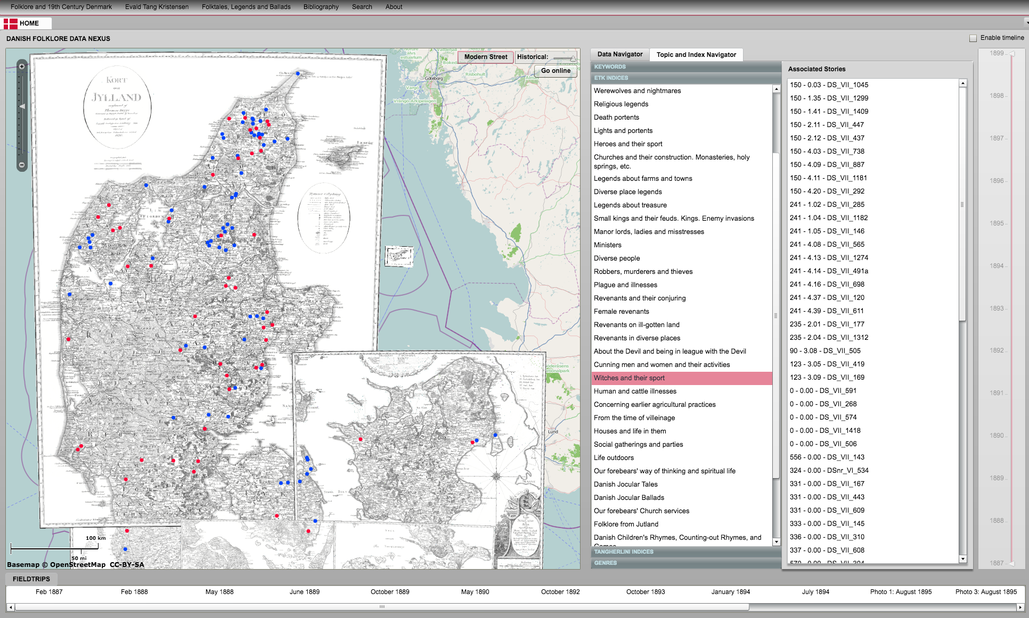

Slide 6
Main Tasks
Understand the existing data structures
Develop a harvester to integrate minimal representations of data
Develop a method for searching across multiple languages
Integrate results with:
Analytic approaches (WitchHunter, TreasureX, TrollFinder, ElfYelp)
Visualize the results in an engaging manner
Allow for user defined research sets for download

Slide 7
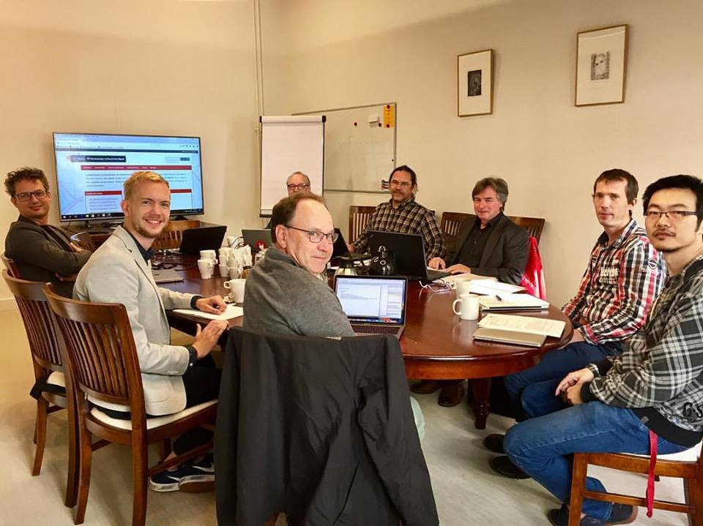
Great team
We have three different areas of expertise
Meertens
infrastructure, databases, production level code
Dutch, Flemish, dialectology
Sustainability
Uni-Rostock
Hypergraph modeling, search optimization, database integration
German and German dialects
UCLA
Multi-lingual search, hGIS, mapping algorithms, text modeling
Danish and other Nordic languages (Icelandic, Norwegian, Swedish)

Slide 8
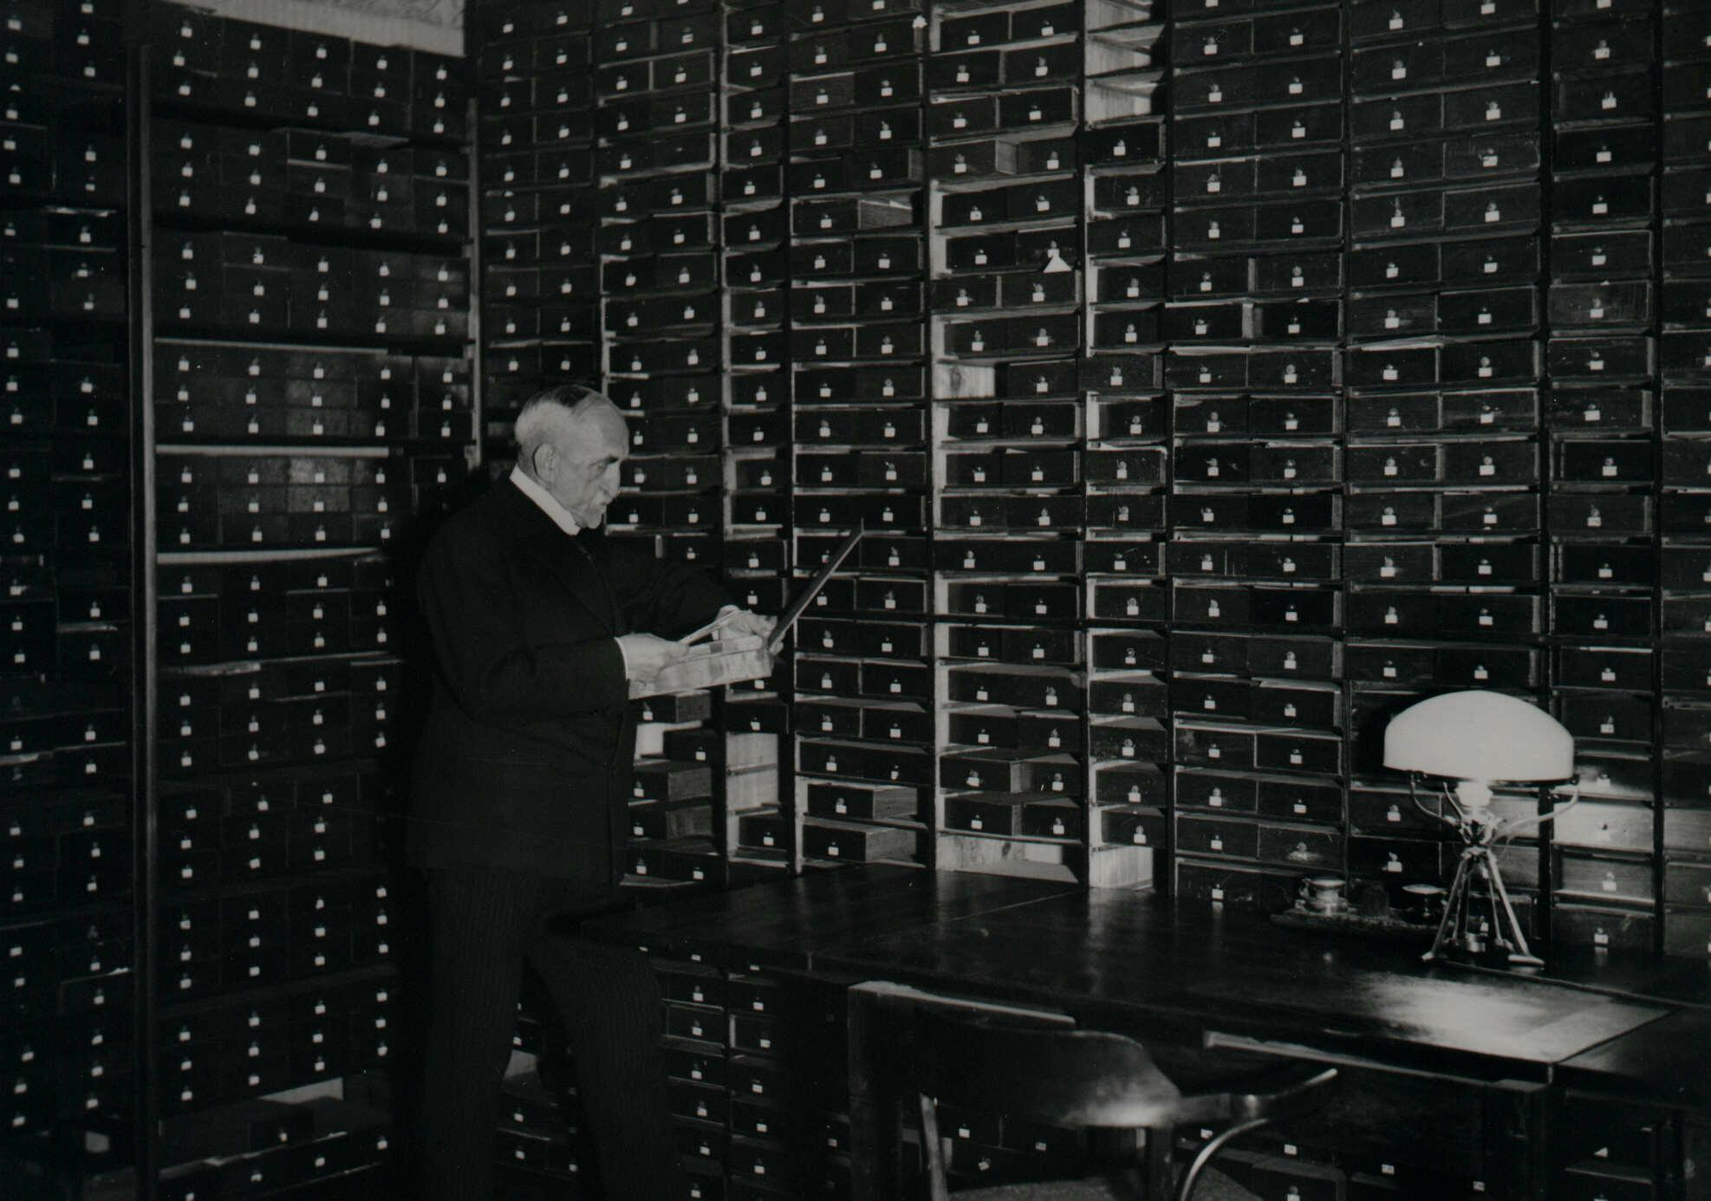
For example…
Richard Wossidlo‘s collection of research notes (1934)

Slide 9
Great range
of topics
and genres

Slide 10
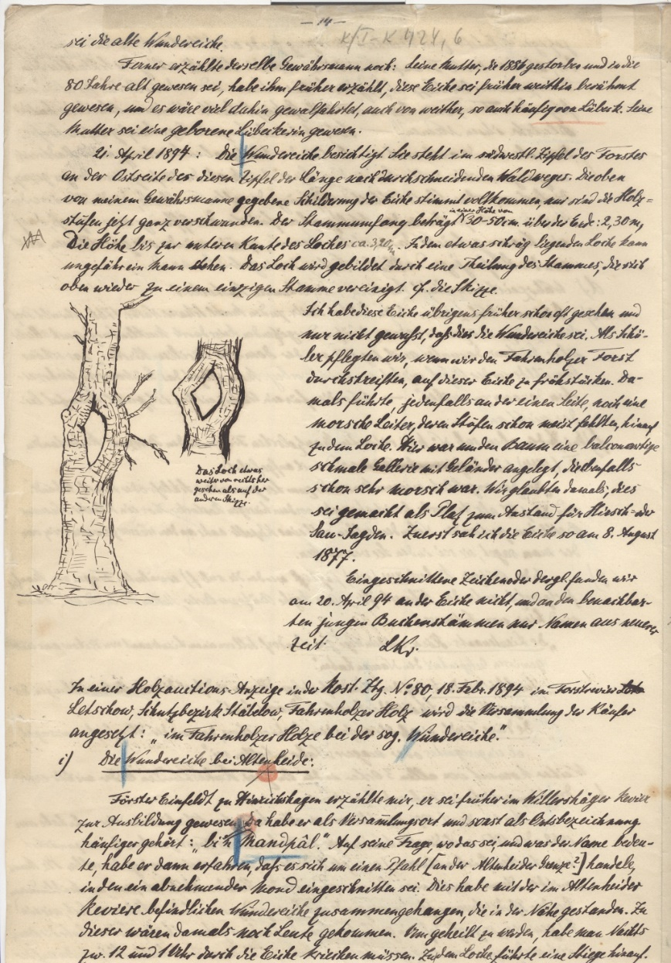
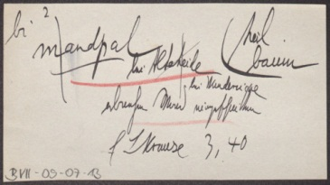
Diversity of collecton
Excerpted by Wossidlo
Notes of a correspondent

Slide 11
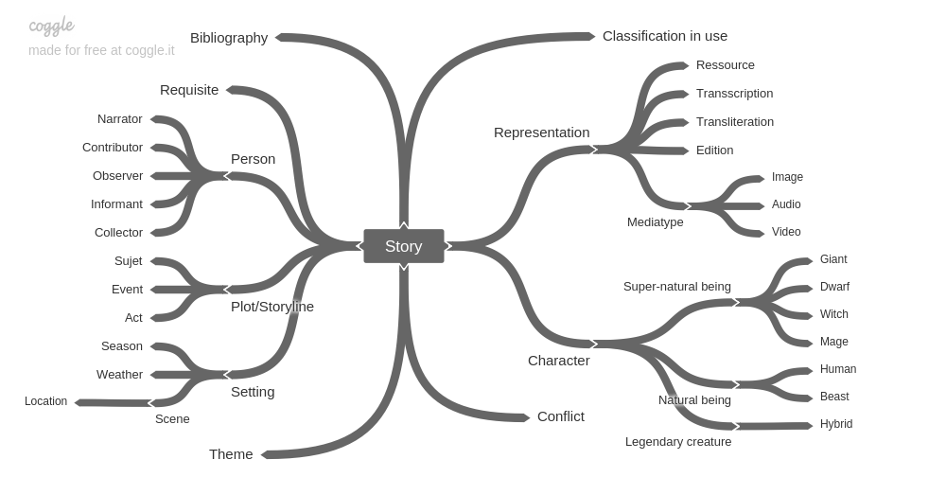
Current status: story and story data

Slide 12
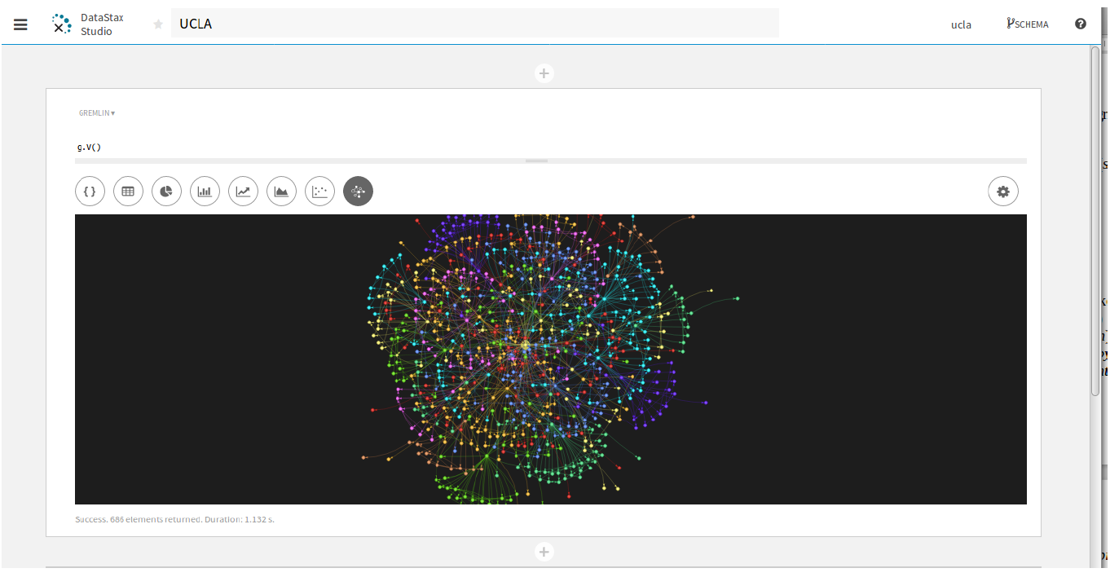
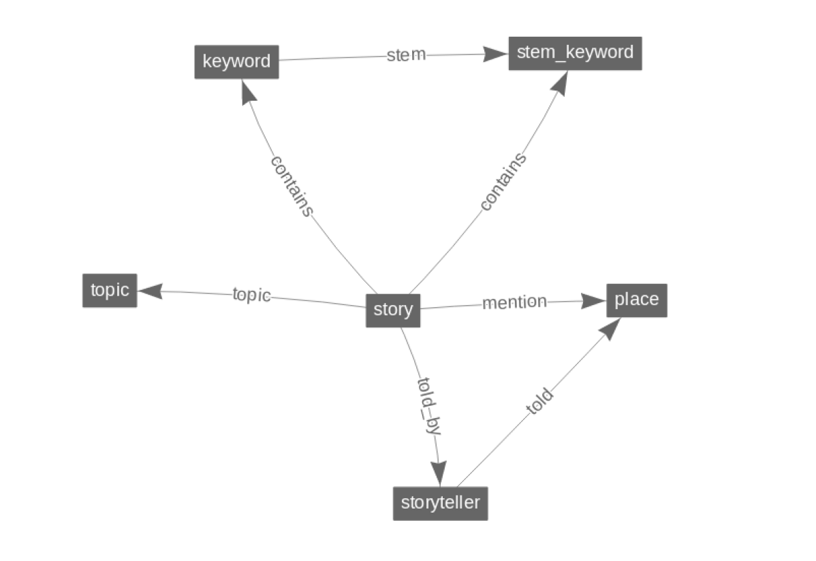

Slide 13
Integration Process
Global Conceptual Schema (GCS)
Integrated Schema from all local data sources
Data model used is the hypergraph model
Intermediate Schemas (InS) for each local data source
Local data has to be expressed using the global model
Translation from local schema (and local model)

Slide 14
The Hypergraph Model
Node types
Represent basic facts, metadata,
e.g. persons, places, events, keywords, descriptors ...
Have a set of attributes
Hyperedge types
Represent relationships among a set of nodes, e.g. field notes, narratives, reports, news coverage
Have a set of attributes
Are directed, mapping of incoming to outgoing node sets
Flexible with relaxed constraints , i.e. content model (sequence, alternative, occurences)
Basic data types for the attributes of a node (and hyperedge): Text Date, Boolean, Integer, ...
In the Relational Model
Node types analogon
Tables for entities
primary keys identfying entities
Hyperedge types analogon
tables for relationships
primary foreign key references connecting entities

Slide 15
Minimal datasets for sharing
Baseline facts about: persons, places, events, references/literature, keyword/descriptor/term/lemma/index entry, …
Strategy Bottom-up:
compose from micro formats,
LOD Linked Open Data as much as possible
e.g. dataCite, unqualified/qualified DublinCore

Slide 16
OAI - PMH
Protocol to harvest different data sources
Data Provider interface for each folktale database
Exports local schema in the hypergraph model
Local Export Schema:
Describes internal schema [relational model] with global model [hypergraph model]
Tranforms local data to external global representation

Slide 17
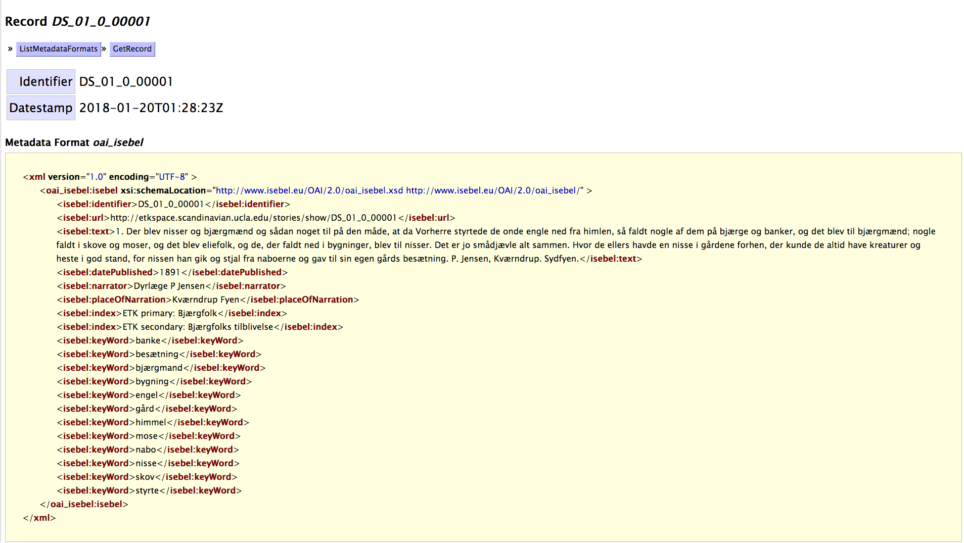

Slide 18
(AC)
(OF)
Power
Graph
GraphMining
Global Data Schema (full ISEBEL)
Modeled
With
Data
Model:
Hyper
Graph
OAI – PMH
(OF)
OAI – Service Provider
(AG)
OAI – Data Provider
WossiDiA
OAI – Data Provider
Dutch Folktale
OAI – Data Provider
Danish Folktale
Local Export Schema
(WossiDiA)
Local Export Schema
(Dutch Folktale)
Local Export Schema
(Danish Folktale)
(AC)
WossiPG View (WossiDiA PowerGraph)
WossiDiA
Digital Archive

Slide 19
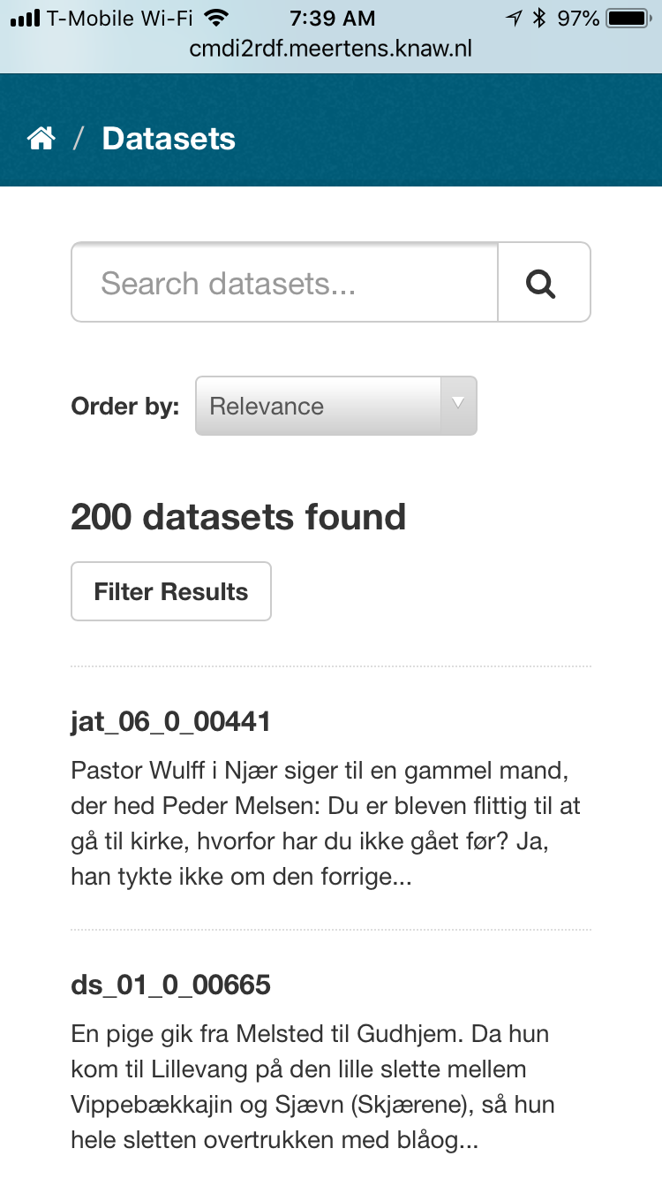
CKAN and harvested data

Slide 20
Multilingual search
Full-text search based on translations of each story
For each story in target language L, we generate a dirty translation D into each of the other ”search” languages, S (Danish, Dutch, German)
These are then indexed using the native indexing in the db system
A full text search in any language S returns stories in each of the target languages based on the search of L and D₁ and D₂
“Dirty translations” are generated using Google NMT
We intend to locate models locally at UCLA and run these locally instead of in the cloud on a GPU machine specifically designed for this
Domain specific terms
We have a series of highly specialized terms that are cross-translated by hand and added as an additional field to each story
Story A will have native ”special terms” as well as translations into each of the partner languages [this does not scale very well, although the number of terms is very limited ~400 per corpus]
White paper at https://git.informatik.uni-rostock.de/isebel/translation

Slide 21
Some examples: Our custom NMT
Original Story Phrase | Prior translation (Transformer) | Current Translation (Byte pair encoding) | Gold Standard
Så siger den fattige Mand , at han havde en Karl , der rimeligvis kunde begrave hende sådan , at hun skulde ikke komme igjen . | Then the poor man says that he had a farmhand who could bury her so that she wouldn ' t come again . | Then the poor man says he had a farmhand who could reasonably bury her so that she shouldn ' t come again | Then the poor man says that he had a farmhand who probably could bury her so that she wouldn ' t come back .
Bjærgfolkene i den bakke havde også undertiden deres linned ude . | The <unk> in that hill also sometimes had their <unk> out . | The mound men in that hill also sometimes had their linen out . | The mound dwellers in that mound sometimes put their linen out .
Heksemesteren havde sagt ham , hvordan det vilde gå til . | <unk> had told him how things would go | The witch master had told him how it would go | The witch master had told him what would happen
Men en gang var bjærgfolkene , der boede i højen , blevne fornærmede på dem | But once <unk> , which lived in <unk> , was <unk> upon them | But once the mound dwellers lived in the mound , they were insulted | But once the mound folk who lived in the mound were offended by them
En karl traf en gang et par snoge , der spøgte , og slog da den ene ihjel . | A farmhand once took a couple of <unk> that <unk> and then killed one | A farmhand once took a couple of songs that ghost , and killed one | A farmhand once met a pair of grass snakes that were slithering about , and he killed one of them

Slide 22
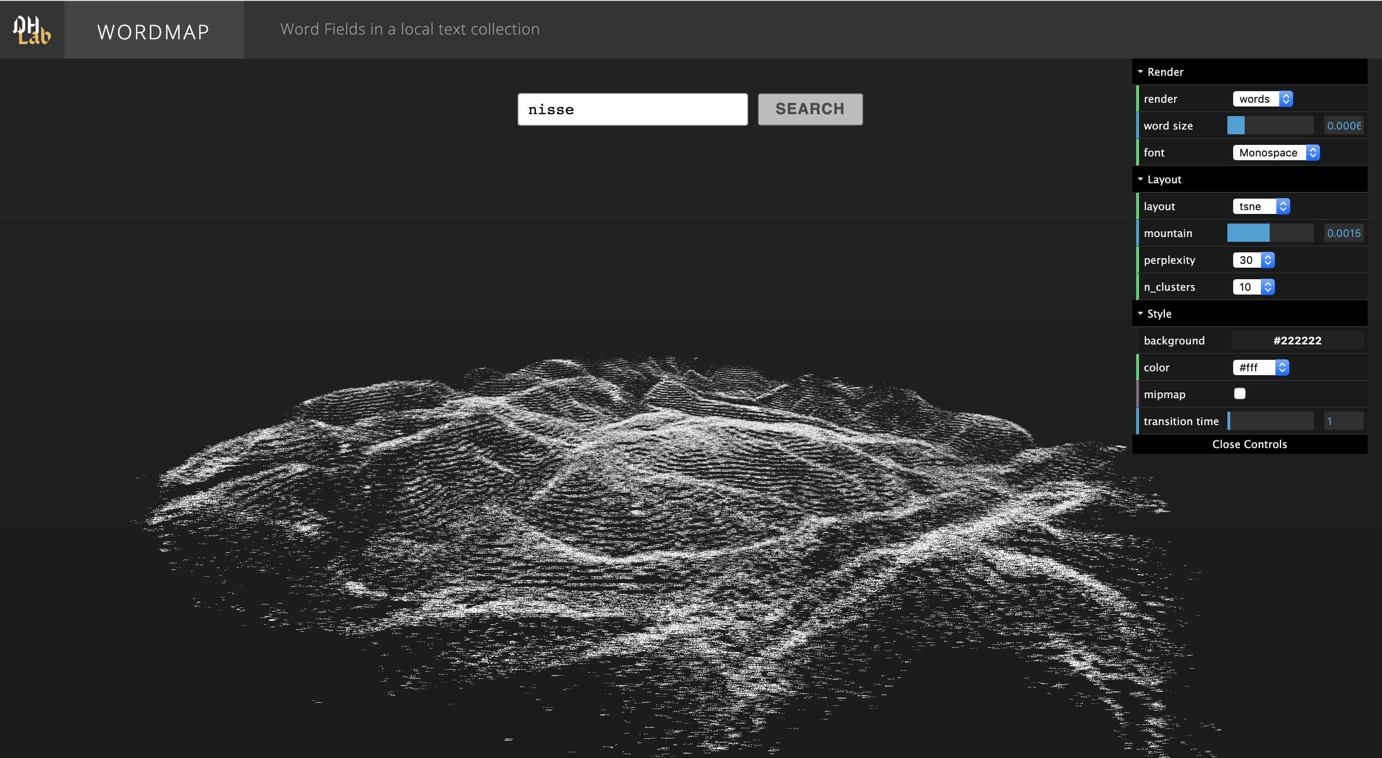
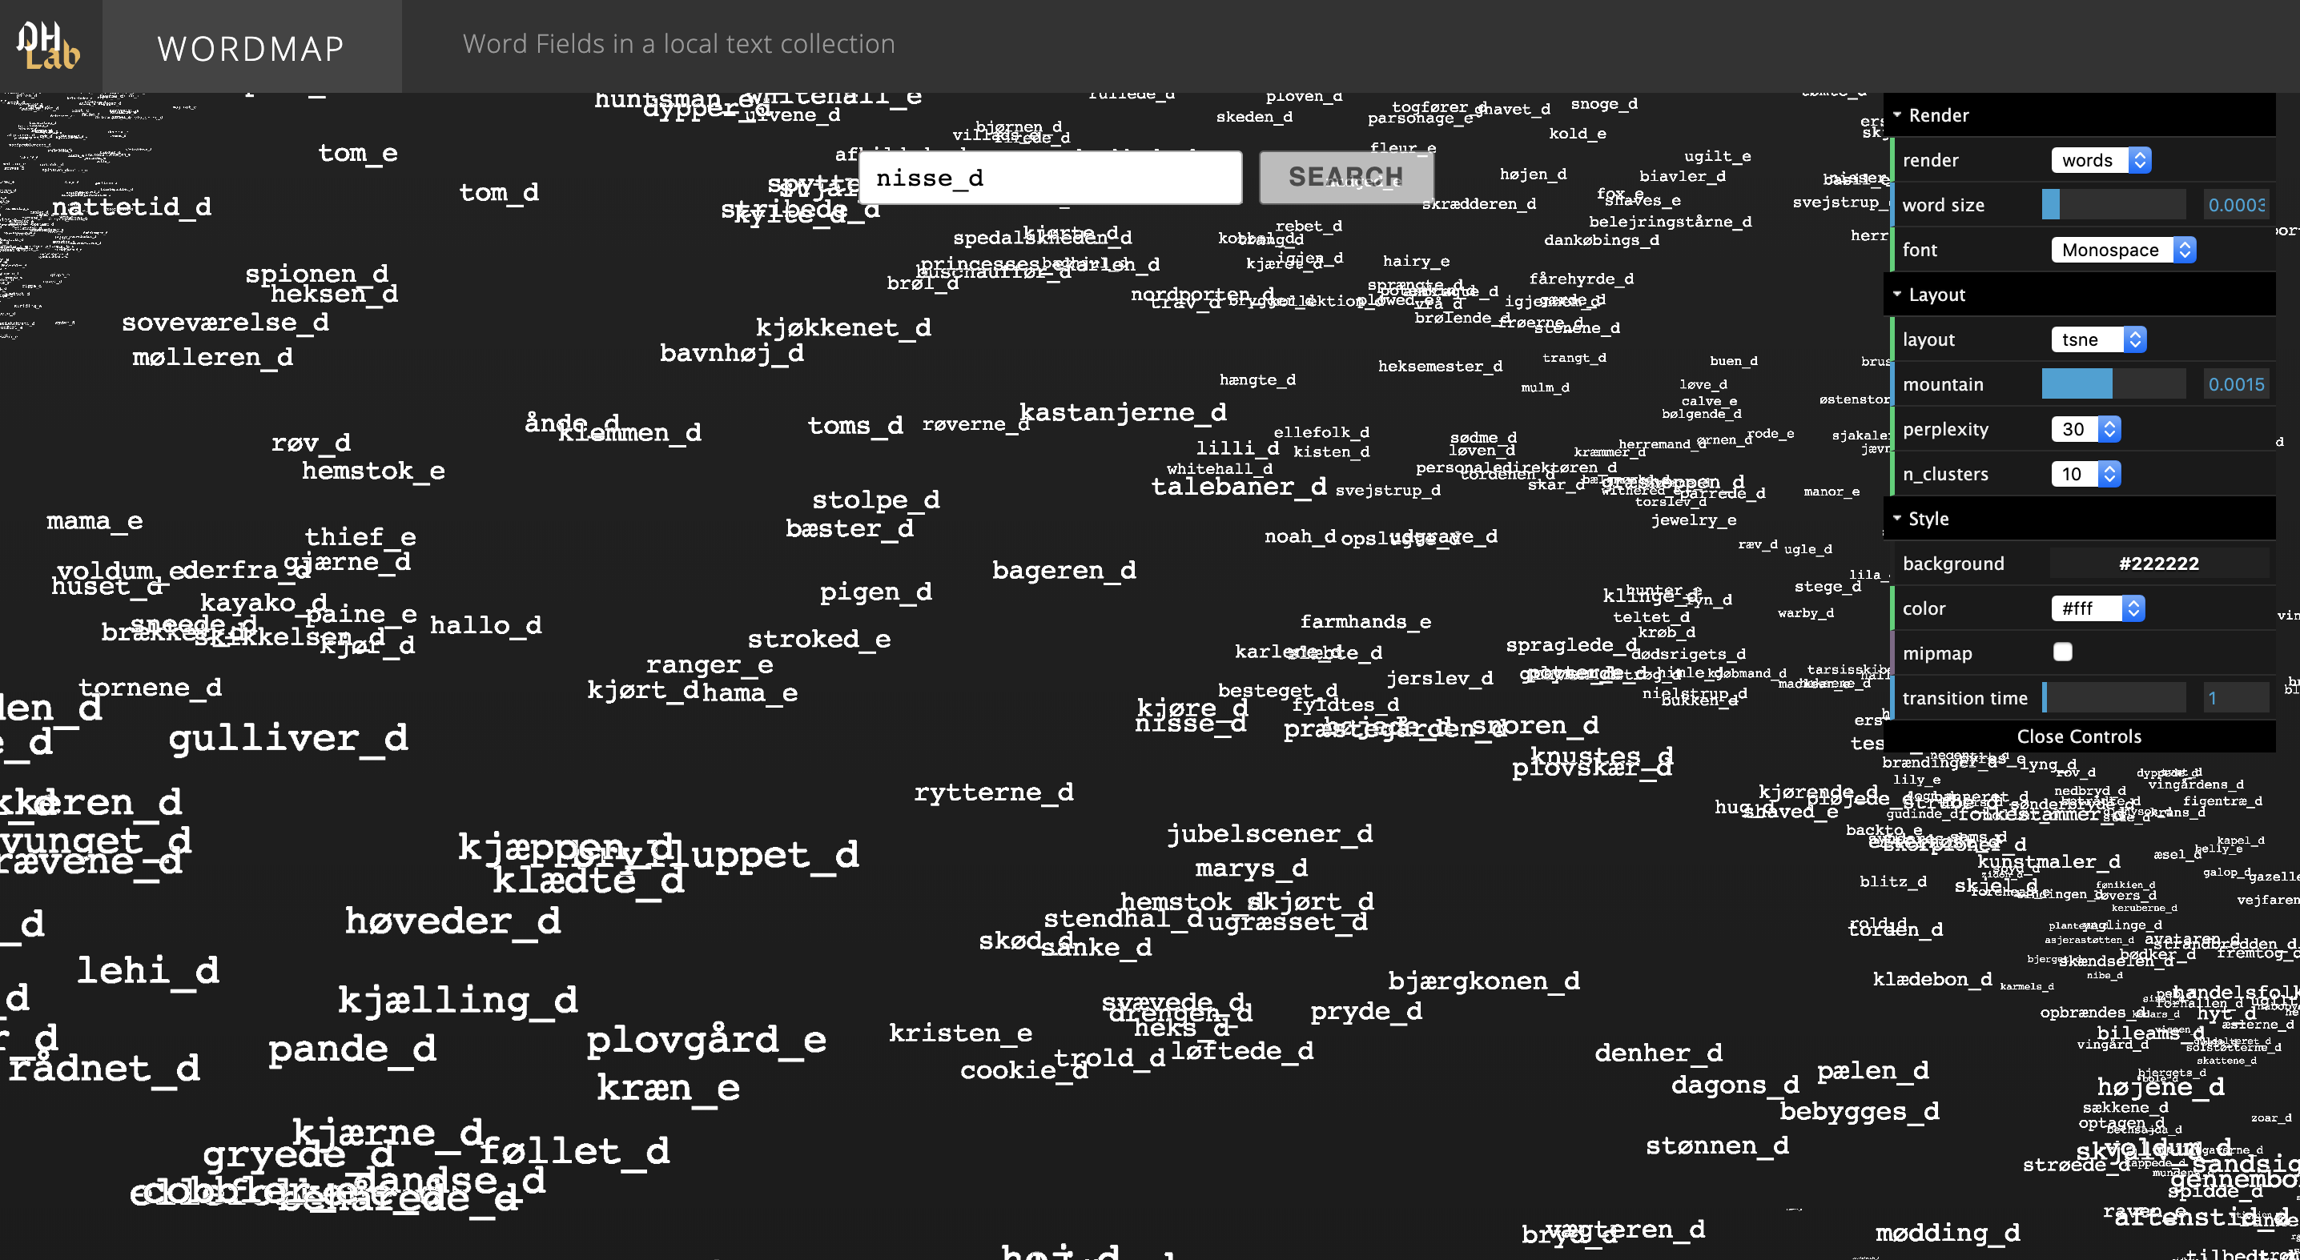
http://164.67.31.25/wordmap/

Slide 23
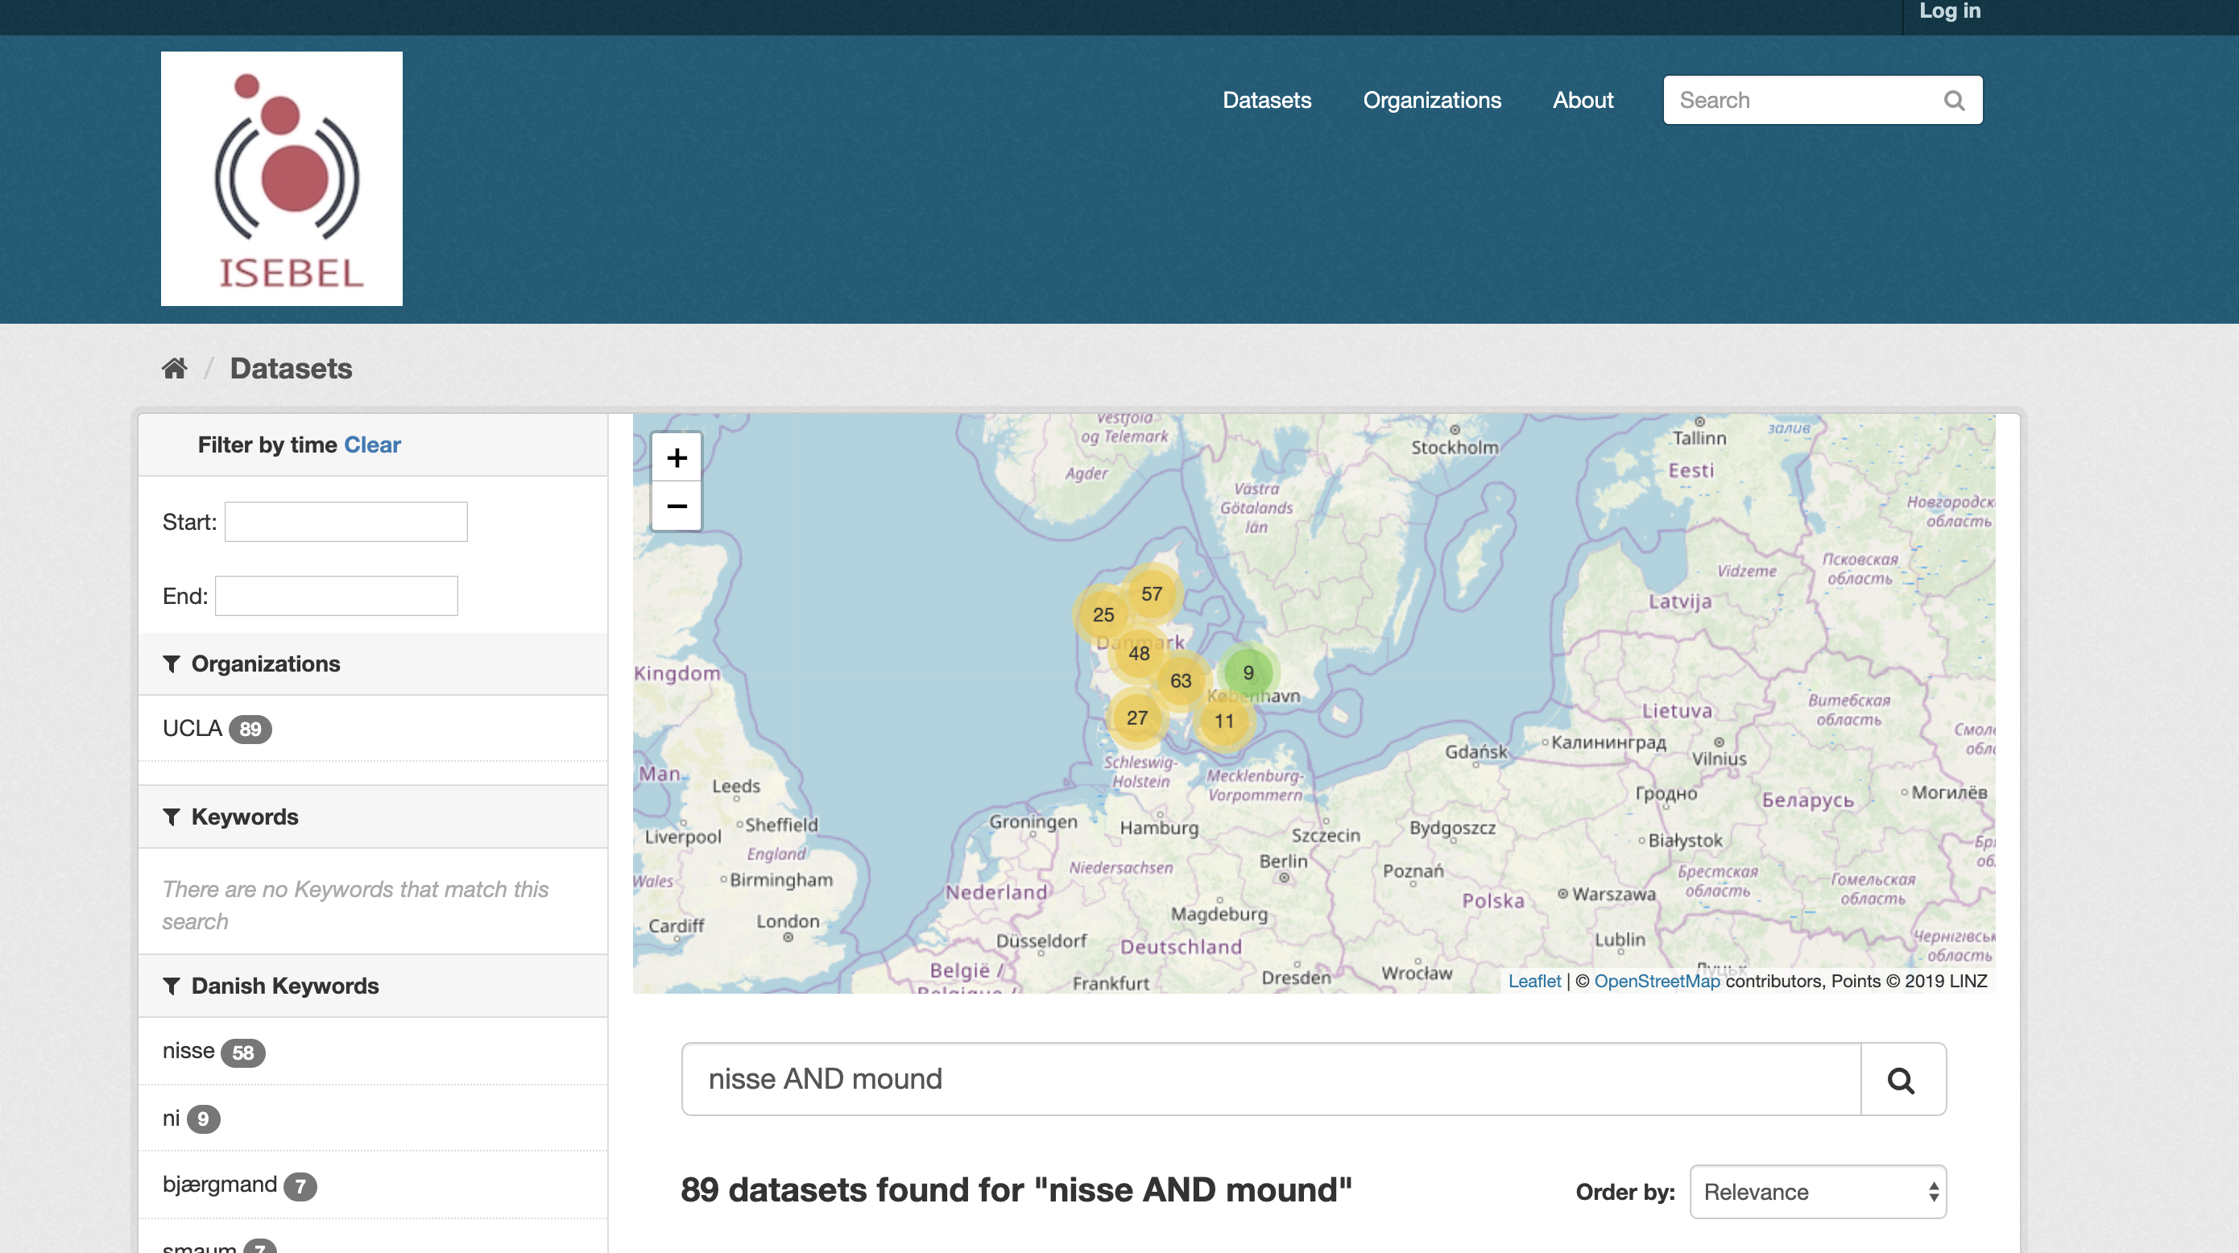
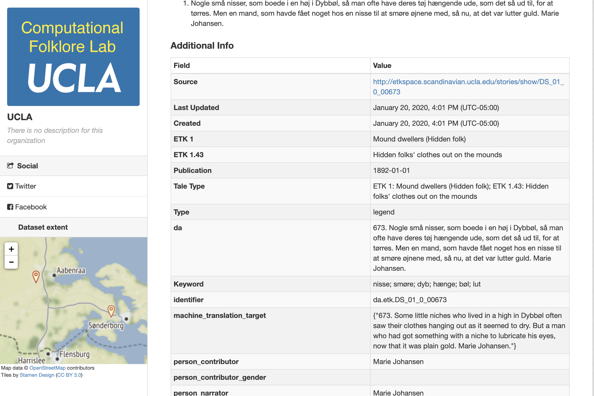
Multilingual Search Interface: Search in English
Search.isebel.eu
http://search.isebel.eu/

Slide 24
Current Work
Adding analytics layers

Slide 25
Analytics layer
Integrate the OAI-PMH results with
Visualization
Analytics

Slide 26
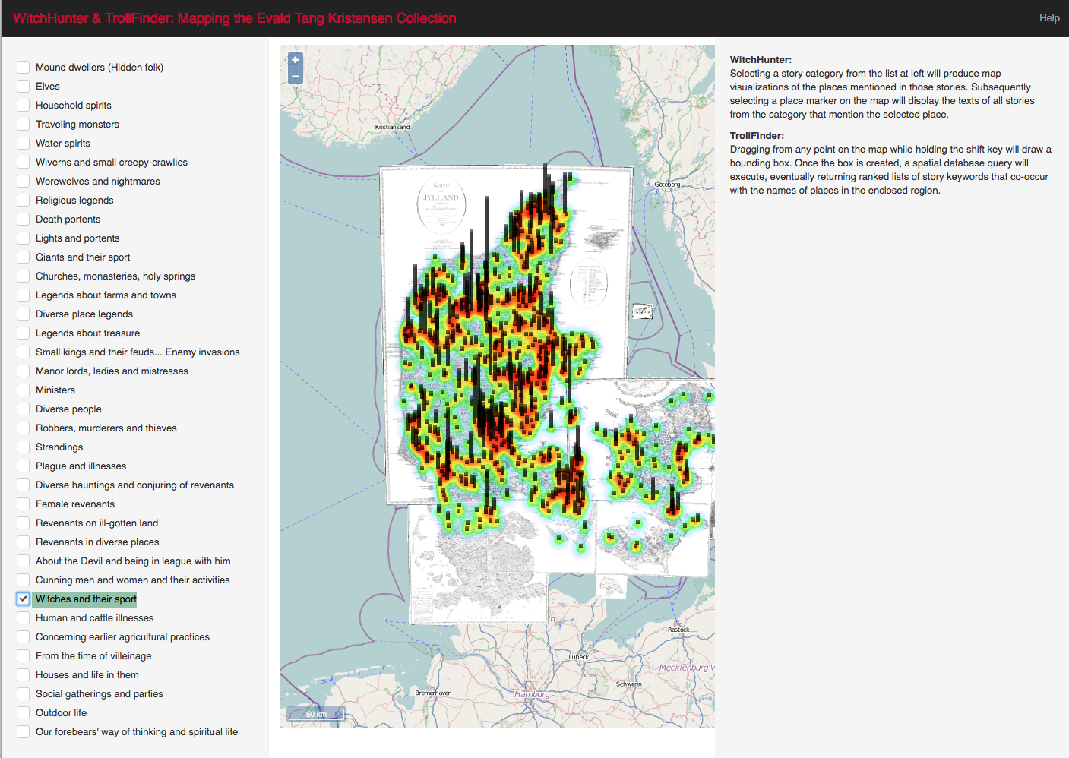
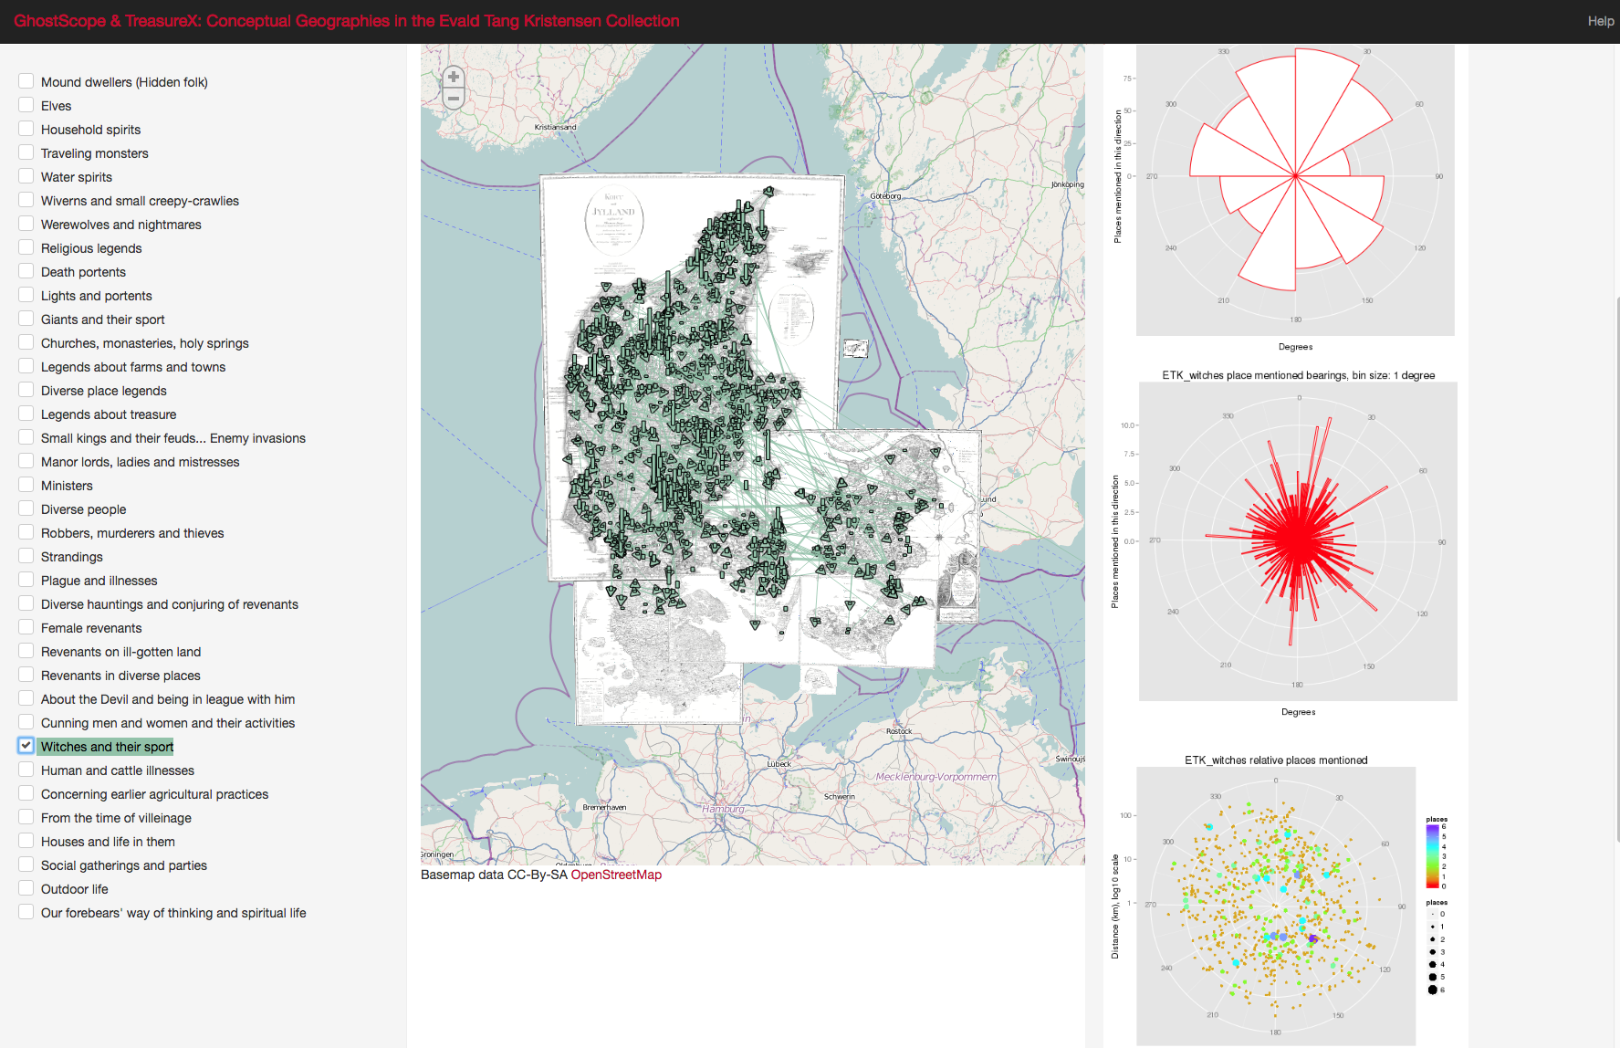
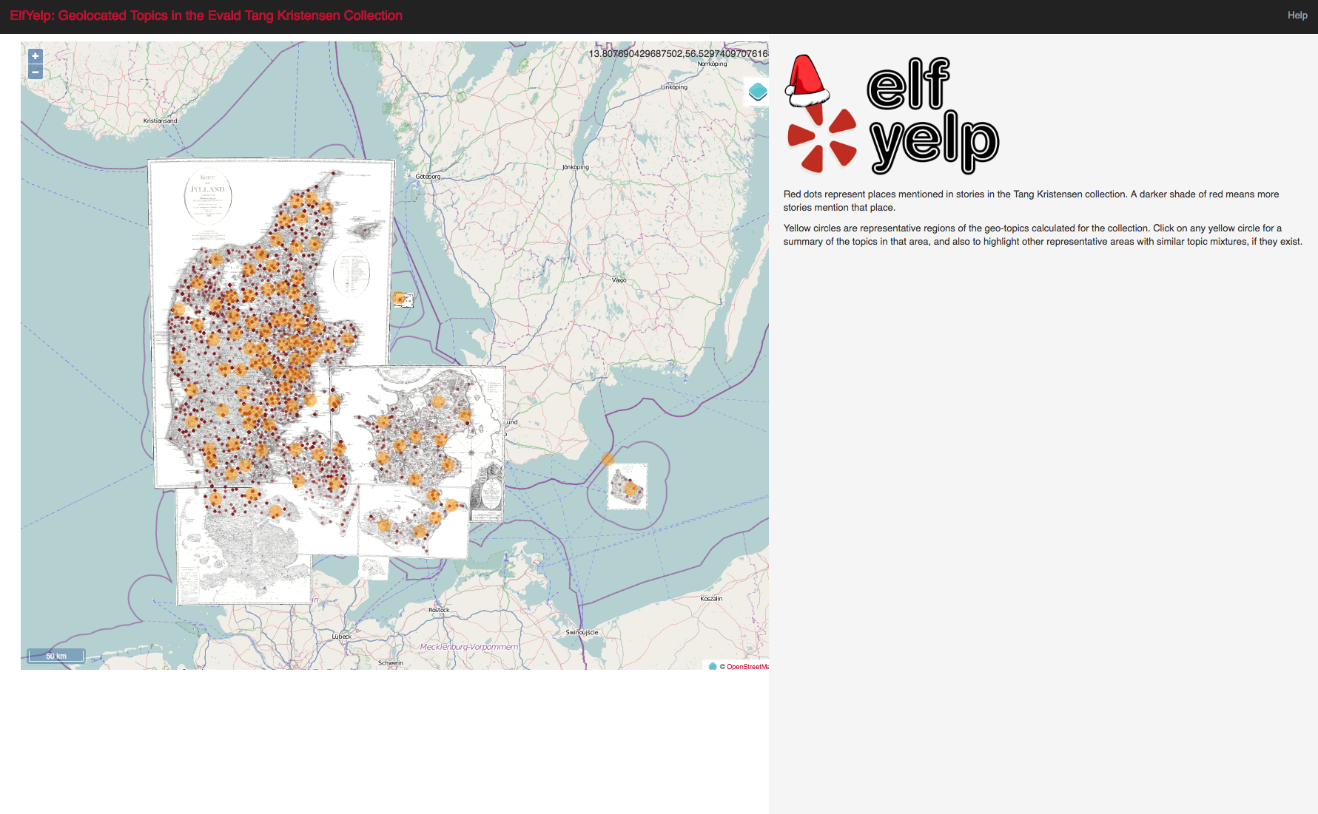
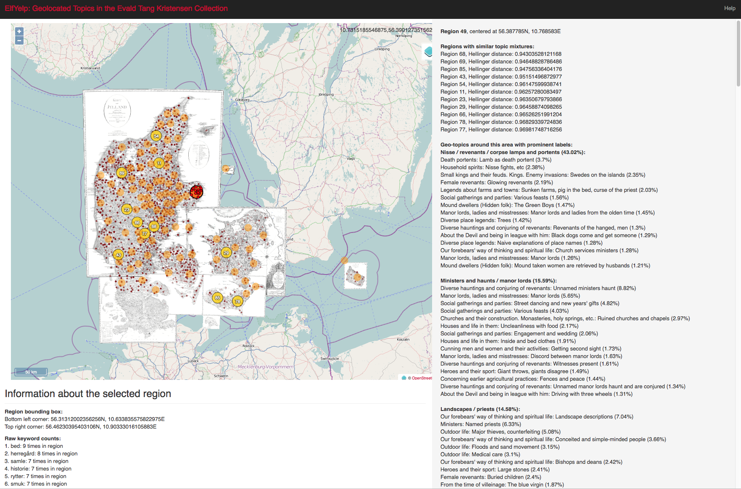

Slide 27
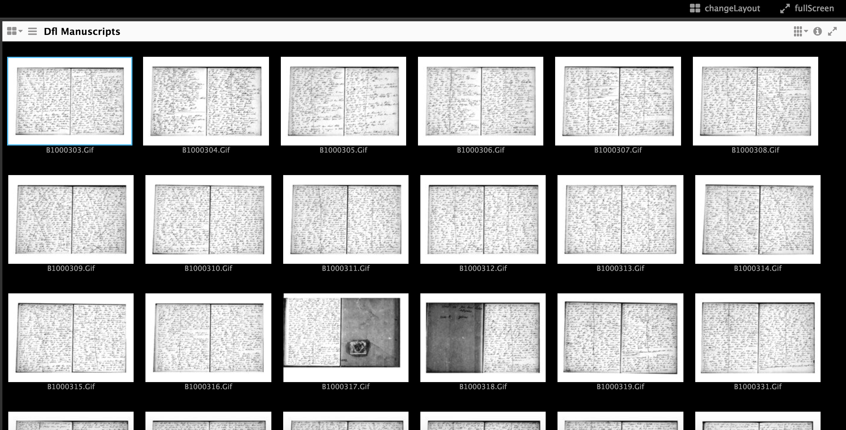
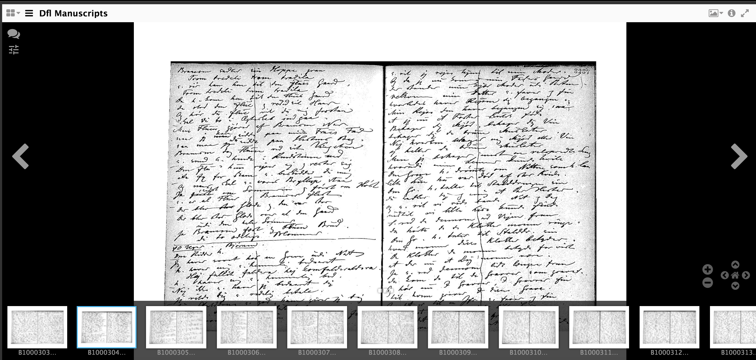
Desideratum:Mss and annotations in IIIF

Slide 28
Future directions
Integrate three other Nordic countries into the project:
Iceland: Sagnagrunnur
Norway & Sweden: Sägenkartan
Funding application to the Kungl. Gustav Adolfs Akademi
Recent funding from Norwegian Research Council (ca NKK28m)
Develop clear methods for other archives to expose their data to the harvester
Current collaboration with Finnish Literary Society
Agreements to work with Estonia, Latvia, Lithuania, Hungary and Greece
Arbitrary Search Language

Slide 29
Sustainability
Meertens Instituut, part of the Dutch Royal Academy of Sciences (KNAW)28, has an open-ended commitment to sustaining the ISEBEL main infrastructure
Individual collections and archives will need to keep their OAI-PMH nodes alive
Future challenges with user access as web technologies evolve in the 5-20 year horizon

Slide 30
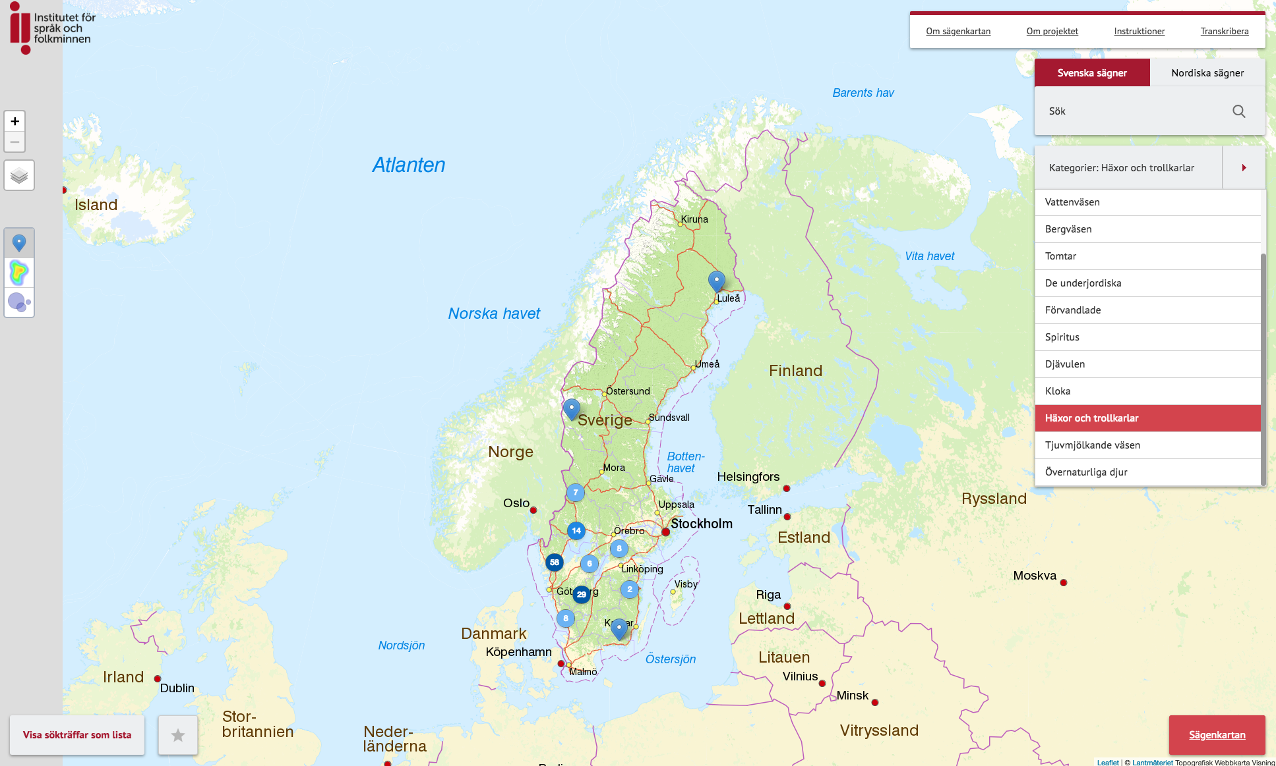
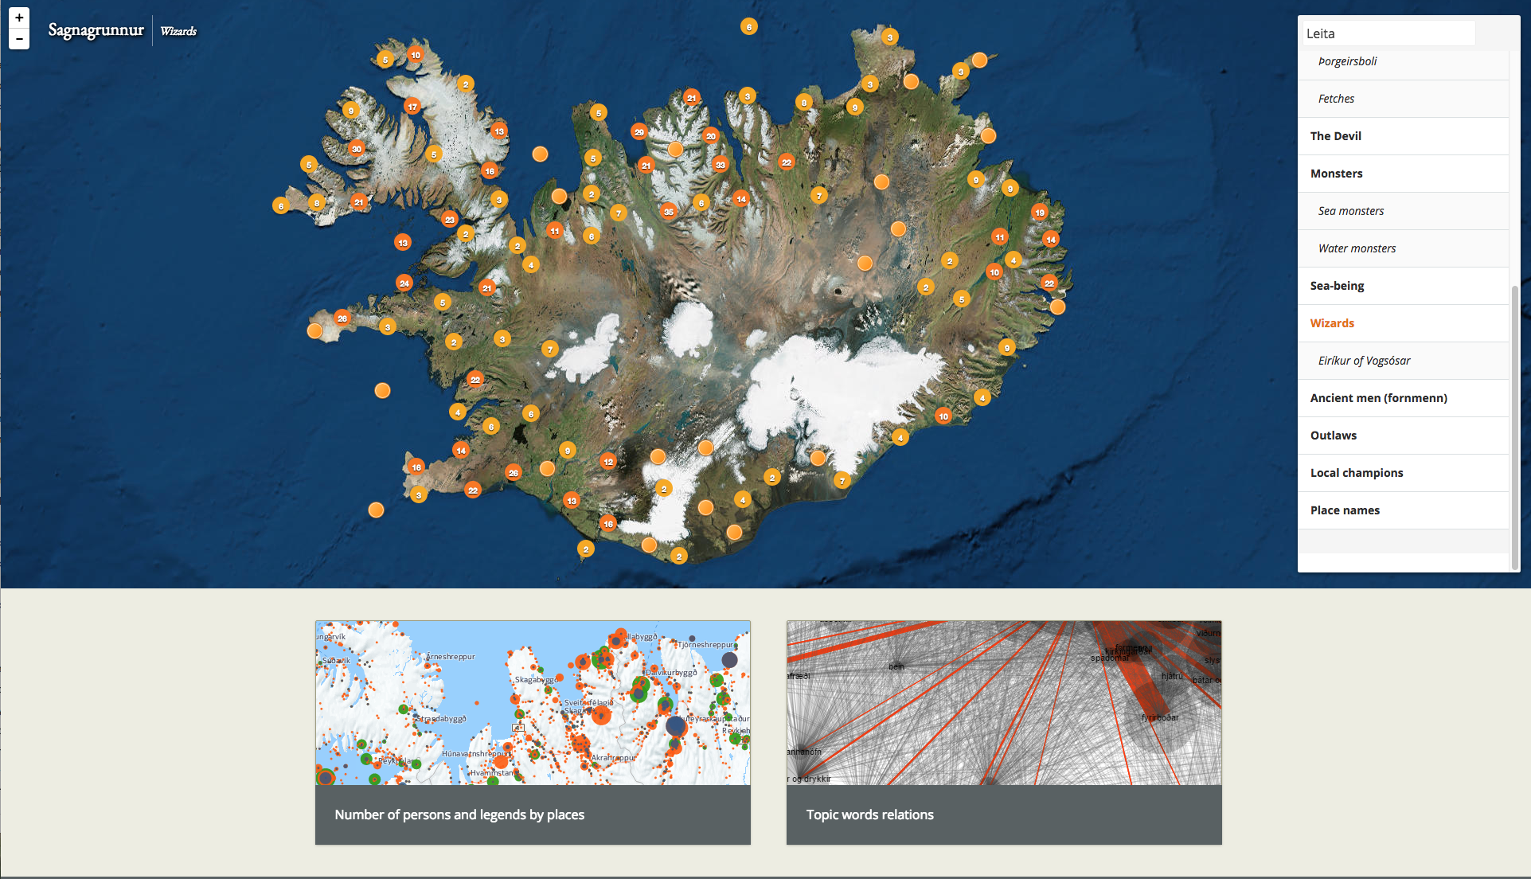
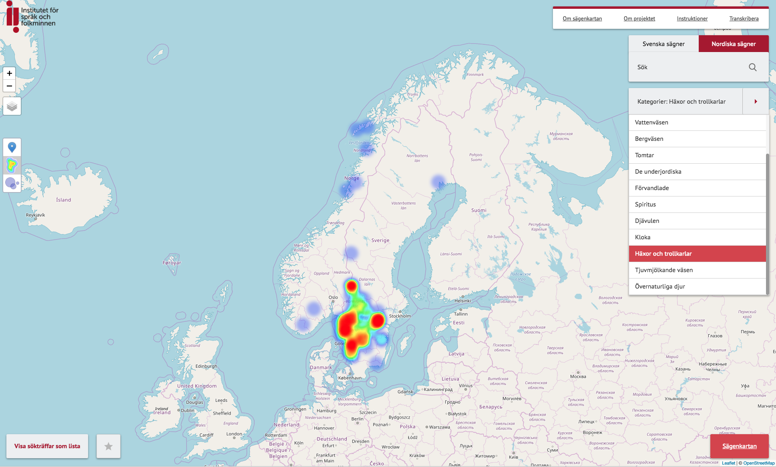

Slide 31
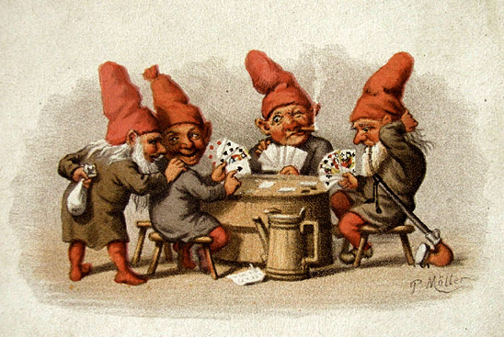
THANK YOU !

