Slide 1
Notes:
1

Slide 2
MMM Project Team
Oxford University (Oxford e-Research Centre and Bodleian Libraries): Toby Burrows (PI), David Lewis, Andrew Morrison, Kevin Page, Pip Willcox, Thanasis Velios, Graham Klyne
Aalto University (Semantic Computing Research Group): Eero Hyvönen (PI), Esko Ikkala, Mikko Koho, Jouni Touminen
Institut de recherche et d’histoire des textes (CNRS-IRHT), Paris: Hanno Wijsman (PI), Antoine Brix, Synnøve Myking, Guillaume Porte, Pierre-Louis Pinault
University of Pennsylvania (Schoenberg Institute for Manuscript Studies): Lynn Ransom (PI), Doug Emery, Mitch Fraas, Benny Heller, Emma Thomson

Slide 3
MMM Project Goals
Combine and transform data from at least three major public data sources
Expose the combined data in a Linked Open Data environment
Implement a software interface for browsing and searching the combined data
Visualize the data: relationships across time and space
Use the data to explore research questions relating to the history and provenance of manuscripts
Make the data and software available for reuse

Slide 4
MMM Project Results
Data models from three source datasets analysed to produce a Unified Data Model
Data from source datasets transformed to RDF, uploaded to the MMM triple store, and mapped to the MMM Unified Data Model
Vocabularies for five main entity categories reconciled across data sources
Public portal to the MMM triple store designed and built
Visualizations of the data implemented in the public portal
Evaluation via a Focus Group and a set of 25 initial research questions
Enhancements to the source datasets
Knowledge transfer across disciplinary groups (e.g., SPARQL)
Future directions and issues identified

Slide 5
MMM Project Products
Unified Data Model for manuscript history and provenance (derived from CIDOC-CRM and FRBR ontologies)
Conversion and transformation tools and pipelines
LOD vocabularies with identifiers for 214,000 manuscripts, 424,000 works, etc.
Public SPARQL endpoint to the MMM triple store (20.4 million RDF triples)
Public portal: browsing, searching, visualizations
Data export and downloads (from the public portal and a data repository)
GitHub site for tools, data, and documentation
Publications and presentations (35+)
Demonstration for the CERL Portal Working Group (February 2020)

Slide 6
MMM Data Sources
Medieval Manuscripts in Oxford Libraries | Text Encoding Initiative (TEI) XML documents | 10,000 catalogue records; more than 1,000 with detailed provenance information
Schoenberg Database of Manuscripts | Relational database - bespoke data model | 240,000 records containing provenance-related observations of manuscript histories
Bibale | Relational database - bespoke data model | 12,000 manuscript records with detailed provenance information

Slide 7
Data in RDB /
TEI XML
MMM Triple Store (RDF)
Public portal
Data in RDF
MMM Data Model
Reconciliation of vocabularies

Slide 8
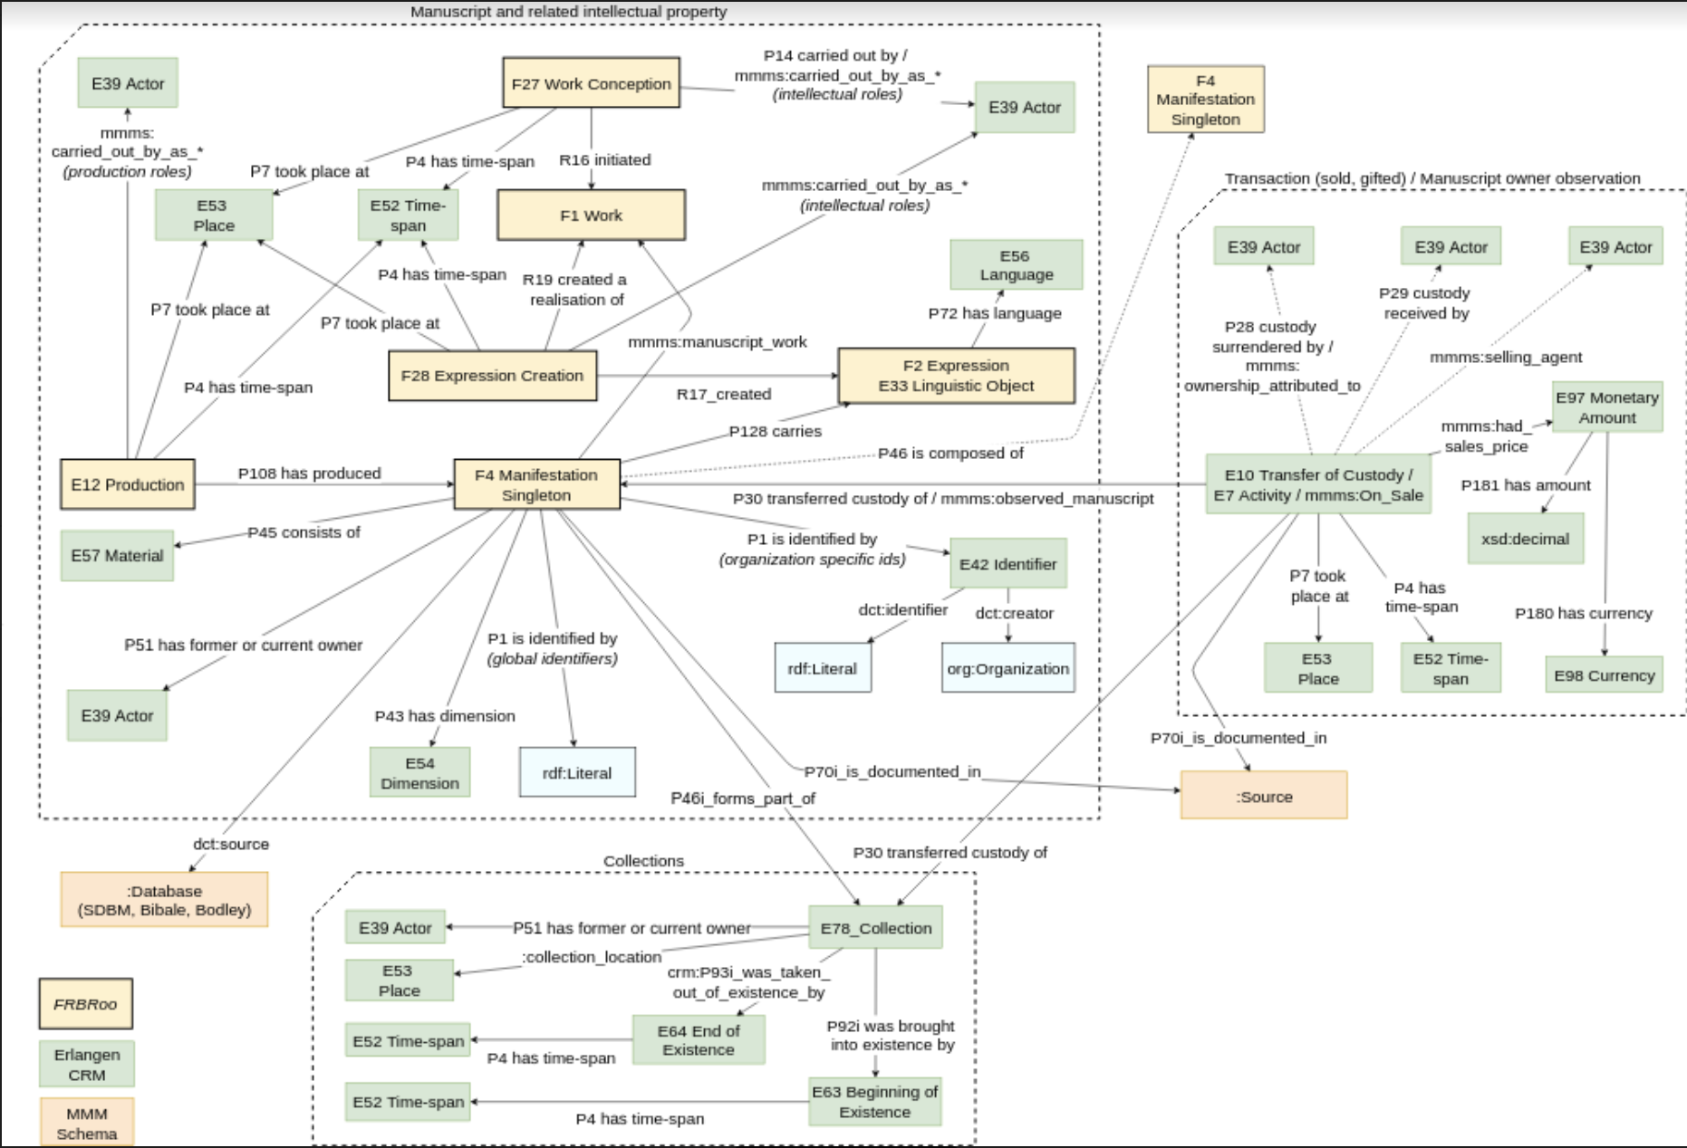
Notes:
8

Slide 9
Reconciliation: Vocabularies
Notes:
The main vocabularies being referenced by the source datasets
Works – Bibale also includes FAMA vocabulary
The reconciliation processes – automatic, semi-automatic, manual

Slide 10
What can you do with the MMM public portal?
Browse and search across entries for:
215,000 Manuscripts 424,000 Works 4,000 Places
946,000 Events 51,000 People & Organizations
Visualize the data on maps: places of production; migrations over time; last known locations
See the raw data behind the MMM interface
Explore the data directly with your own SPARQL queries
Export the data into your own software environment

Slide 11
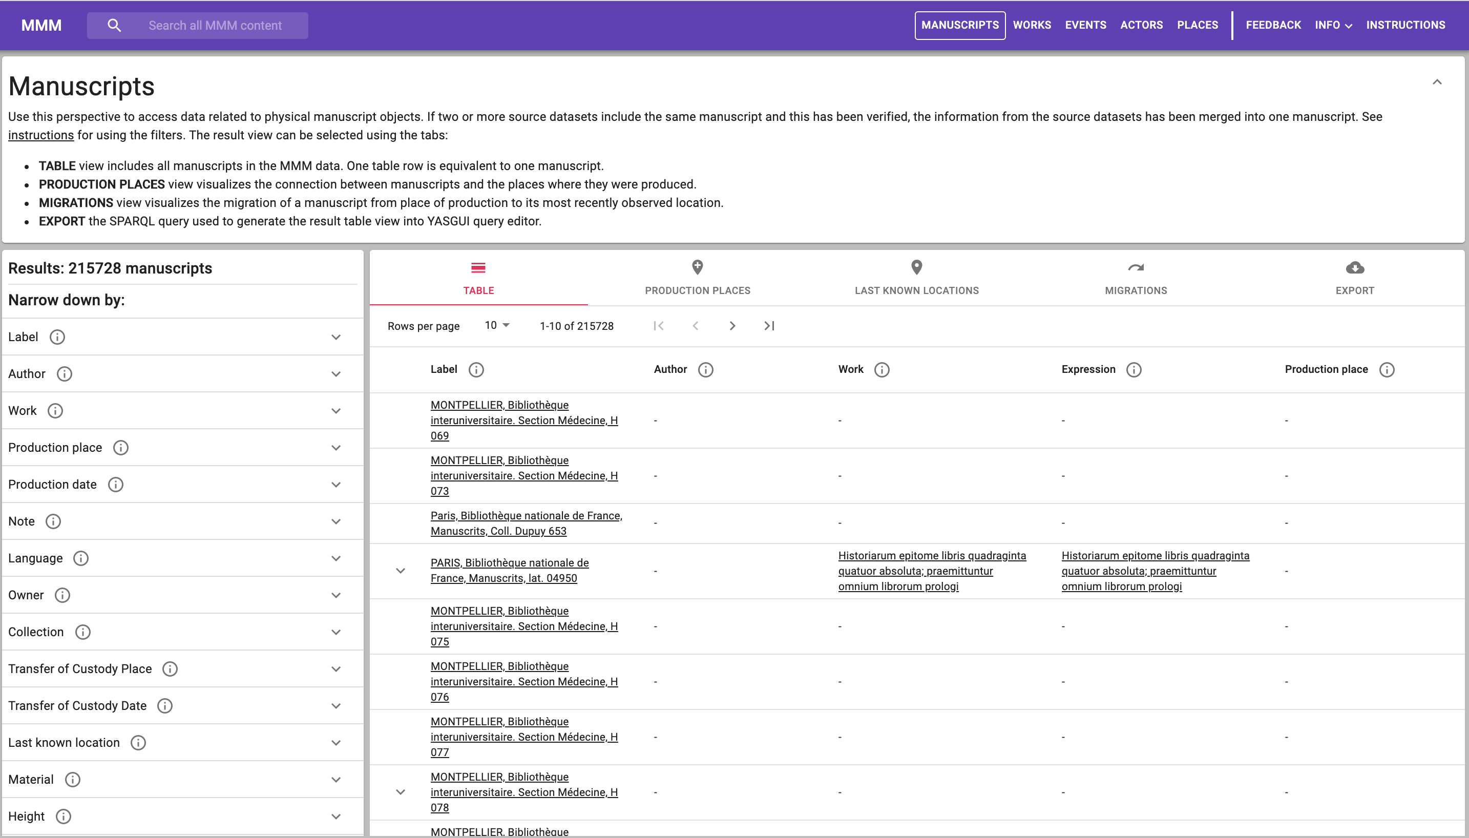
Notes:
11

Slide 12
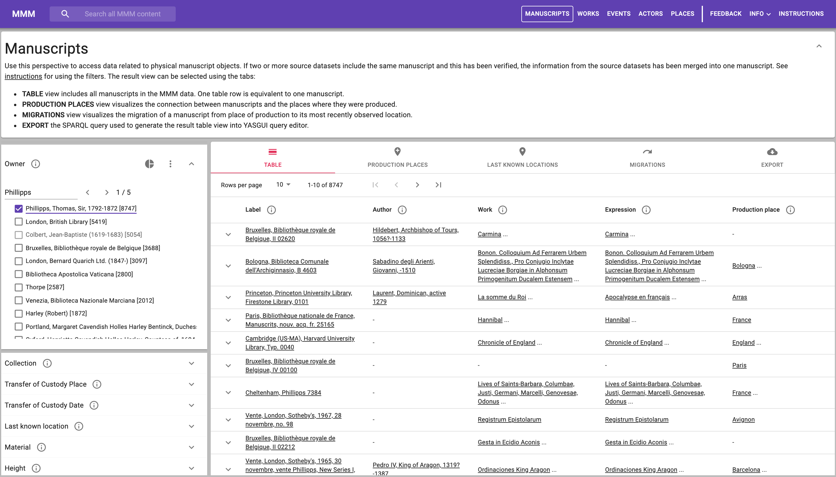
Notes:
12

Slide 13
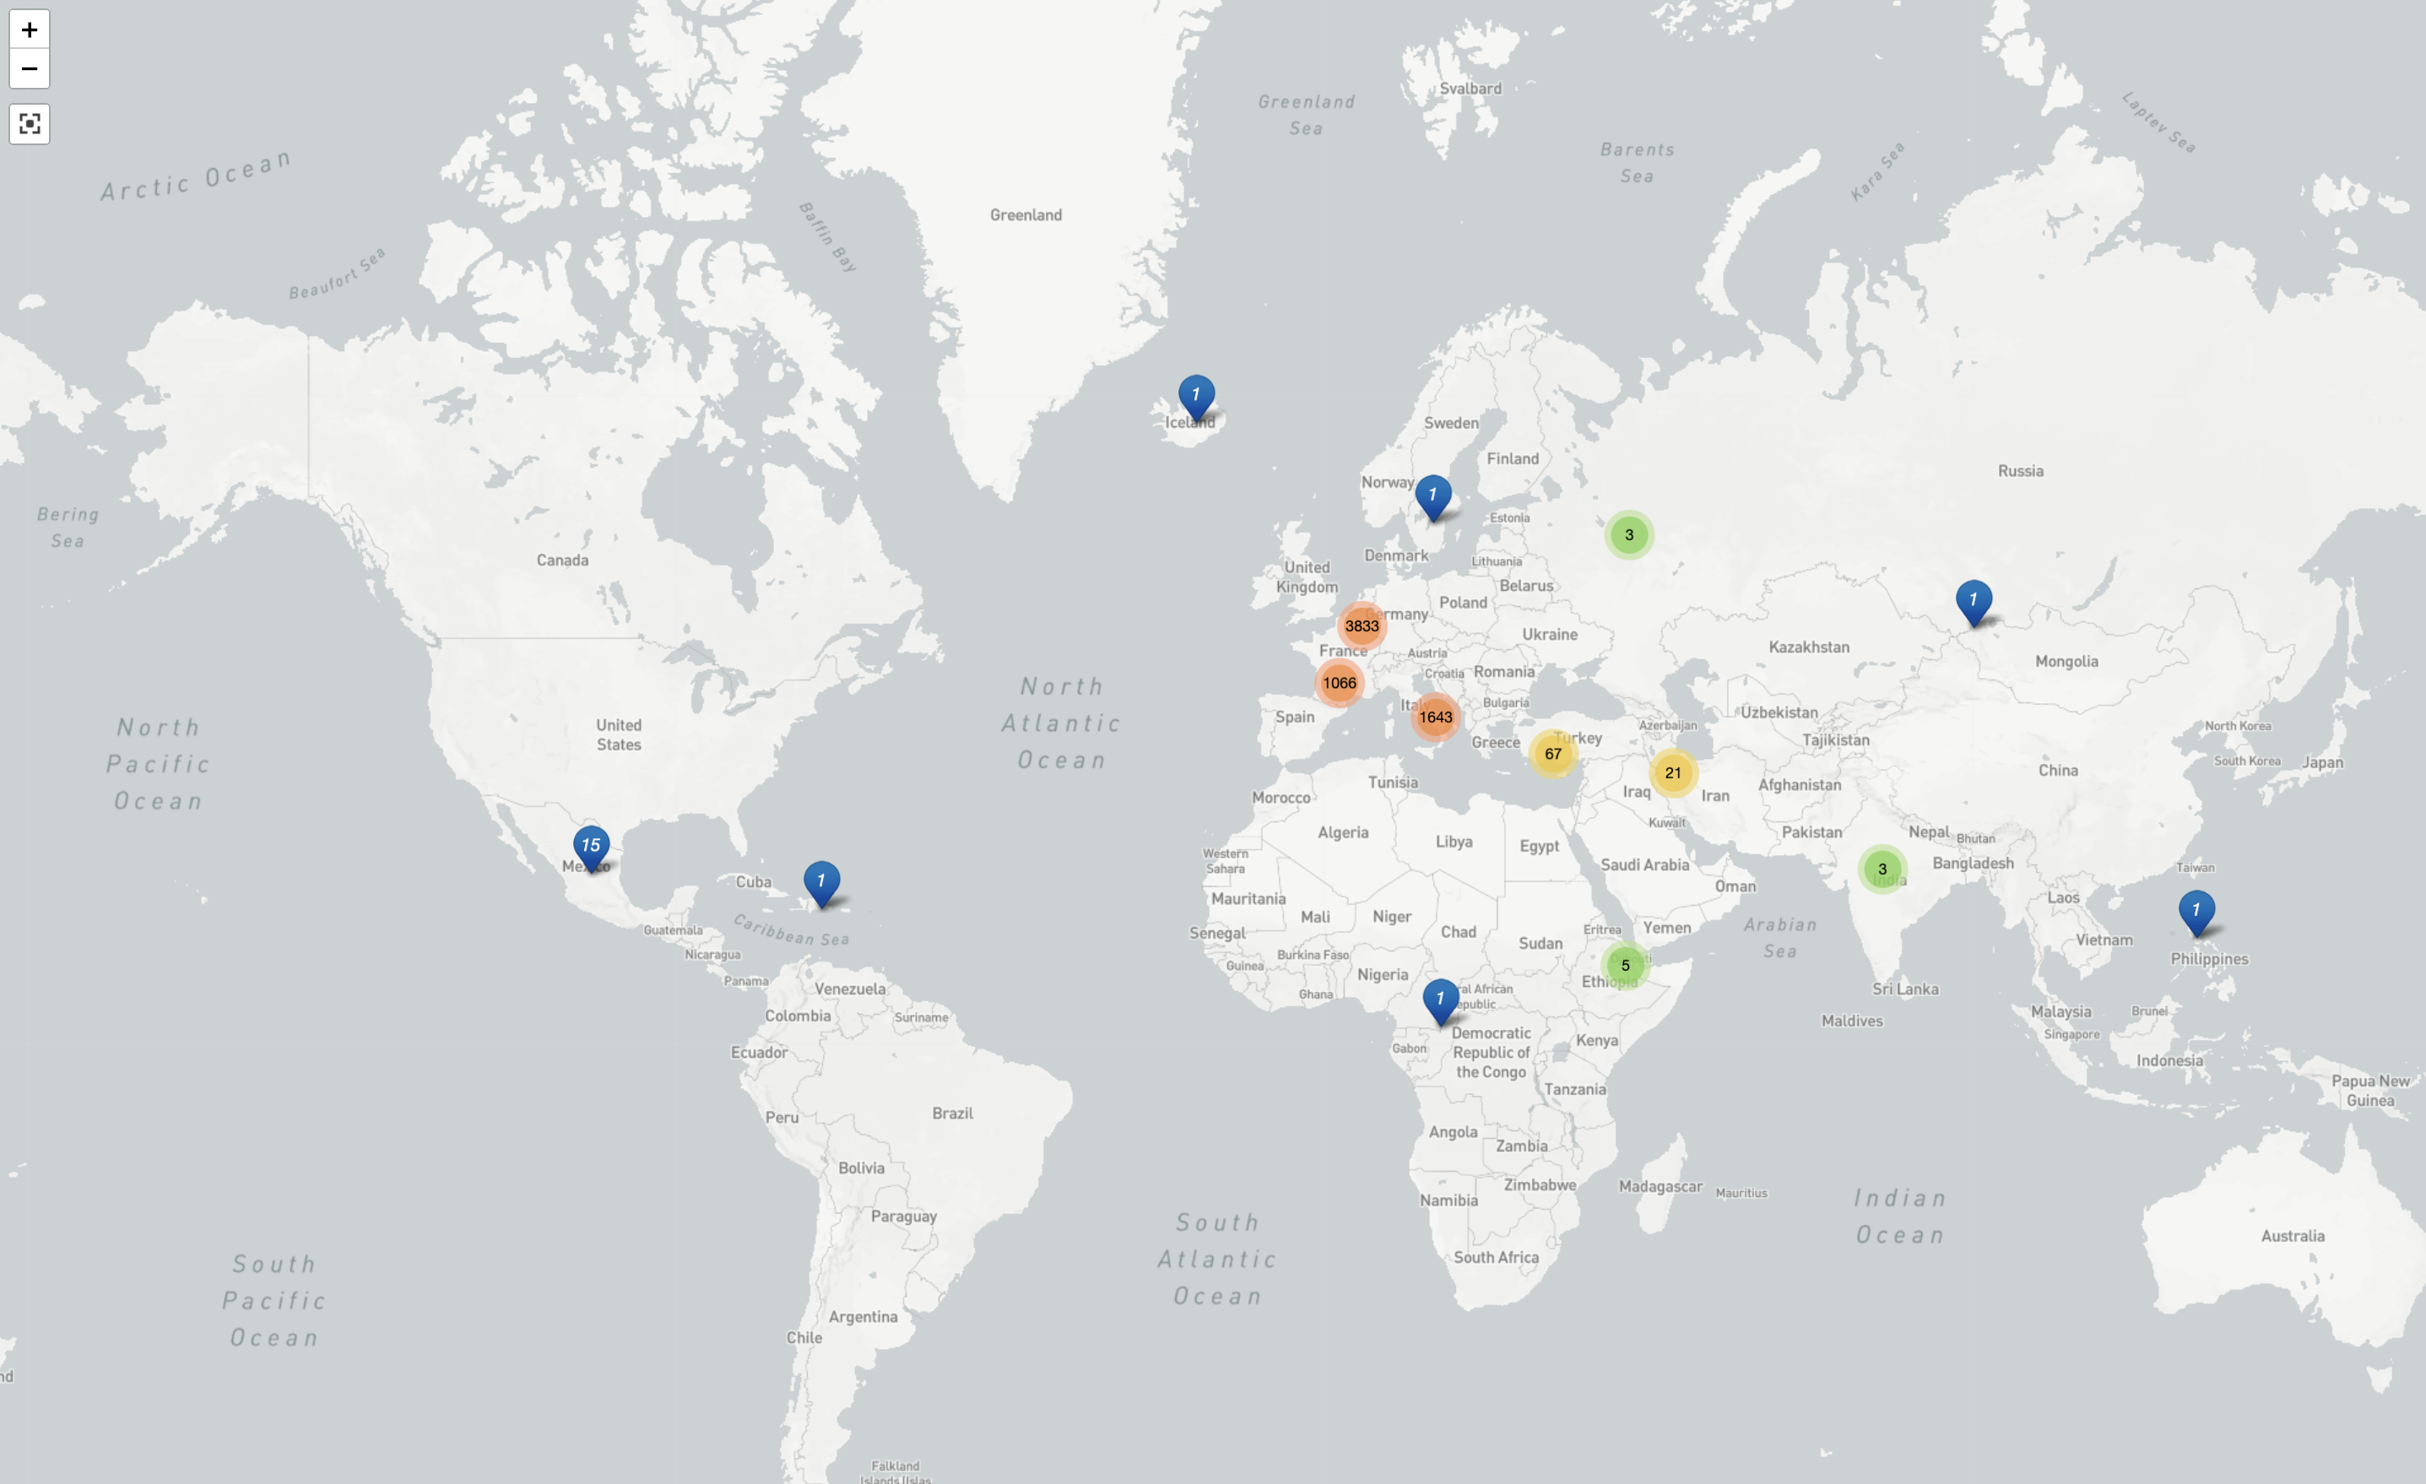
Notes:
13

Slide 14
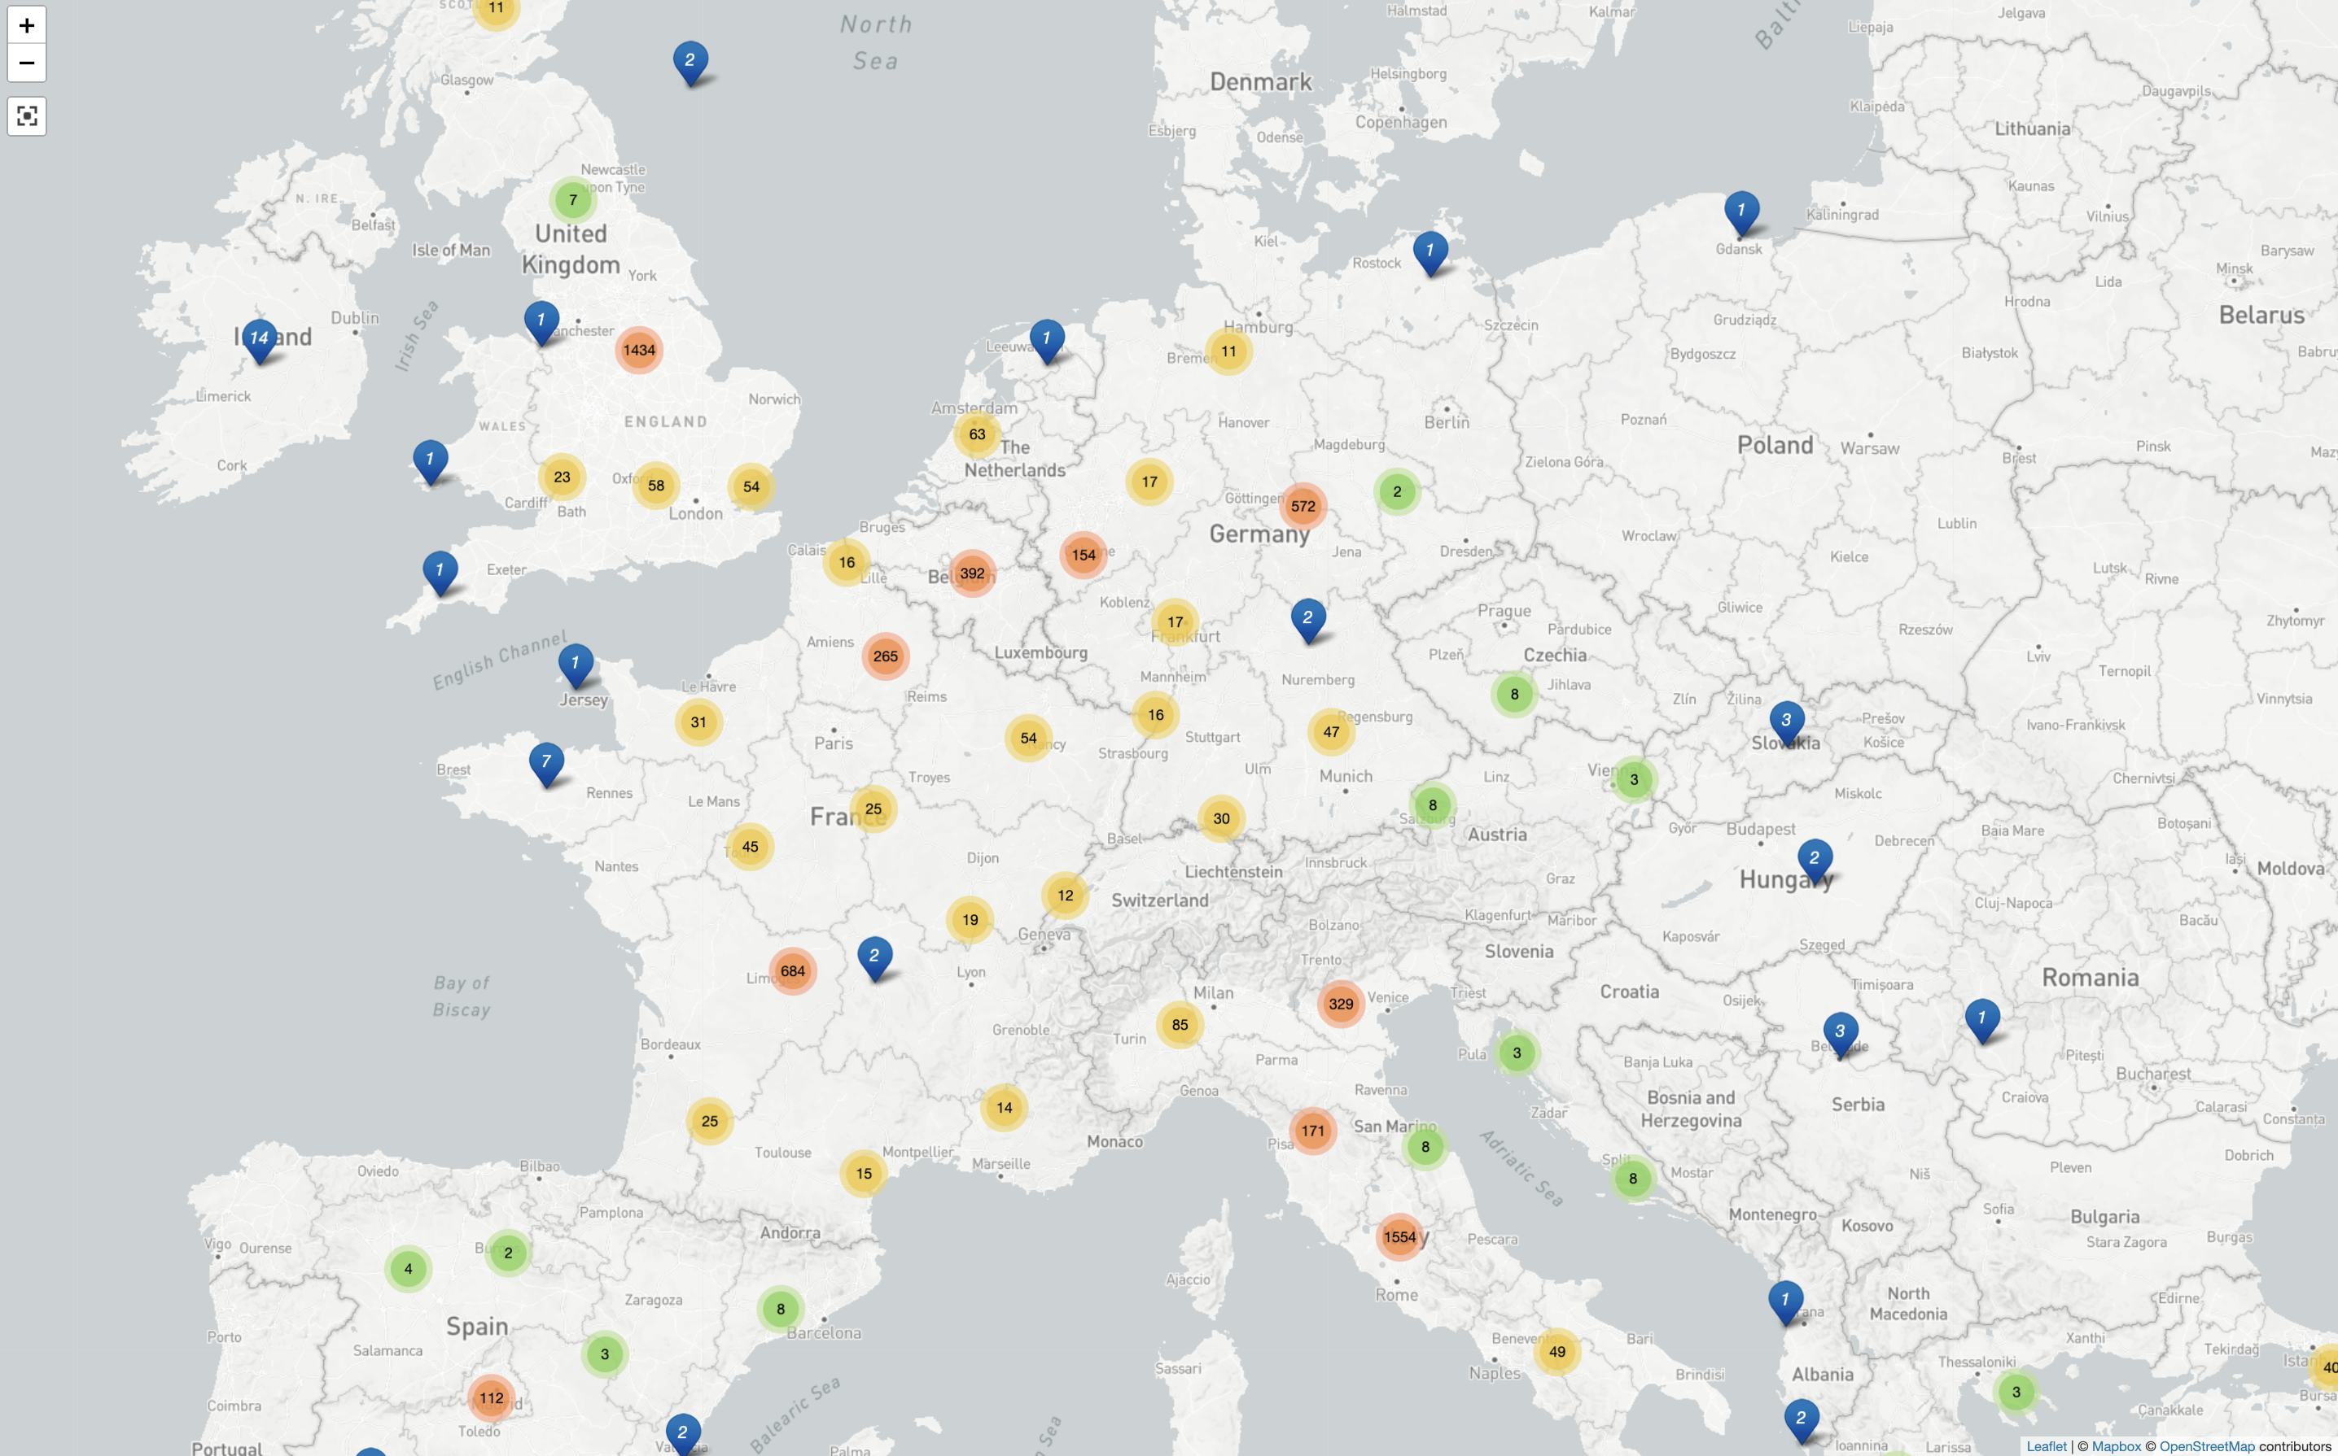
Notes:
14

Slide 15
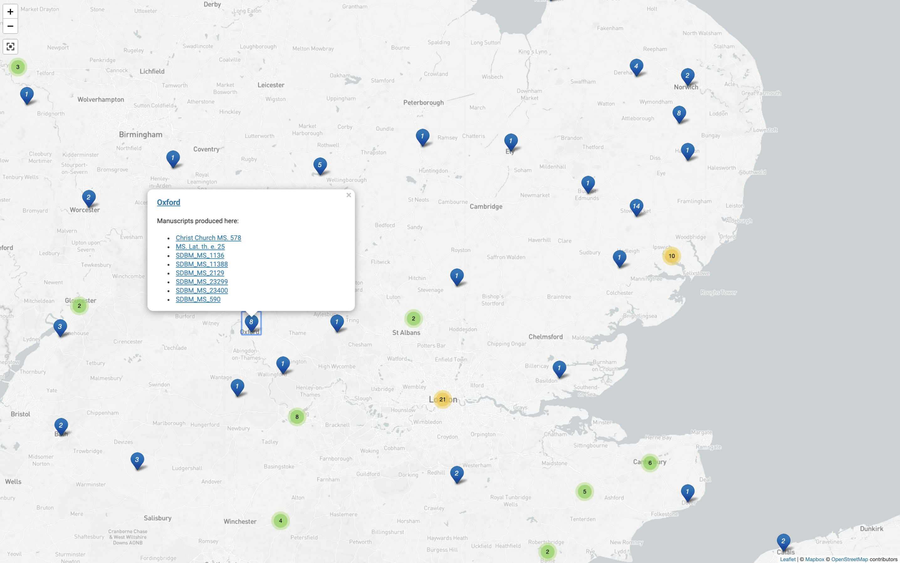
Notes:
15

Slide 16
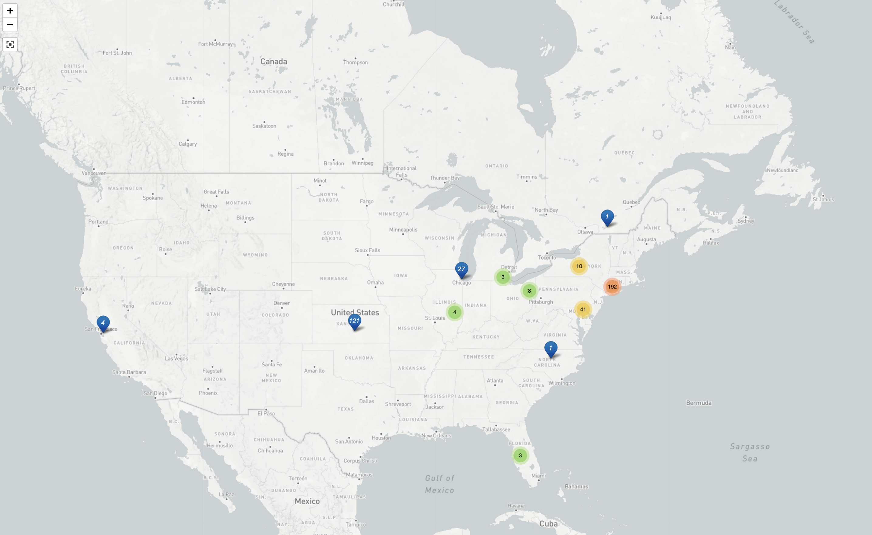
Notes:
16

Slide 17
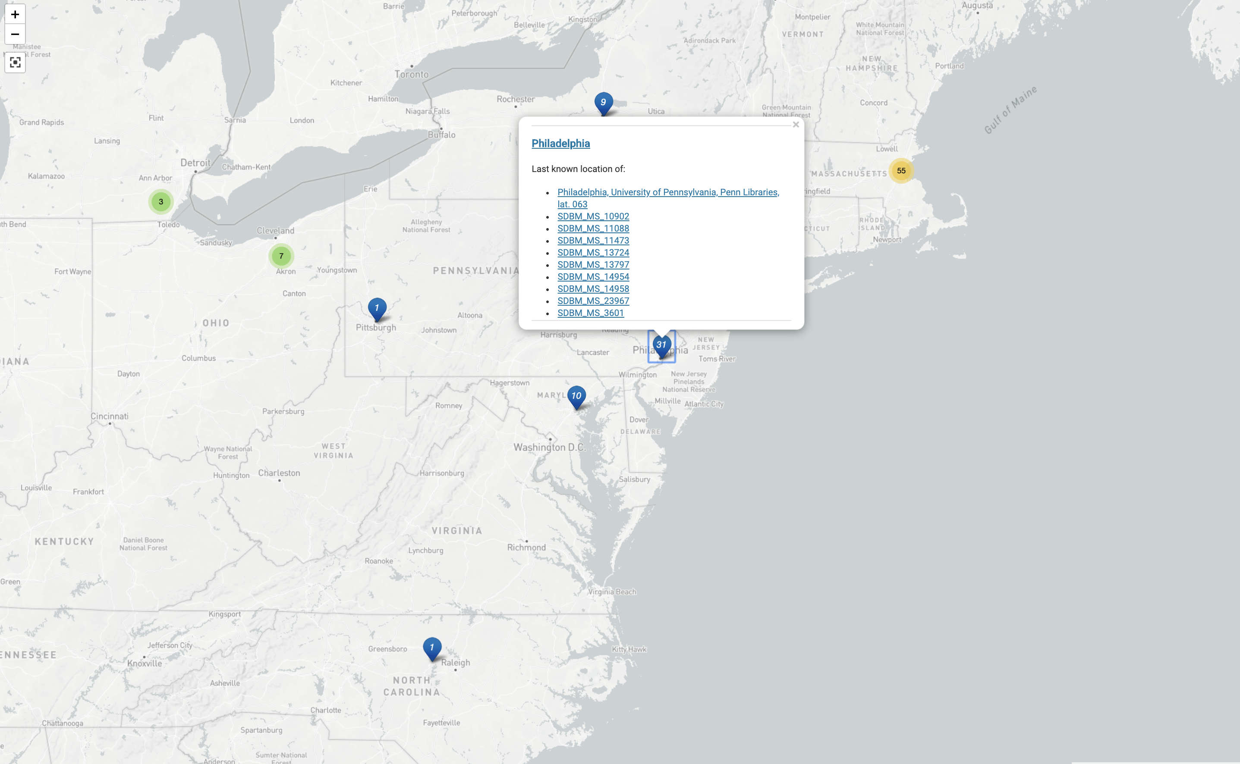
Notes:
17

Slide 18
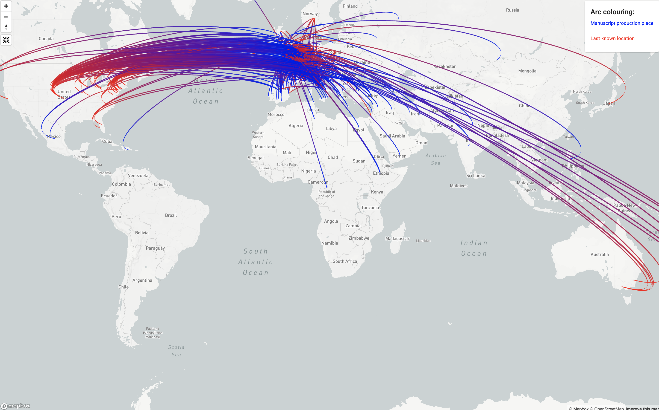
Notes:
18

Slide 19
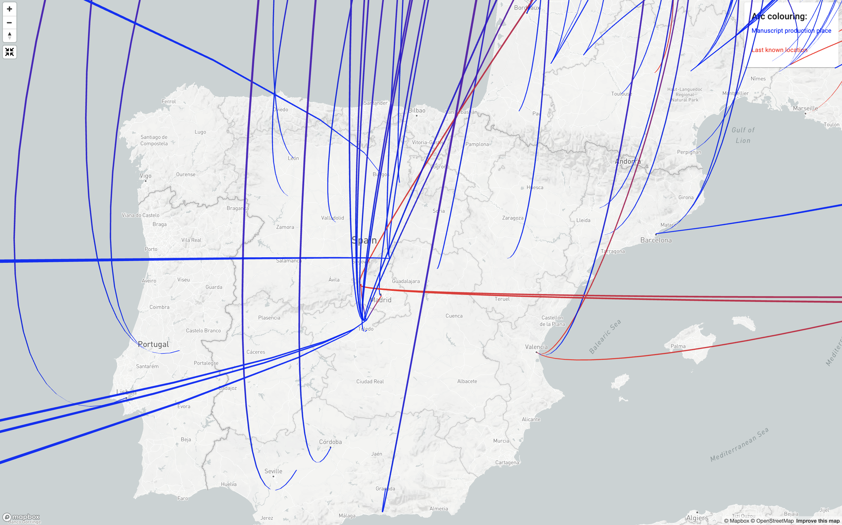
Notes:
19

Slide 20
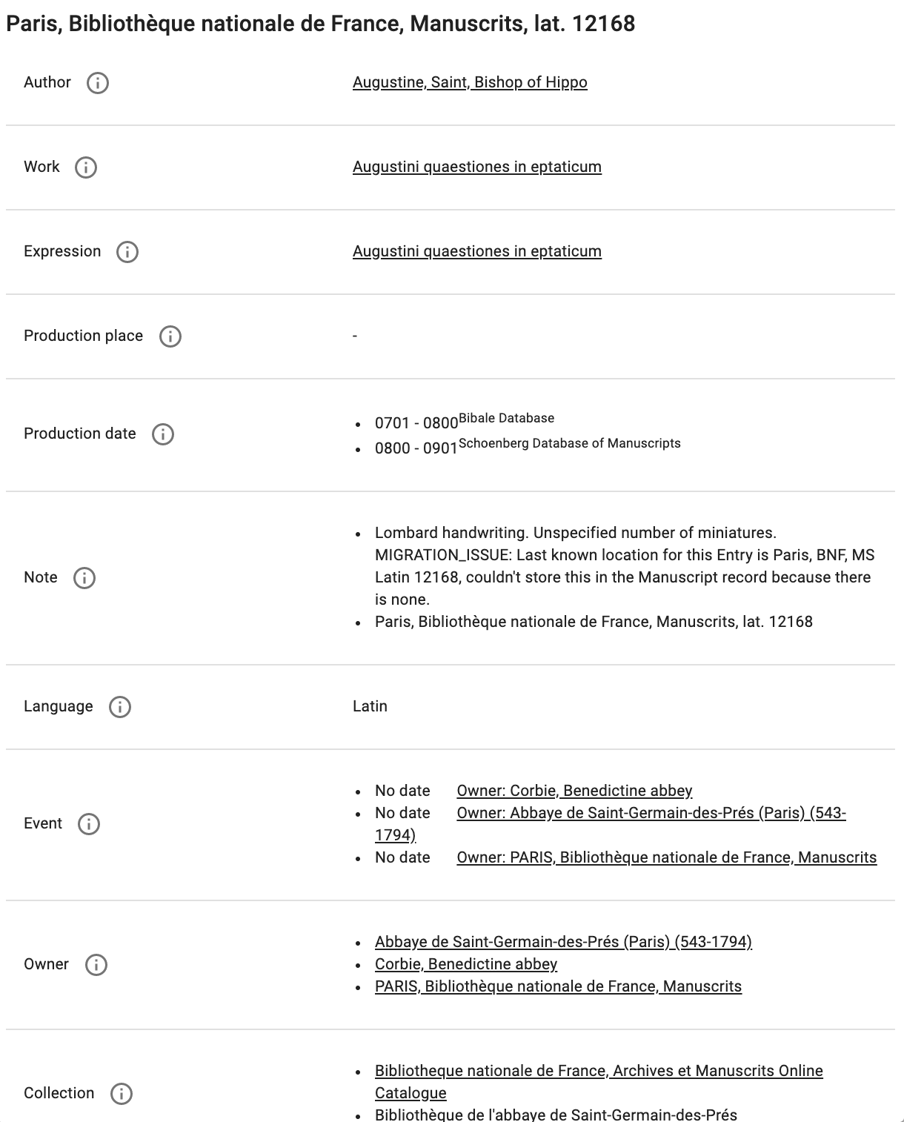
Notes:
20

Slide 21
MMM Initial Research Questions
How many manuscripts were produced in London in the 15th century?
Which French collectors acquired manuscripts in the century after the end of the Wars of Religion (1598)? Where are their manuscripts now?
Which manuscripts containing texts by Ramon Llul were sold in the 19th century?
Which manuscripts formerly owned by Sir Thomas Phillipps (1792-1872) are now in North American libraries?
Did Sir Thomas Phillipps own a thirteenth-century bible with historiated initials?

Slide 22
Original MMM Research Question | Bibale results – public interface | Bibale interface – comments | Oxford results – public interface | Oxford interface – comments | SDBM results – public interface | SDBM interface – comments
How many manuscripts were produced in London in the 15th century? | One can obtain a list of results by general browses on modern places (e.g. London) and then filter by the field “lieu” and by the object “livre”. But currently one cannot search by date range. |  | Can filter places of production by country and a few regions, but not by a specific city or town. Can add a century filter to countries of production. | You would need to go through each of the 1,313 MSS produced in England in the 15th century and calculate manually how many of these were produced in London. Alternatively, you can do a keyword search for “London” and look through the results. | Use Advanced Search to limit Manuscript Date to 1400-1501 and Production Place to London. 348 Entries. It is possible to get to only MS records associated with date, but it is not easy to count the faceted list of results. | We can only easily answer how many Entries, not MS Records. It is possible to get to MS records associated with a date range, but it is not easy to count the faceted list of results, and you do not get orphan records.

Slide 23
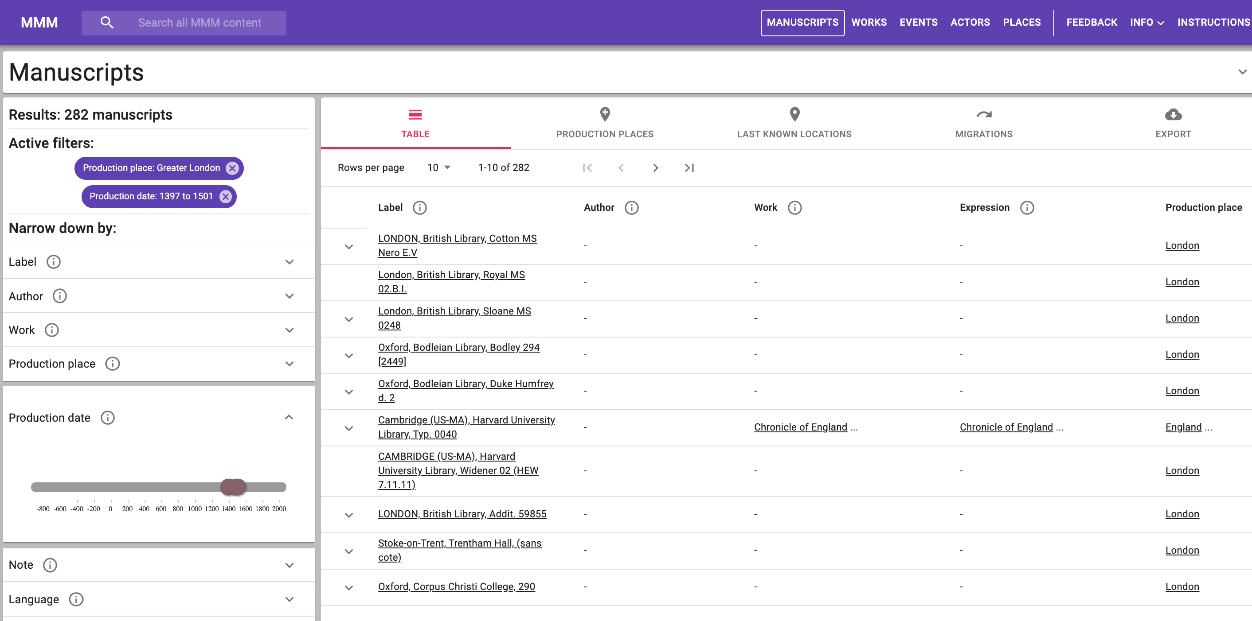

Slide 24
Original MMM Research Question | Bibale results – public interface | Bibale interface – comments | Oxford results – public interface | Oxford interface – comments | SDBM results – public interface | SDBM interface – comments
What French collectors purchased manuscripts in the century after the end of the Wars of Religion (i.e., after 1598)? Where are their manuscripts now? | Currently impossible. One can currently not run a query on transactions of a specific period (e.g. after a specififc year). | One general problem (in Bibale, in the UI and elsewhere) remains that it is difficult to define a "French collector", since it can involve birthplace, but also any other place of activity. We have discussed this at several occasions. | You can filter the list of "People" by role (e.g., "Owner, signer, or donor”). But you cannot further filter this list by country - whether this is place of birth, place of death, or place of residence. | The interface does not display any information about individual people (dates or places of birth and death, etc.). | This question can't easily be answered. You can search for SDBM Names that are linked to France and have life dates after 1598, but then you'd have to run separate queries to find people linked to places nested within France (there's currently no way to search for France and all of its children within the same query). Once you found all of these names, you could then view the entries linked to them and determine last known locations, but this would be very time consuming. | SDBM could be improved by allowing for nested place searching (the data is in there, it just isn't possible in the UI).

Slide 25
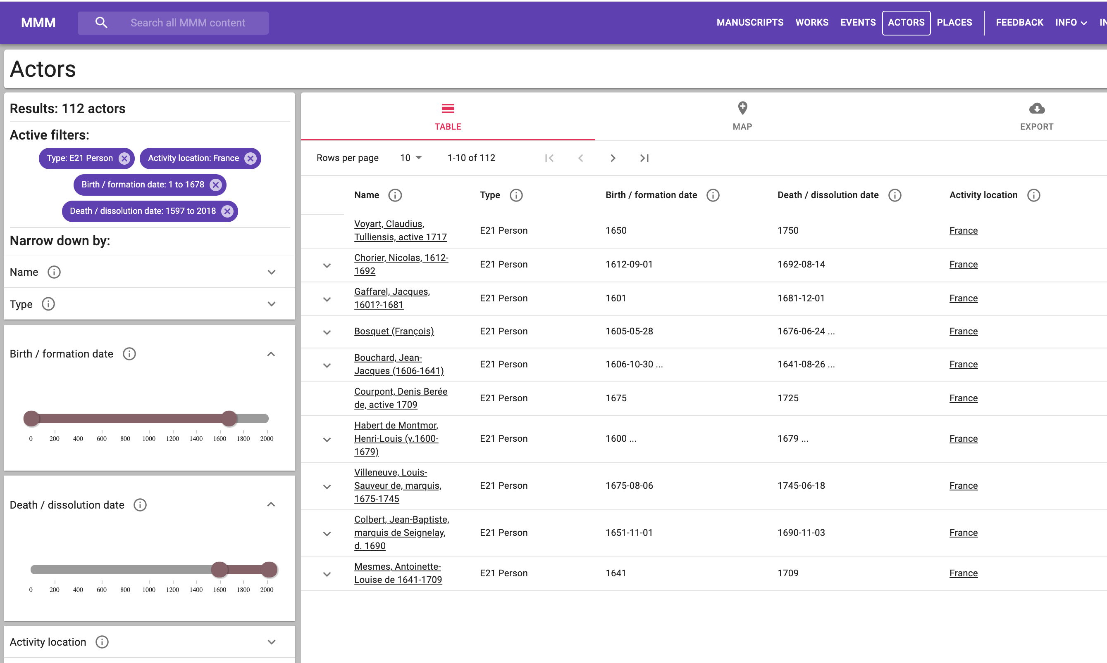

Slide 26
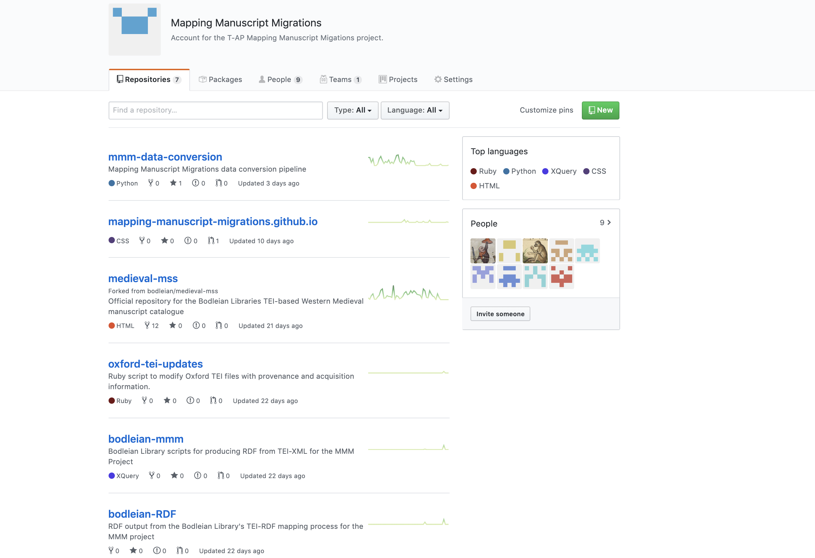

Slide 27
MMM: future directions for data-driven manuscript research
Improving the structure of provenance data in library catalogues
Sharing approaches to modelling provenance with analogous projects in art history, e.g., Linked Art
Deciding which external vocabularies are most effective for reconciliation
in view of the lack of specialist medieval vocabularies in Linked Open Data form
Working towards implementing unique global identifiers for manuscripts (ISMI)
Extending the use of Linked Open Data for medieval studies

Slide 28
Mapping Manuscript Migrations: information and contacts
MMM Portal: https://mappingmanuscriptmigrations.org/
More information at: http://blog.mappingmanuscriptmigrations.org/
Twitter: @MSMigrations
Contacts:
Dr Toby Burrows toby.burrows@oerc.ox.ac.uk
Prof. Eero Hyvönen eero.hyvonen@aalto.fi
Dr Lynn Ransom lransom@upenn.edu
Dr Hanno Wijsman hanno.wijsman@irht.cnrs.fr

